Slide 1
Opener

Slide 2
°

Slide 5
66 °
7
ESR
If the apprentice uses a pair of 3 ft, a pair of 7ft, and a pair of 9ft lengths, and then uses one for each triangle, by SSS the triangles are guaranteed to be congruent.

Slide 6
Essential Question
Learning Objective
What are the shortcuts to knowing if two triangles are congruent?
Given triangles, I will explain whether they are congruent or not by SAS (side-angle-side).

Slide 7
4.4 SAS
what you've learned:
What is perimeter and area
how to calculate perimeter and area of rectangles, squares, and triangles
undefined terms: point, line, plane
defined terms: segment, ray, angle, parallel, perpendicular
angle pair relationships: complementary, supplementary, linear pair, vertical angles
Transformations: reflections, translations, rotations.
Congruence
Triangle congruence shortcuts: SSS
you should know:
SAS shortcut
)
)

Slide 15
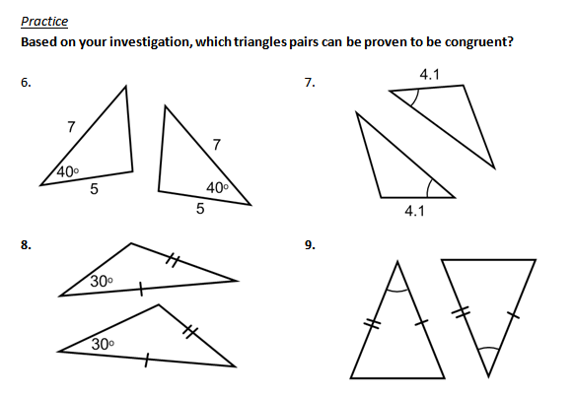
Think…Ink…Share Be prepared to explain

Slide 16
included angle
Angle B is included between AB and BC
B
C
A

Slide 17
included angle
What is the included angle between RS and TS?
S
R
Angle S
T

Slide 18
Why it has to be an INCLUDED ANGLE

Slide 19
Why it has to be an INCLUDED ANGLE

Slide 20
Essential Question
Learning Objective
What are the shortcuts to knowing if two triangles are congruent?
Given triangles, I will explain whether they are congruent or not by SAS (side-angle-side).

Slide 21
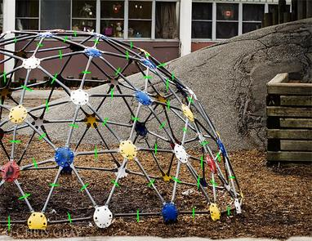
Closure
Are these two triangles congruent? Explain.
The included angles between the two congruent sides are congruent by Vertical angles. So both triangles are congruent by SAS.

Slide 22
HW
PDF Online

Slide 23
7
7
40o
5
40o
5
4.1
30o
30o
4.1

