Slide 1
Think.. Ink..Compare…Share
1.
How is a dilation transformation different from the three other kinds of transformations (reflections, translations, & rotations)?
Dilations increase or decrease proportionately by a scale factor. Transformations do not change in size.
2.
A preimage segment length is 6 cm. Its image segment length is 42 cm. What is the scale factor of the dilation?
Image divided by Pre-image……..7 is the scale factor
3.
A preimage segment length is 12 cm. Its image segment length is 3 cm. What is the scale factor of the dilation?
Image divided by Pre-image……..3/12 = 1/4 is the scale factor

Slide 2
Essential Question
Learning Objective
What does it mean to say that two figures are similar?
Given a figure, I will perform a dilation transformation and describe how scale factor determines new lengths.

Slide 3
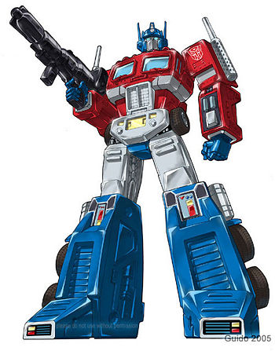
Transformations
Reflections
Translations
Rotations
Dilations

Slide 4
9.7 Dilations
what you've learned:
What is perimeter and area
how to calculate perimeter and area of rectangles, squares, and triangles
undefined terms: point, line, plane
defined terms: segment, ray, angle, parallel, perpendicular
angle pair relationships: complementary, supplementary, linear pair, vertical angles
Transformations: reflections, translations, rotations.
Congruence
Triangle congruence shortcuts: SSS, SAS, ASA
Triangle Facts: Triangle Sum, 3rd Angles ≅
Constructions: ≅ segments, ≅ triangles, perpendicular bisectors, ≅ angles, angle bisectors, parallel segments, equilateral triangles, regular hexagon, square
you should know:
Transformation: Dilations

Slide 5
Key Terms:
Dilations - a kind of transformation that increases or decreases the size of a figure.
(doesn't make a congruent copy)
Scale factor - the ratio of the side length of an image to the corresponding side length of its preimage.

Slide 6
2 in
4 in

Slide 7
In the space below, draw a triangle and a point not on the triangle or inside it. Label the triangle ABC and the point not on or in it X. Measure all the angles and side lengths, set them aside for further observation. Next dilate the triangle by a scale factor of 2.
Check the angles and side lengths of the image. Compare and contrast the pre-image and image. Be prepared to share out.
5
A
5
A’
X
5
3
4
6
B
10
C
4
4
B’
8
C’
3
6
60
60
4
8
90
90
5
10
30
30

Slide 8
Think…Ink…Compare….Share
In reference to the previous example. Will the distance the point outside the triangle is from the triangle have any impact on the pre-image to image?
Explain

Slide 9
In the space below, repeat the process as we did in the previous problem. Label the triangle DEF and the point not on or in it X. Measure all the angles and side lengths, set them aside for further observation. Next dilate the triangle by a scale factor of YOUR CHOICE. Make sure not to label your measurements on the same sheet of paper.
Check the angles and side lengths of the image. Compare and contrast the pre-image and image to make sure they are correct.
We will switch papers with our Pair share partner and they will have to determine the scale factor based on your constructions.

Slide 10
Essential Question
Learning Objective
What does it mean to say that two figures are similar?
Given a figure, I will perform a dilation transformation and describe how scale factor determines new lengths.

Slide 11
Closure
Explain the relationship between scale factor and the length of the dilated segment.
focus words: scale factor, dilated

Slide 12
Closure
Explain the relationship between scale factor and the length of the dilated segment.
The scale factor of a dilation tells you how much bigger or smaller the dilated segments will be. You can use multiplication to determine the exact lengths. For example, a side length of 4 dilated by a scale factor of 3, will have an image side length of 12.

Slide 13
HW
HW #14
HW #14 Worksheet

Slide 15
A'
A
4
2
3
B
B'
3.5
C
7
C'

