Slide 1
Opener
1.
The diagram shows a dilation. What is the length of segment AC?
B
B'
2
2
6
C
6
A
C'
A'
9
The side lengths of a preimage triangle are 6, 10, and 14 mm. The first two corresponding image sides are 48 and 80 mm. What is the third corresponding image side length?
2.
5.6
3.
x
preimage
7
image
3.85
11.2
6.16

Slide 2
Opener
1.
The diagram shows a dilation. What is the length of segment AC?
B
B'
2
2
6
C
6
A
C'
A'
9
AC = 3

Slide 3
Opener
The side lengths of a preimage triangle are 6, 10, and 14 mm. The first two corresponding image sides are 48 and 80 mm. What is the third corresponding image side length?
2.
112mm
6 * 8 = 48
10 * 8 = 80
14 * 8 = 112

Slide 4
Opener
5.6
3.
x
preimage
7
image
3.85
11.2
6.16
Scale factor .55
5.6 * .55= 3.08

Slide 5
Essential Question
Learning Objective
What does it mean to say that two figures are similar?
Given a figure, I will perform a dilation transformation and describe how scale factor determines new lengths.

Slide 6
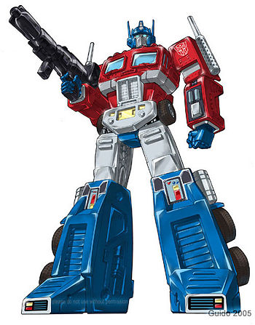
Transformations
Reflections
Translations
Rotations
Dilations

Slide 7
9.7 Dilations
what you've learned:
What is perimeter and area
how to calculate perimeter and area of rectangles, squares, and triangles
undefined terms: point, line, plane
defined terms: segment, ray, angle, parallel, perpendicular
angle pair relationships: complementary, supplementary, linear pair, vertical angles
Transformations: reflections, translations, rotations.
Congruence
Triangle congruence shortcuts: SSS, SAS, ASA
Triangle Facts: Triangle Sum, 3rd Angles ≅
Constructions: ≅ segments, ≅ triangles, perpendicular bisectors, ≅ angles, angle bisectors, parallel segments, equilateral triangles, regular hexagon, square
you should know:
Transformation: Dilations

Slide 8
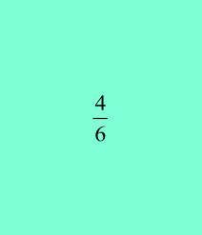
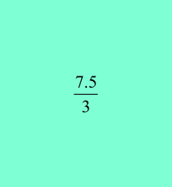
Scale factor can be written as a decimal or as a fraction:
4.2
Scale Factor
2.8
preimage
6
image
or .6667
4
7.5
5
10
4
or 2.5
preimage
image
3
7.5
3
7.5

Slide 9
You can calculate scale factor by dividing the image lengths from the preimage lengths:
Scale Factor
10
4
or 2.5
3
preimage
7.5
image
3
7.5
7.5 / 3 = 2.5
10 / 4 = 2.5
7.5 / 3 = 2.5

Slide 10
"WE DO" TIME
WHITE BOARDS READY..

Slide 11
Problem
What is the scale factor of the dilation?
A'
20/5 = 4
A
5
20
B
B'

Slide 12
Problem
What is the scale factor of the dilation?
A'
A
50/5 = 10
5
B
50
B'

Slide 13
Problem
What is the scale factor of the dilation?
A
A'
20
5
5/20 = ¼ or .25
B'
B

Slide 14
Problem
What is the scale factor of the dilation?
10/4 = 5/2 or 2.5
A
4
B
A'
10
B'

Slide 15
Problem
What is the scale factor of the dilation?
A
8
B
A'
6
B'
6/8 or ¾ or .75

Slide 16
Problem
What is the scale factor of the dilation?
B'
B
10
5
6
12
A'
A
7
C
14
10/5 or 2
C'

Slide 17
Problem
What is the scale factor of the dilation?
B
B'
10
5
6
12
A
A'
7
C'
14
5/10 or ½ or .5
C

Slide 18
Problem
What is the scale factor of the dilation?
B'
B
7.5
5
6
9
A
A'
7
C
10.5
C'
7.5/5 or 1.5

Slide 19
Problem
What is the scale factor of the dilation?
B
8
4
4/8 or 1/2
A
C
7
B'
4
2
A'
3.5
C'

Slide 20
Problem
What is the scale factor of the dilation?
B
12
6
A
10.5
C
B'
4/12 or 1/3
4
2
A'
3.5
C'

Slide 21
Problem
What is the scale factor of the dilation?
B
2
1
A
1.75
C
12/2 or 6
B'
12
6
A'
10.5
C'

Slide 22
Problem
What is the scale factor of the dilation?
C
C'
2
7
B'
2.5
4
B
A'
14
8.75
2.5/8.75 or .285
A

Slide 23
Problem
What is the scale factor of the dilation?
C'
C
7
4
B
B'
?
8
5
8.75
A
7/4 times 8 or 1.75 times 8 = 14
A'

Slide 24
Problem
What is the scale factor of the dilation?
?
C'
C
2
B
2.5
4
B'
A
14
8.75
14/4 times 2 or 7/2 times 2 or 3.5 times 2 = 7
A'

Slide 25
Problem
What is the scale factor of the dilation?
C
C'
2
B
4.5
2.5
4
B'
?
A
5.625
4.5/2 times 4 or 2.25 times 4 = 9
A'

Slide 26
Essential Question
Learning Objective
What does it mean to say that two figures are similar?
Given a figure, I will perform a dilation transformation and describe how scale factor determines new lengths.

Slide 27
Closure
Explain the relationship between scale factor and the length of the dilated segment.
focus words: scale factor, dilated

Slide 28
Closure
Explain the relationship between scale factor and the length of the dilated segment.
The scale factor of a dilation tells you how much bigger or smaller the dilated segments will be. You can use multiplication to determine the exact lengths. For example, a side length of 4 dilated by a scale factor of 3, will have an image side length of 12.

Slide 29
HW
HW 15 PDF Scale Factors

Slide 31
A'
A
4
2
3
B
B'
3.5
C
7
C'

