Slide 1
Opener
15 in
1. How much more area does the bigger rectangle have?
7 in
2 in
5 in
2. What is the area of the triangle?
11 cm
6 cm
5.47 cm
12 cm
3. How much more area does the square have
than the triangle?
5 mm
9 mm

Slide 2
Opener
15 in
1. How much more area does the bigger rectangle have?
7 in
2 in
5 in
15*5 for the large piece and 7*2 for the small. 75-14= 61
The larger one has 61 square inches more than the smaller one.

Slide 3
Opener
2. What is the area of the triangle?
11 cm
6 cm
5.47 cm
12 cm
Area is ½ base times the height. ½(12)(5.47) = 32.82 cm squared

Slide 4
Opener
3. How much more area does the square have
than the triangle?
5 mm
9 mm
Area of Square:
Area of Triangle:
Square has 4 congruent sides so all sides measure 9mm. 9*9 = 81mm squared.
Triangle is ½ base * height
½ (5)(9) = 22.5 mm squared
81mm squared – 22.5mm squared is 58.5mm squared.

Slide 5
Essential Question
Learning Objective
Why are the undefined terms important in geometry?
I will identify and describe the undefined terms and use them to define other geometric objects.

Slide 6
1.1 Undefined Terms
.
what you've learned:
What is perimeter and area
how to calculate perimeter and area of rectangles, squares, and triangles
you should know:
the undefined terms

Slide 7
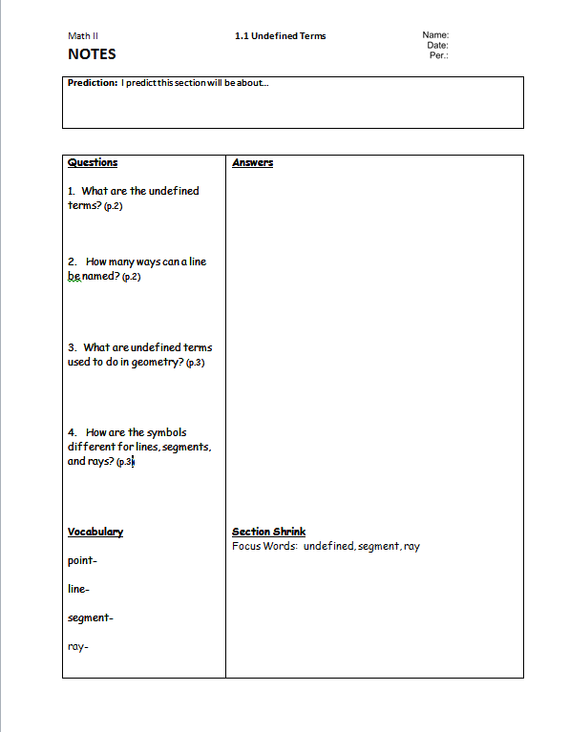

Slide 9
Geometry
Watch the video and take note(s) of the key terms (undefined terms).

Slide 13
Point

Slide 14
Point
Line

Slide 18
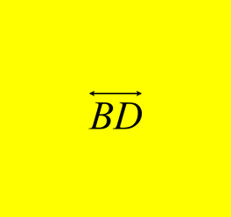
a)Give two other names for
b)Give another name for plane T
c)Name three points that are collinear
d)Name four points that are coplanar
l
T
A
B
m
D
E
C

Slide 25
a) Give another name for
b) Name all rays with endpoint Q. Which of these rays are
opposite rays?
P
Q
T
R
S

Slide 29
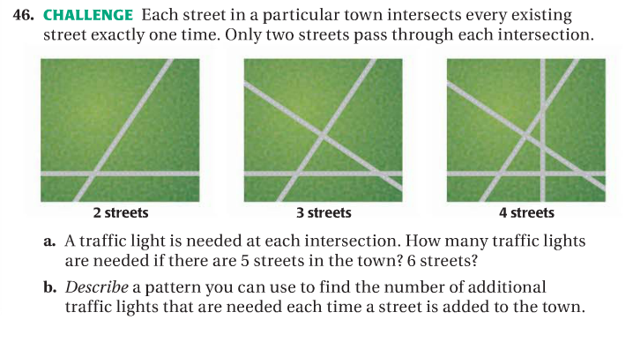

Slide 30
Essential Question
Learning Objective
Why are the undefined terms important in geometry?
I will identify and describe the undefined terms and use them to define other geometric objects.

Slide 31
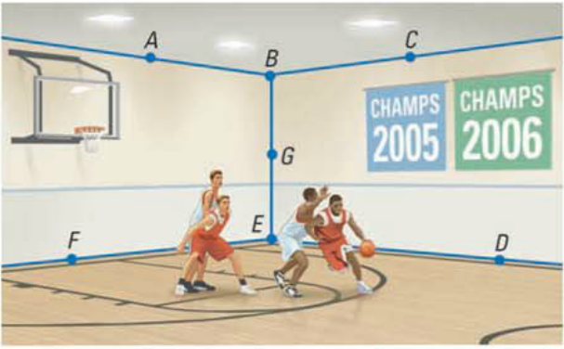
Closure
1. What are the three undefined terms?
2. Give an example of each one, based on the picture below.

