Slide 1
APK…..5 minute check

Slide 2
Section 6.5-prove triangles similar by SSS & SAS
Similar Triangles
Students will apply the AA, SSS & SAS Similarity Theorems to determine similarity in triangles.
Why? So you can show that triangles are similar, as seen in EX 28.
Mastery is 80% or better on 5 minute checks and independent practice problems.

Slide 3
Skill Development
In previous lessons, you learned several basic tests for determining whether
two triangles are congruent. Recall that each congruence test involves only
three corresponding parts of each triangle.
Likewise, there are tests for similarity that will not involve all the parts of
each triangle.
Postulate 22 AA Similarity | If two angles of one triangle are congruent to two corresponding angles of another triangle, then the triangles are ______.
similar
C
F
A
B
D
E
If A ≈ D and B ≈ E, then ΔABC ~ ΔDEF

Slide 4
Skill Development
Two other tests are used to determine whether two triangles are similar.
proportional
Theorem 6-2 SSS Similarity | If the measures of the sides of a triangle are ___________ to the measures of the corresponding sides of another triangle, then the triangles are similar.
C
6
2
F
1
3
A
8
B
D
4
E
then the triangles are similar
then ΔABC ~ ΔDEF

Slide 5
Skill Development
proportional
Theorem 6-3 SAS Similarity | If the measures of two sides of a triangle are ___________ to the measures of two corresponding sides of another triangle and their included angles are congruent, then the triangles are similar.
C
2
F
1
A
8
B
D
4
E
then ΔABC ~ ΔDEF

Slide 6
Skill Develop

Slide 7
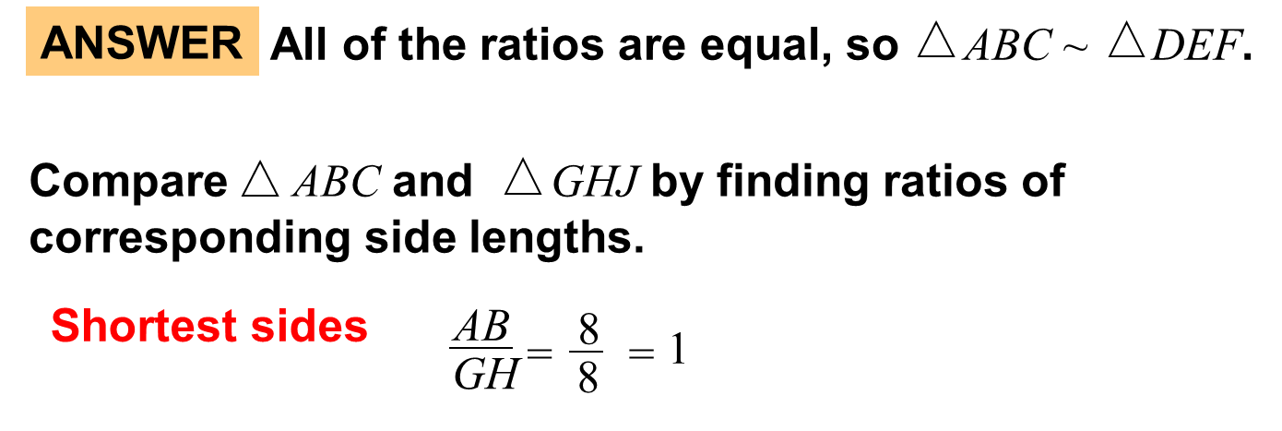
Example 1

Slide 8
Example 1

Slide 9
Skill Develop Example 2

Slide 10
Example 2

Slide 11
Example 2

Slide 12
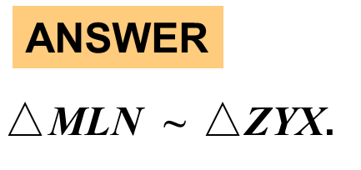
Think……Ink…share

Slide 13
HOTS……..White Boards

Slide 14
HOTS Example 3
Explain your reasoning

Slide 15
Example 3

Slide 16
Example 3

Slide 17
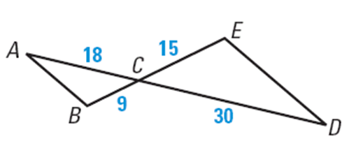
Skill Develop Example 4

Slide 18
Think…..write…..share

Slide 19
Think….write….share

Slide 20
Exit slips
What was the objective for today?
Students will apply the SSS & SAS Similarity Theorems to determine similarity in triangles.
Why, So you can show that triangles are similar, as seen in EX 28.
Mastery is 80% or better on 5 minute checks and independent practice problems.

Slide 21
homework
PDF Online

