Slide 1
Opener APK
Write "Correct Quiz"

Slide 2
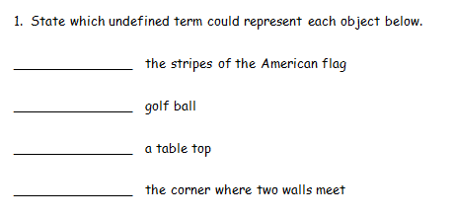
line
point
plane
line

Slide 3
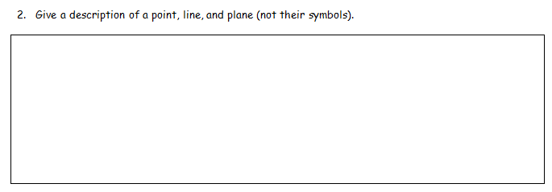
point - a location in space. It has no dimension.
line - a straight thing that goes forever in both directions. It has one dimension (length).
plane - a flat surface that goes in every direction without end. It has two dimensions (length and width).

Slide 4
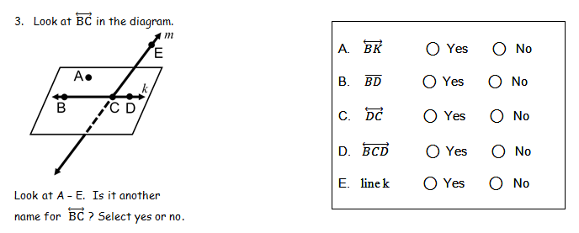

Slide 5
ray
point
segment

Slide 6
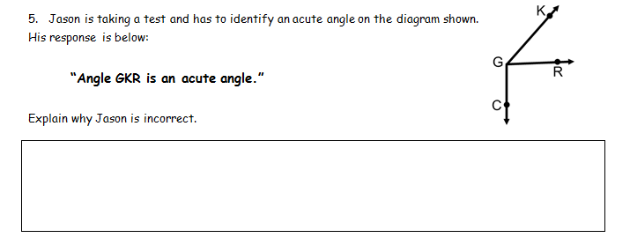
Jason is incorrect because he named the angle incorrectly. He should have said angle KGR or angle RGK. The middle point must be the vertex.

Slide 7
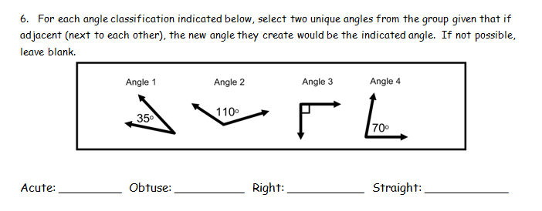
Angle 1 & 2
Angle 2 & 4
Angle 1 & 3
Angle 1 & 4
Angle 3 & 4

Slide 8
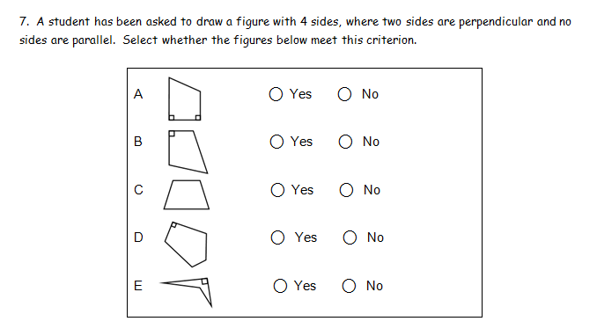

Slide 9
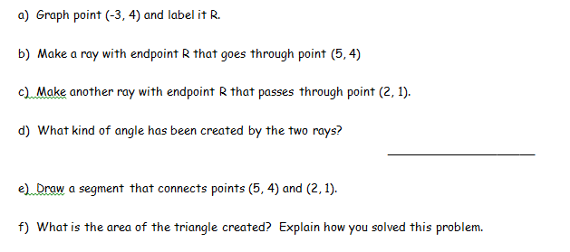
R
acute
The area of the triangle is 12 u2. The base is 8 units long and the height to that base is 3 units long. Half of their product is 12 u2.

Slide 10
31

Slide 11
Essential Question
Learning Objective
What are some important angle pair relationships and their properties?
Given an angle pair, I will identify their relationship (vertical, linear pair, complementary, or supplementary) and use their properties to determine unknown angle measures.

Slide 12
1.5 Angle Pair
Relationships
what you've learned:
What is perimeter and area
how to calculate perimeter and area of rectangles, squares, and triangles
undefined terms: point, line, plane
defined terms: segment, ray, angle, parallel, perpendicular
you should know:
vertical angles
linear pair
complementary & supplementary

Slide 14
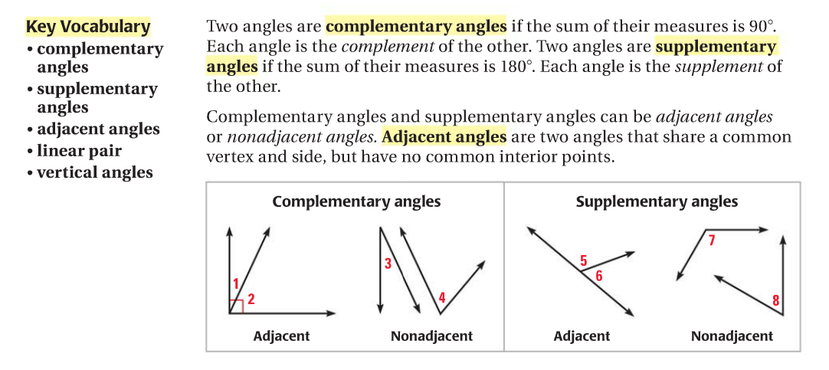

Slide 16
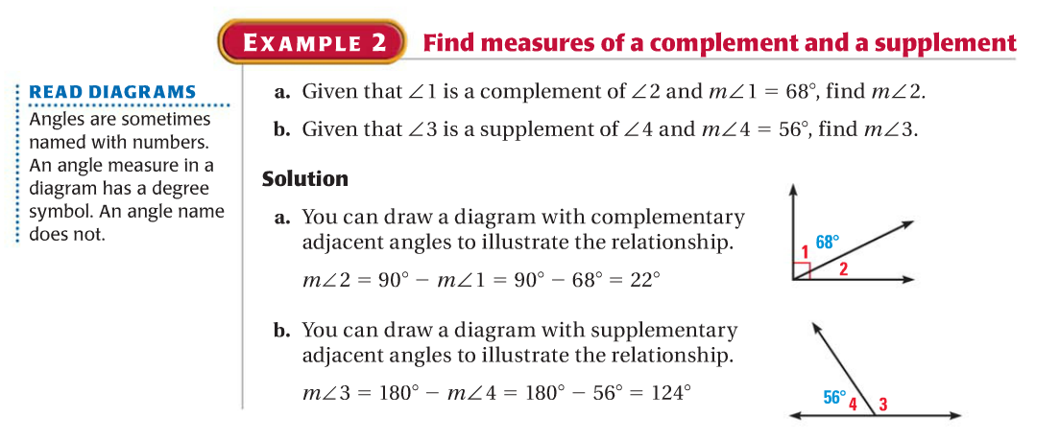

Slide 18
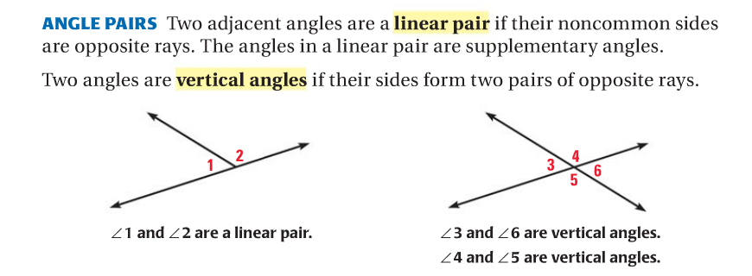

Slide 22
CLOSURE ACTIVITY

Slide 23
Essential Question
Learning Objective
What are some important angle pair relationships and their properties?
Given an angle pair, I will identify their relationship (vertical, linear pair, complementary, or supplementary) and use their properties to determine unknown angle measures.

Slide 24
Closure
Name all the angle pair relationships.
Vertical Angles
1 & 4
2 & 3
5 & 8
6 & 7
1
2
3
4
5
6
7
8
Linear Pairs
1 & 2
2 & 4
4 & 3
3 & 1
5 & 6
6 & 8
8 & 7
7 & 5

Slide 25
PDF Online
Comp & Supp Angles HW

