Slide 1
Opener
Use the diagram to answer the questions.
E
F
1. Name a line, a segment, and a ray.
2. Name an acute, right, obtuse,
and straight angle.
G
D
A
3. Name two complementary angles.
C
B

Slide 2
Opener
Use the diagram to answer the questions.
E
F
1. Name a line, a segment, and a ray.
G
D
A
C
B

Slide 3
Opener
Use the diagram to answer the questions.
E
F
2. Name an acute, right, obtuse,
and straight angle.
obtuse
G
acute
D
A
C
B
right
straight

Slide 4
Opener
Use the diagram to answer the questions.
E
F
3. Name two angles whose
measures would sum to 90o.
(are complementary)
G
D
A
or
C
B

Slide 5
Think / Record / Report
Red
What is a real world object that has an obtuse angle?
Blue
What is a real world object that has an acute angle?
THINK
RECORD
REPORT
Key Vocab:
n/a
Sentence Starter:
"A real world object that has..."

Slide 6
Essential Question
Learning Objective
What are the possible ways that lines can intersect? Is a circle a line?
I will use the definitions of parallel and perpendicular lines to solve problems.

Slide 7
graph

Slide 12
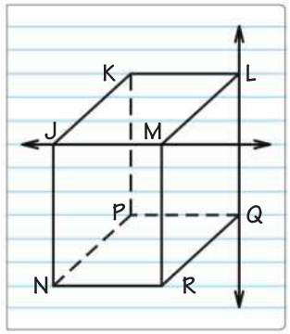

Slide 18
Parallel & Perpendicular Lines
what you've learned:
What is perimeter and area
how to calculate perimeter and area of rectangles, squares, and triangles
undefined terms: point, line, plane
defined terms: segment, ray, angle
you should know:
properties of perpendicular and parallel lines
definition of circle

Slide 19
Parallel, Perpendicular, & Skew?
C
G
H
D
F
B
A
E

Slide 20
"WE DO" TIME

Slide 21
Problem
Which shows parallel lines?
a)
b)
c)
d)

Slide 22
Problem
Which shows perpendicular lines?
a)
b)
c)
d)

Slide 23
Problem
Which term(s) are used to define parallel lines?
a)
b)
line
point
c)
d)
segment
ray

Slide 24
Problem
Which term(s) are used to define perpendicular lines?
a)
b)
square
segment
c)
d)
point
line

Slide 25
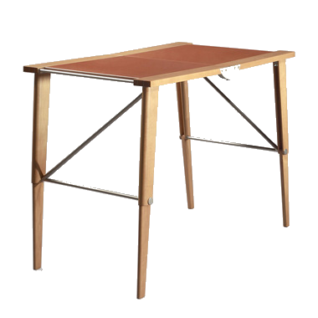
Problem
Which shows perpendicular lines?
a)
b)
c)
d)

Slide 26
Problem
Which shows parallel lines?
a)
b)
c)
d)

Slide 27
Problem
Which shows skew lines?
a)
b)
c)
d)

Slide 28
Essential Question
Learning Objective
What are the possible ways that lines can intersect? Is a circle a line?
I will use the definitions of parallel and perpendicular lines to solve problems.

Slide 29
Closure
Name a pair of sides that are parallel, perpendicular, and skew.
Parallel
C
B
D
G
Perpendicular
A
Skew
E
F

