Slide 1
Opener
Factor the polynomial completely.
1. $8x^{2}+4xy−20x−10y$
2(2x-5) (2x+y)
What are the x-intercepts of the quadratic functions below?
2. y = $x^{2} − 9x − 36$
Factors are (x-12) (x+3)……Ints are 12 & -3
3. y = $x^{2} + 3x − 54$
Factors are (x-6) (x+9)……Ints are 6 & -9

Slide 2
Opener
Factor the polynomial completely.
1. 8x2+4xy-20x-10y

Slide 3
Opener
What are the x-intercepts of the quadratic functions below?
2. y = x2 - 9x - 36

Slide 4
Opener
What are the x-intercepts of the quadratic functions below?
3. y = x2 + 3x - 54

Slide 5
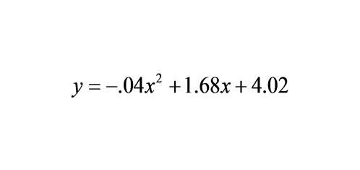
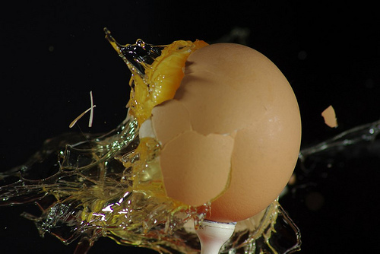
You have entered a contest to be a human target for an egg-toss competition for charity. You are standing 40 feet away from the egg-thrower. The donor's egg toss is modeled by the equation:
Are you splattered with egg?

Slide 6
Essential Question
Learning Objective
How do you take a quadratic function and determine its factors?
Given a quadratic trinomial, with a leading coefficient, I will factor it into its binomial factors.

Slide 7
Quadratic Functions
(factoring to find x-intercepts)
you should know:
how to factor a quadratic trinomial into its binomial factors

Slide 8
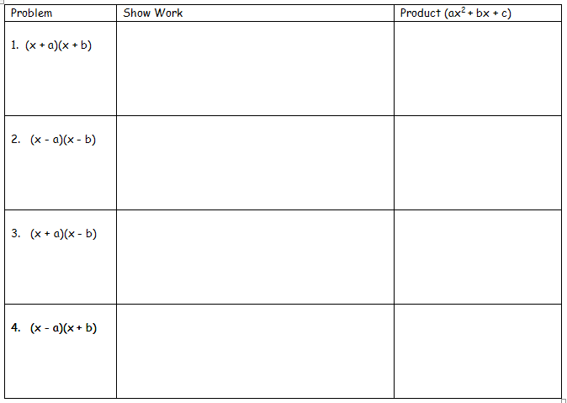
x2+bx+ax+ab
x2+ax+bx+ab
x2+(a+b)x+ab
x2+(a+b)x+ab
x2-bx-ax+ab
x2+(-bx)+(-ax)+ab
x2+(-a+-b)x+ab
x2+(-ax)+(-bx)+ab
x2+(-a+-b)x+ab
x2-bx+ax+ab
x2+(-bx)+ax+ab
x2+(a+-b)x+ab
x2+ax+(-bx)+ab
x2+(a+-b)x+ab
x2+bx-ax+ab
x2+bx+(-ax)+ab
x2+(-ax)+bx+ab
x2+(-a+b)x+ab
x2+(-a+b)x+ab

Slide 9
Standard Form of a Quadratic Trinomial
ax2+bx+c
$$X^{2}+9x+18$$
$$5w^{2}−9w+4$$
$$2y^{4}+2y^{2}−12$$
a=1 b=9 c=18
x=x
a=5 b=-9 c=4
x=w
a=2 b=2 c=-12
x=y2

Slide 10
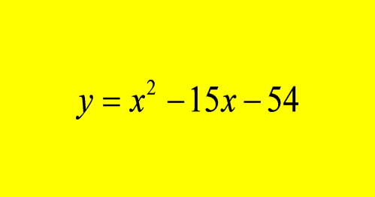
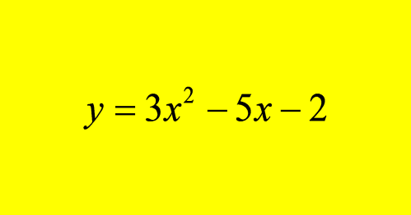
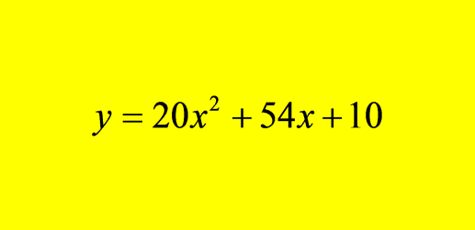
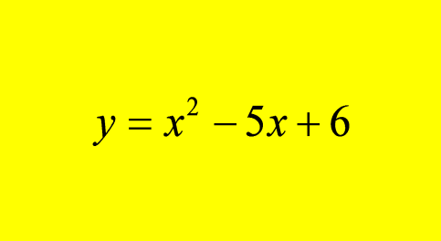
Problem

Slide 12
6x2+13x+6
multiply a-term & c-term then write product below c-term.
(36)
6x2+9x+4x+6
Find factors of (ac) that sum to b term.
(6x2+9x)+(4x+6)
Factor by grouping
3x(2x+3)+2(2x+3)
find GCF of each term
(2x+3)(3x+2)
Factor out binomial GCF

Slide 13
2x2-7x+3
(6)
multiply a-term & c-term then write product below c-term.
2x2-6x-x+3
Find factors of (ac) that sum to b term.
(2x2-6x)+(-x+3)
Factor by grouping
2x(x-3)+(-1)(x-3)
find GCF of each term
(x-3)(2x-1)
Factor out binomial GCF

Slide 14
3x2-x-4
(-12)
Multiply a-term & c-term then write product below c-term.
3x2-4x+3x-4
Find factors of (ac) that sum to b term.
(3x2-4x)+(3x-4)
Factor by grouping
x(3x-4)+(3x-4)
find GCF of each term
(3x-4)(x+1)
Factor out binomial GCF

Slide 15
"WE DO" TIME

Slide 16
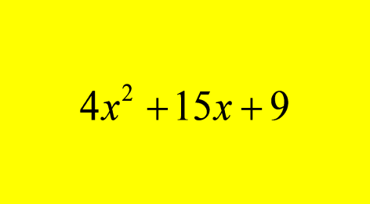
Problem
Factor completely.
$$(X+3) (4x+3)$$

Slide 17
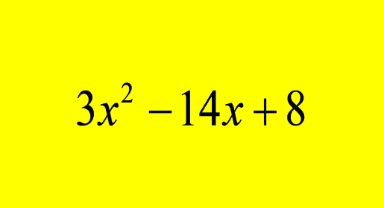
Problem
Factor completely.
$$\left(3x−2\right)(x−4)$$

Slide 18
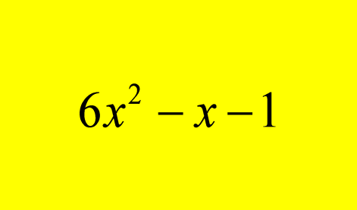
Problem
Factor completely.
(3x+1)(2x-1)

Slide 19
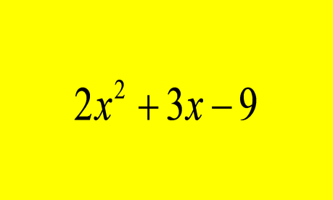
Problem
Factor completely.
(2x-3)(x+3)

Slide 20
$$3x^{2}−5x −2$$
(3x+1) (x-2)
$$3x^{2}−6x+3$$
3 (x-1)(x-1)
$$8x^{2}−8x+2$$
2(2x-1)(2x-1)
$$5x^{2}−14x −3$$
(5x+1)(x-3)
$$6x^{2}−13x −8$$
(3x-8)(2x+1)
$$4x^{2}−12x+9$$
(2x-3)(2x-3)
$$12x^{2}−17x+6$$
(4x-3)(3x-2)
$$24x^{2}−2x −1$$
(6x-1)(4x-1)

Slide 21
Essential Question
Learning Objective
How do you take a quadratic function and determine its factors?
Given a quadratic trinomial, I will factor it into its binomial factors.

Slide 22
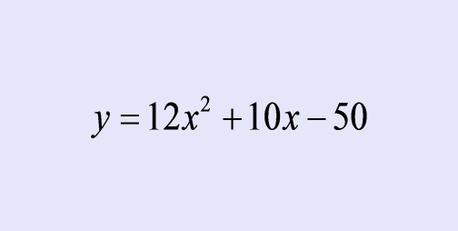
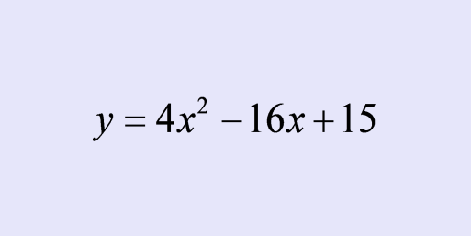
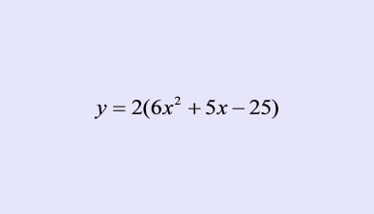
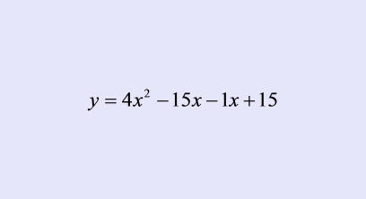
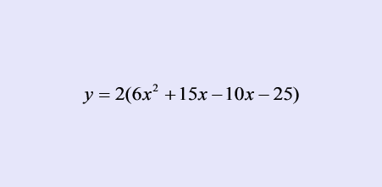
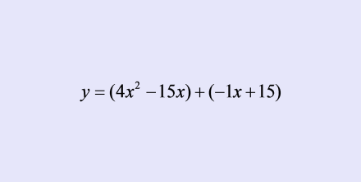
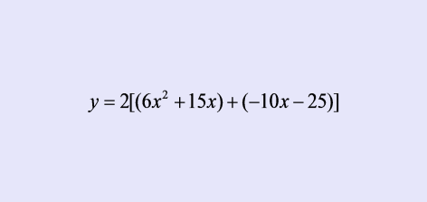
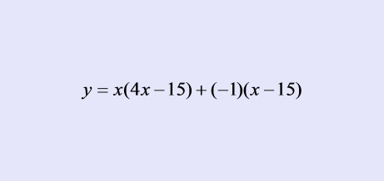
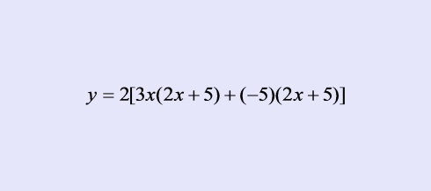
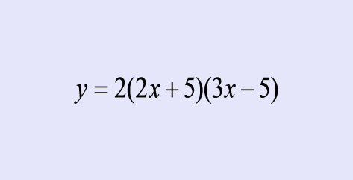
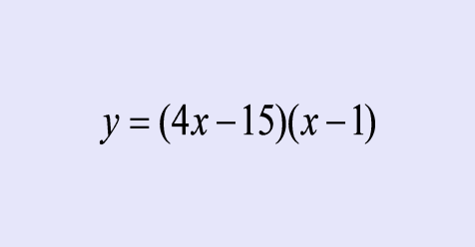
Closure
Which one has the incorrect factors given and why?
#1
#2
(-150)

Slide 23
HW
Trinomials with Leading coefficients PDF

Slide 24
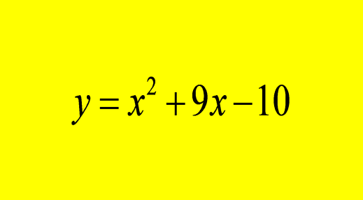
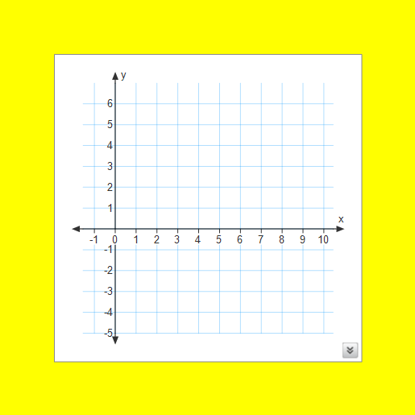
Problem
Determine the x-intercepts of the quadratic functions.

Slide 25
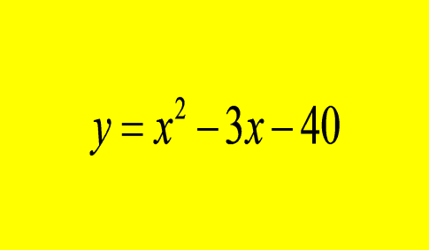
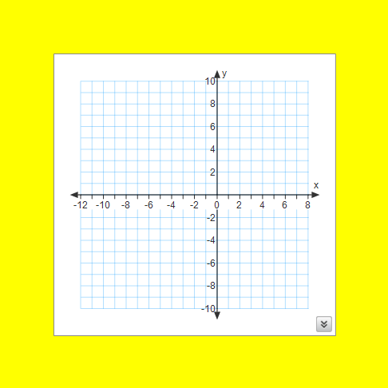
Problem
If a hole in the ground is modeled by the quadratic function below, how long would a plank of wood need to be to cross it?

