Slide 1
LESSON 1-1 Accounting in Action
Learning Objectives
LO1 Describe the different users of accounting information.
LO2 Prepare a net worth statement and explain its purpose.
Notes:
Page 6

Slide 2
The Role of Accounting
Lesson 1-1
LO1
Data must be recorded and reported in accounting reports.
Then, the information can be provided to business owners, managers, investors, and others to make business decisions and measure performance.
SLIDE 2
Notes:
Page 6

Slide 3
What Is Accounting?
Lesson 1-1
LO1
Accounting is the process of planning, recording, analyzing, and interpreting financial information.
An accounting system is a planned process designed to compile financial data and summarize the results in accounting records and reports.
Financial reports that summarize the financial condition and operations of a business are called financial statements.
SLIDE 3
Notes:
Page 6

Slide 4
Accounting in Personal Life
Lesson 1-1
LO2
A net worth statement allows the person extending the loan to see the financial position of a borrower on a specific date and make a lending decision.
Anything of value that is owned is called an asset.
An amount owed is called a liability.
The difference between personal assets and personal liabilities is called personal net worth.
In business, net worth is also called equity.
Equity is the difference between assets and liabilities.
SLIDE 4
Notes:
Page 7

Slide 5
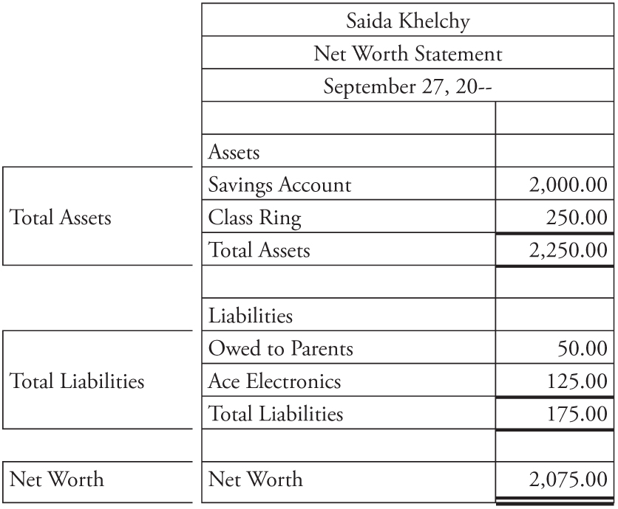
Personal Net Worth Statement
Lesson 1-1
LO2
1
2
3
Total Assets
(owned)
Total Liabilities
(owed)
3
−
=
Net Worth
(also known as Equity)
1
2
SLIDE 5
Notes:
Page 7

Slide 6
Ethics in Business
Lesson 1-1
LO2
The principles of right and wrong that guide an individual in making decisions are called ethics.
The use of ethics in making business decisions is called business ethics.
SLIDE 6
Notes:
Page 8

Slide 7
Written Communication
Lesson 1-1
LO2
Keep these questions in mind when writing any written communication
Why am I writing and who is my audience?
Is the message logically organized for easy reading?
Am I communicating responsibly and ethically?
Does my writing style demand the reader’s attention?
Is the document free from grammatical and formatting errors?
SLIDE 7

Slide 8
Lesson 1-1 Audit Your Understanding
Lesson 1-1
1. What is accounting?
ANSWER
Accounting is the process of planning, recording, analyzing, and interpreting financial information.
SLIDE 8
Notes:
Page 9

Slide 9
Lesson 1-1 Audit Your Understanding
Lesson 1-1
2. Why is accounting called the language of business?
ANSWER
Accounting provides financial information to everyone who needs it to make good business decisions.
SLIDE 9
Notes:
Page 9

Slide 10
Lesson 1-1 Audit Your Understanding
Lesson 1-1
3. Describe a scenario in which you, as a nonaccountant, might use accounting.
ANSWER
Answers may include creating a personal budget or providing information for a loan or credit card application.
SLIDE 10
Notes:
Page 9

Slide 11
1-1 Class / HW
Work Together 1-1
On Your Own 1-1

