Slide 1
LESSON 1-3 How Transactions Change Owner’s Equity in an Accounting Equation
Learning Objectives
LO6 Compare and contrast the types of transactions that increase and decrease owner’s equity.
LO7 Explain the difference between expenses and liabilities.
Notes:
Page 18

Slide 2
Transactions Affecting Owner’s Equity
Lesson 1-3
LO6
An increase in equity resulting from the sale of goods or services is called revenue.
A sale for which payment will be received at a later date is called a sale on account.
SLIDE 2

Slide 3
Transactions Affecting Owner’s Equity
Lesson 1-3
LO6
Transaction 6 January 10. Received cash from sales, $1,100.00.
Transaction 7 January 12. Sold services on account to Main Street Services, $500.00.
SLIDE 3

Slide 4
Transactions Affecting Owner’s Equity
Lesson 1-3
LO6
Total of left side:
$1,935 + $500 + $385 + $900 =
$3,720
Total of right side:
$120 + $3,600 =
$3,720
SLIDE 4

Slide 5
Expense Transactions
Lesson 1-3
LO7
Unlike a liability, which is an amount that is owed, the cost of goods or services used to operate a business is called an expense.
SLIDE 5

Slide 6
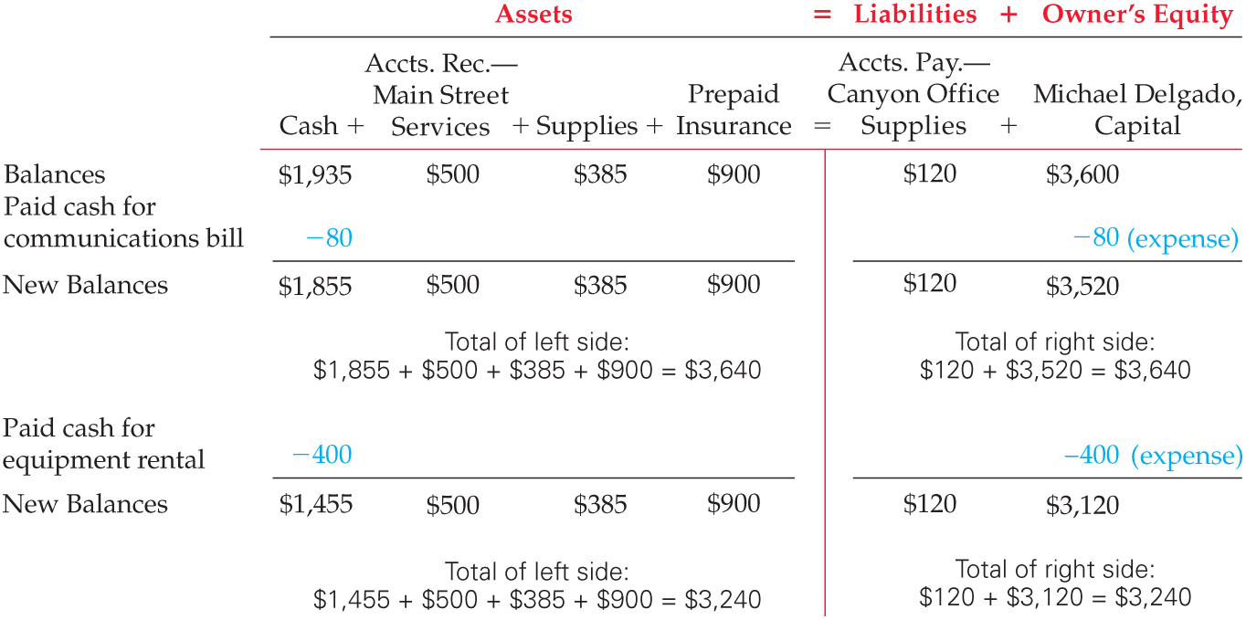
Expense Transactions
Lesson 1-3
LO7
Transaction 8 January 12. Paid cash for communications bill for cell phone and Internet service, $80.00.
SLIDE 6

Slide 7
Expense Transactions
Lesson 1-3
LO7
Transaction 9 January 13. Paid cash for equipment rental, $400.00.
SLIDE 7

Slide 8
Other Cash Transactions
Lesson 1-3
Assets taken from the business for the owner’s personal use are called withdrawals.
SLIDE 8

Slide 9
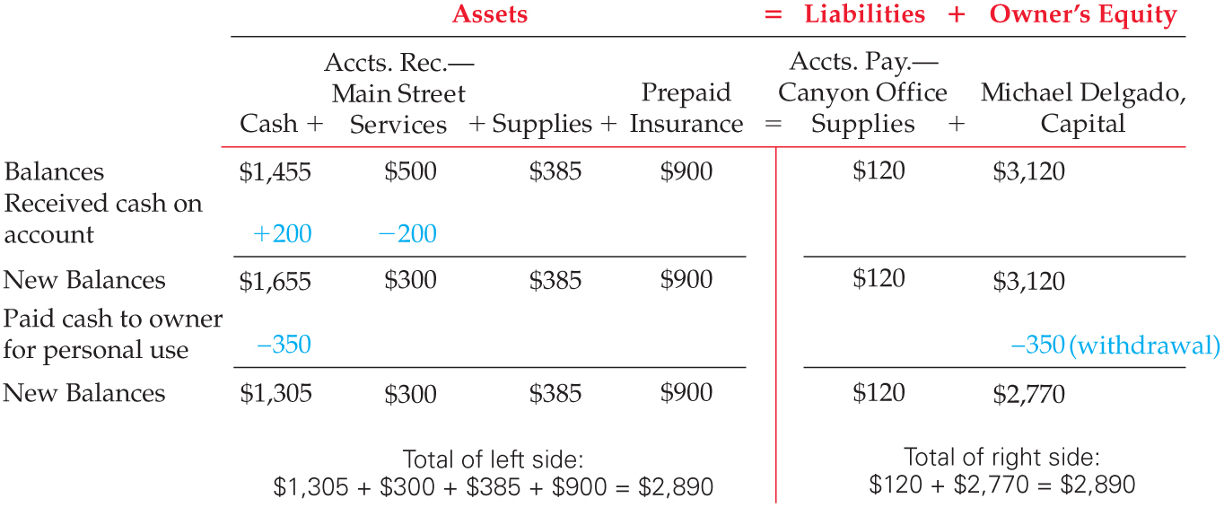
Other Cash Transactions
Lesson 1-3
Transaction 10 January 16. Received cash on account from Main Street Services, $200.00.
Transaction 11 January 16. Michael Delgado withdrew equity in the form of cash, $350.00.
SLIDE 9

Slide 10
Summary of Changes in Owner’s Equity
Lesson 1-3
Transaction Number | Kind of Transaction | Change in Owner’s Equity
6 | Revenue (cash) | +1,100.00
7 | Revenue (on account) | +500.00
8 | Expense (communications) | −80.00
9 | Expense (equipment rental) | −400.00
11 | Withdrawal of equity | −350.00
Net change in owner’s equity |  | +770.00
SLIDE 10

Slide 11
Lesson 1-3 Audit Your Understanding
Lesson 1-3
1. How is owner’s equity affected when cash is received from sales?
ANSWER
Owner’s equity is increased.
SLIDE 11

Slide 12
Lesson 1-3 Audit Your Understanding
Lesson 1-3
2. How is owner’s equity affected when services are sold on account?
ANSWER
Owner’s equity is increased.
SLIDE 12

Slide 13
Lesson 1-3 Audit Your Understanding
Lesson 1-3
3. How is owner’s equity affected when cash is paid for expenses?
ANSWER
Owner’s equity is decreased.
SLIDE 13

