Slide 1
LESSON 2-1 Using T Accounts
Learning Objectives
LO1 Show the relationship between the accounting equation and a T account.
LO2 Identify the debit and credit side, the increase and decrease side, and the balance side of various accounts.
LO3 Restate and apply the two rules that are associated with the increase side of an account.

Slide 2
Analyzing the Accounting Equation
Lesson 2-1
LO1
SLIDE 2

Slide 3
Accounts
Lesson 2-1
LO2
A record summarizing all the information affecting a single item in the accounting equation is known as an account.
An accounting device used to analyze transactions is called a T account.
Debit means an amount recorded on the left side of an account.
Credit means an amount recorded on the right side of an account.
SLIDE 3

Slide 4
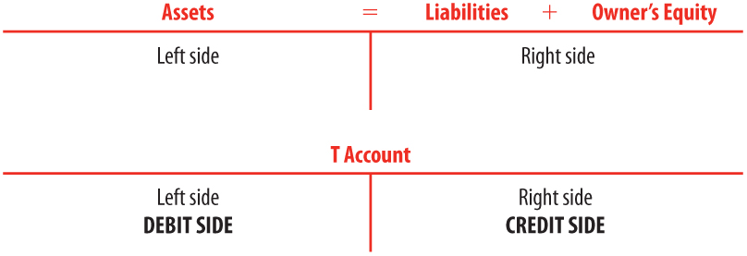
Accounts
Lesson 2-1
LO2
SLIDE 4

Slide 5
Increases, Decreases, and Balances in Accounts
Lesson 2-1
LO3
Assets
On the left side of the accounting equation
Increase on the left, or debit, side of the account
Liabilities and the owner’s capital account
On the right side of the accounting equation
Increase on the right, or credit, side of the account
Normal balance
The side of the account that is increased is called the normal balance of the account
Assets have normal debit balances
Liabilities and the owner’s capital account have normal credit balances
SLIDE 5

Slide 6
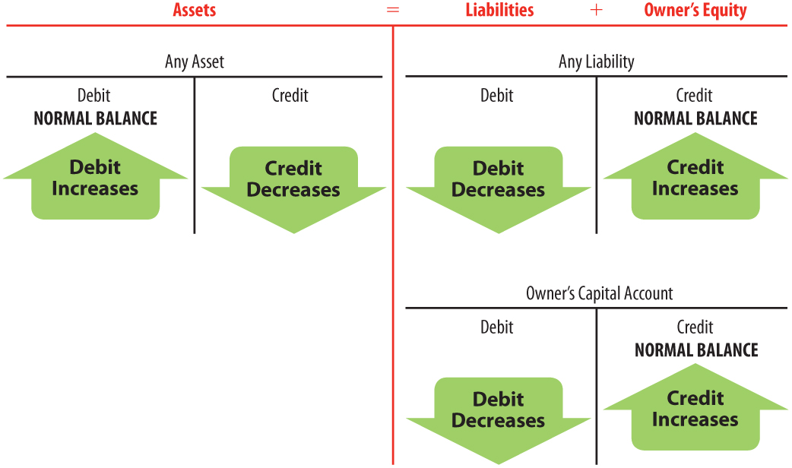
Increases, Decreases, and Balances in Accounts
Lesson 2-1
LO3
SLIDE 6

Slide 7
Lesson 2-1 Audit Your Understanding
Lesson 2-1
1. Draw the accounting equation on a T account.
ANSWER
SLIDE 7

Slide 8
Lesson 2-1 Audit Your Understanding
Lesson 2-1
2. What are the two accounting rules that explain increases of account balances?
ANSWER
(1) Assets are on the left side of the accounting equation. Therefore, assets increase on the left, or debit, side of the account.
(2) Liabilities and the owner’s capital account are on the right side of the accounting equation. Therefore, liabilities and the owner’s capital account increase on the right, or credit, side of the account.
SLIDE 8

