Slide 1
LESSON 2-2 Analyzing How Transactions Affect Accounts
Learning Objectives
LO4 Restate and apply the four questions necessary to analyze transactions for starting a business into debit and credit parts.

Slide 2
Chart of Accounts
Lesson 2-2
Each transaction changes the balances of at least two accounts.
A list of accounts used by a business is called a chart of accounts.
SLIDE 2

Slide 3
Chart of Accounts for Delgado Web Services
Lesson 2-2
Balance Sheet Accounts
(100) ASSETS
110 Cash
120 Petty Cash
130 Accounts Receivable—Main Street Services
140 Accounts Receivable—Valley Landscaping
150 Supplies
160 Prepaid Insurance
(200) LIABILITIES
210 Accounts Payable—Canyon Office Supplies
220 Accounts Payable—Mountain Graphic Arts
(300) OWNER’S EQUITY
310 Michael Delgado, Capital
320 Michael Delgado, Drawing
330 Income Summary
Income Statement Accounts
(400) REVENUE
410 Sales
(500) EXPENSES
510 Advertising Expense
520 Cash Short and Over
530 Communications Expense
540 Equipment Rental Expense
550 Insurance Expense
560 Miscellaneous Expense
570 Supplies Expense
SLIDE 3

Slide 4
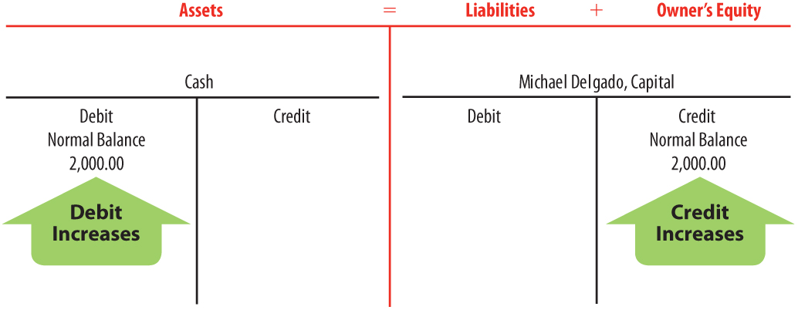
Received Cash from Owner as an Investment
Lesson 2-2
LO4
January 2. Received cash from owner as an investment, $2,000.00.
1
Cash and Michael Delgado, Capital are affected.
2
Cash is an asset account.
2
Michael Delgado, Capital is an owner‘s equity account.
4
Cash is debited.
4
Michael Delgado,
Capital is credited.
3
Assets are increased.
3
Owner’s Equity is increased.
SLIDE 4

Slide 5
Paid Cash for Supplies
Lesson 2-2
LO4
January 2. Paid cash for supplies, $165.00.
1
Supplies and Cash are affected.
2
Supplies and Cash are assets.
4
4
Supplies is debited.
Cash is credited.
3
Assets (Supplies) are increased.
3
Assets (Cash) are decreased.
SLIDE 5

Slide 6
Paid Cash for Insurance
Lesson 2-2
LO4
January 3. Paid cash for insurance, $900.00.
2
Prepaid Insurance and Cash are assets.
1
Prepaid Insurance and Cash are affected.
4
4
Prepaid Insurance is debited.
Cash is credited.
3
Assets (Prepaid Insurance) are increased.
3
Assets (Cash) are decreased.
SLIDE 6

Slide 7
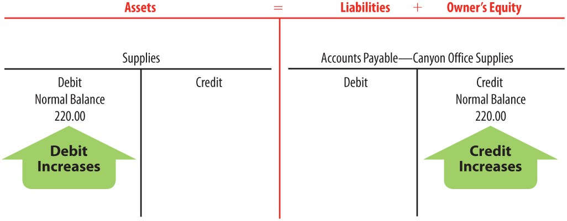
Bought Supplies on Account
Lesson 2-2
LO4
January 5. Bought supplies on account from Canyon Office Supplies, $220.00.
Supplies and Accounts Payable—Canyon Office Supplies are affected.
1
Accounts Payable—
Canyon Office
Supplies is a
liability.
2
Supplies is an asset.
2
4
Supplies is debited.
4
Accounts Payable—
Canyon Office
Supplies is credited.
3
Assets are increased.
3
Liabilities are increased.
SLIDE 7

Slide 8
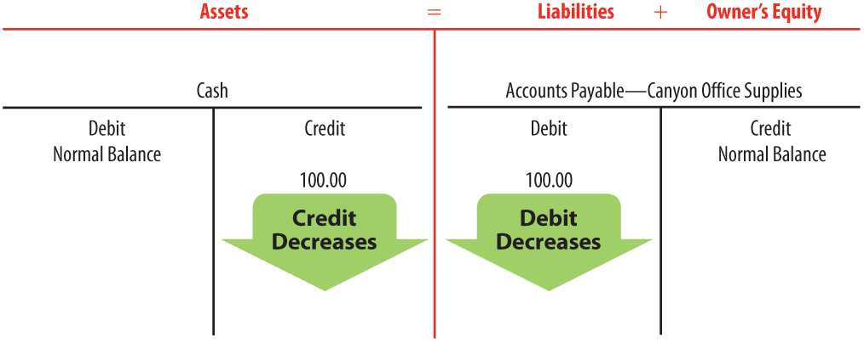
Paid Cash on Account
Lesson 2-2
LO4
January 9. Paid cash on account to Canyon Office Supplies, $100.00.
Accounts Payable—Canyon Office Supplies
and Cash are affected.
1
2
Cash is an asset.
2
Accounts Payable—
Canyon Office
Supplies is a
liability.
4
4
Cash is
credited.
Accounts Payable—
Canyon Office
Supplies is debited.
Assets are decreased.
Liabilities are decreased.
3
3
SLIDE 8

Slide 9
Lesson 2-2 Audit Your Understanding
Lesson 2-2
1. State the four questions used to analyze a transaction.
ANSWER
1. Which accounts are affected?
2. How is each account classified?
3. How is each classification changed?
4. How is each amount entered in the accounts?
SLIDE 9

Slide 10
Lesson 2-2 Audit Your Understanding
Lesson 2-2
2. What two accounts are affected when a business buys supplies on account?
ANSWER
Supplies
Accounts Payable
SLIDE 10

