Slide 1
LESSON 3-3 Transactions Affecting Owner’s Equity and Asset Accounts
Learning Objectives
LO6 Analyze and record transactions that affect owner’s equity.
LO7 Analyze and record sales and receipt of cash on account.

Slide 2
Received Cash from Sales
Lesson 3-3
LO6
Cash
January 10. Received cash from sales, $1,100.00. Calculator Tape No. 10.
1,100.00
Sales
1
Date
4
Source Document
1,100.00
2
Debit
3
Credit
1. Write the date in the Date column.
2. Write the title of the account debited in the Account Title column. Write the debit amount in the Debit column.
3. On the next line, indented about one centimeter, write the title of the account credited in the Account Title column. Write the credit amount in the Credit column.
4. Write the source document number in the Doc. No. column.
SLIDE 2

Slide 3
Sold Services on Account
Lesson 3-3
LO7
January 12. Sold services on account to Main Street Services, $500.00. Sales Invoice No. 1.
Accounts Rec.—Main Street Services
500.00
Sales
500.00
1
Date
2
Debit
4
Source Document
3
Credit
1. Write the date in the Date column.
2. Write the abbreviated title of the account debited in the Account Title column. Write the debit amount in the Debit column.
3. On the next line, indented about one centimeter, write the title of the account credited in the Account Title column. Write the credit amount in the Credit column.
4. Write the source document number in the Doc. No. column.
SLIDE 3

Slide 4
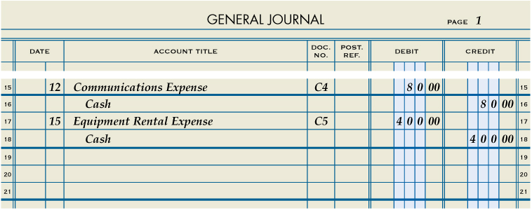
Paid Cash for an Expense
Lesson 3-3
LO7
January 12. Paid cash for communications bill including cell phone and Internet service, $80.00. Check No.4.
Communications Expense
80.00
Cash
80.00
1
Date
2
Debit
4
Source Document
3
Credit
1. Write the date in the Date column.
2. Write the title of the account debited. Write the debit amount.
3. On the next line, write the title of the account credited. Write the credit amount.
4. Write the source document number in the Doc. No. column.
SLIDE 4

Slide 5
Paid Cash for an Expense
Lesson 3-3
LO7
Equipment Rental Expense
January 15. Paid cash for equipment rental, $400.00. Check No. 5.
400.00
Cash
1
Date
2
Debit
400.00
4
Source Document
3
Credit
1. Write the date in the Date column.
2. Write the title of the account debited. Write the debit amount.
3. On the next line, write the title of the account credited. Write the credit amount.
4. Write the source document number in the Doc. No. column.
SLIDE 5

Slide 6
Received Cash on Account
Lesson 3-3
LO7
Cash
January 16. Received cash on account from Main Street Services, $200.00. Receipt No. 2.
200.00
Accts Rec.—Main Street Services
200.00
1
Date
2
Debit
4
Source Document
3
Credit
1. Write the date in the Date column.
2. Write the title of the account debited. Write the debit amount.
3. On the next line, indented about one centimeter, write the title of the account credited. Write the credit amount.
4. Write the source document number in the Doc. No. column.
SLIDE 6

Slide 7
Paid Cash to Owner as Withdrawal of Equity
Lesson 3-3
LO7
Michael Delgado, Drawing
January 16. Paid cash to owner for a withdrawal of equity, $350.00. Check No. 6.
350.00
Cash
1
Date
2
Debit
350.00
4
Source Document
3
Credit
1. Write the date in the Date column.
2. Write the title of the account debited. Write the debit amount.
3. On the next line, indented about one centimeter, write the title of the account credited. Write the credit amount.
4. Write the source document number in the Doc. No. column.
SLIDE 7

Slide 8
Lesson 3-3 Audit Your Understanding
Lesson 3-3
1. When cash is received from sales, which account is listed on the first line of the entry?
ANSWER
Cash
SLIDE 8

Slide 9
Lesson 3-3 Audit Your Understanding
Lesson 3-3
2. When cash is received from sales, which account is listed on the second line of the entry?
ANSWER
Sales
SLIDE 9

Slide 10
Lesson 3-3 Audit Your Understanding
Lesson 3-3
3. When services are sold on account, which account is listed on the second line of the entry?
ANSWER
Sales
SLIDE 10

Slide 11
Lesson 3-3 Audit Your Understanding
Lesson 3-3
4. When cash is paid for any reason, what abbreviation is used for the source document?
ANSWER
C (for check)
SLIDE 11

Slide 12
Lesson 3-3 Audit Your Understanding
Lesson 3-3
5. When cash is received on account, what abbreviation is used for the source document?
ANSWER
R (for receipt)
SLIDE 12

