Slide 1
LESSON 4-1 Using Accounts and Preparing and Maintaining a Chart of Accounts
Learning Objectives
LO1 Construct a chart of accounts for a service business organized as a proprietorship.
LO2 Demonstrate correct principles for numbering accounts.
LO3 Apply file maintenance principles to update a chart of accounts.
LO4 Complete the steps necessary to open general ledger accounts.

Slide 2
Account Form
Lesson 4-1
LO1
Used to summarize in one place all the changes to a single account
A separate form is used for each account
Sample of a blank account form
SLIDE 2

Slide 3
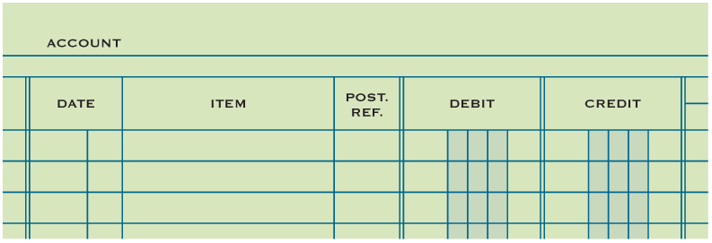
Relationship of a T Account to an Account Form
Lesson 4-1
LO1
Information needed to trace entry back to journal page.
T Account
Debit side
Credit side
Balance columns
SLIDE 3

Slide 4
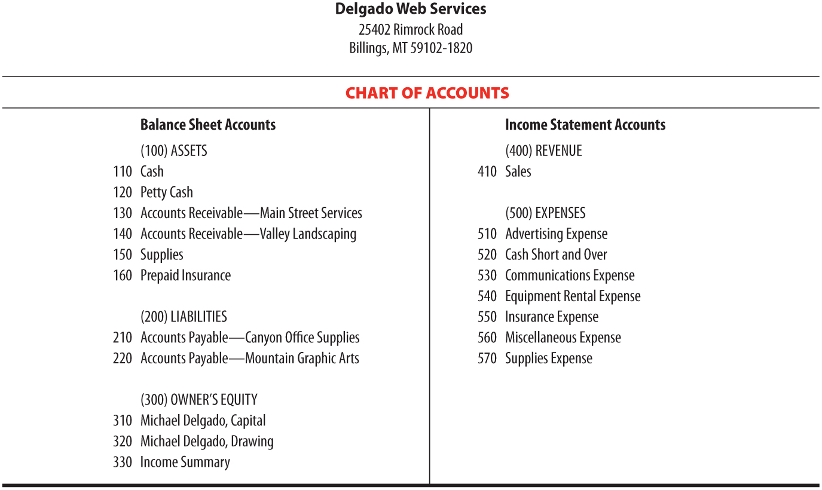
Chart of Accounts
Lesson 4-1
LO1
SLIDE 4

Slide 5
Chart of Accounts
Lesson 4-1
LO1
A group of accounts is called a ledger.
A ledger that contains all accounts needed to prepare financial statements is called a general ledger.
The name given to an account is known as an account title.
The number assigned to an account is called an account number.
SLIDE 5

Slide 6
Account Numbers
Lesson 4-1
LO2
SLIDE 6

Slide 7
Assigning Account Numbers
Lesson 4-1
LO3
The procedure for arranging accounts in a general ledger, assigning account numbers, and keeping records current is called file maintenance.
SLIDE 7

Slide 8
Assigning Account Numbers
Lesson 4-1
LO3
560 Miscellaneous Expense (Existing account)
570 Supplies Expense (Existing account)
565 Postage Expense (New Account)
570 Supplies Expense (Existing account)
580 Water Expense (New Account)
SLIDE 8

Slide 9
Opening an Account in a General Ledger
Lesson 4-1
LO4
Writing an account title and number on the heading of an account is called opening an account.
SLIDE 9

Slide 10
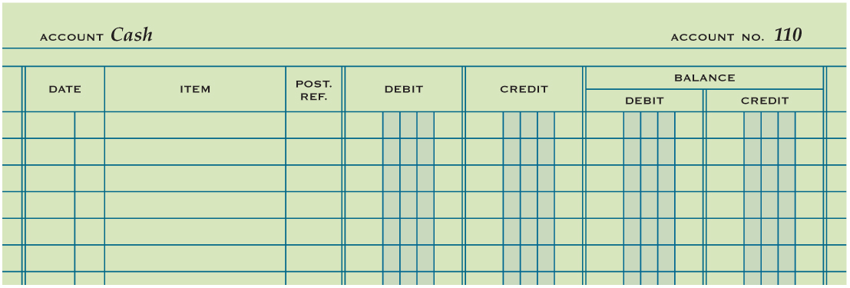
Opening an Account in a General Ledger
Lesson 4-1
LO4
1
2
1. Write the account title, Cash, after the word Account in the heading.
2. Write the account number, 110, after the words Account No. in the heading.
SLIDE 10

Slide 11
Lesson 4-1 Audit Your Understanding
Lesson 4-1
1. Describe the two parts of an account number.
ANSWER
The first digit indicates in which general ledger division the account is located.
The second and third digits indicate the location of the account within that division.
SLIDE 11

Slide 12
Lesson 4-1 Audit Your Understanding
Lesson 4-1
2. List the two steps for opening an account.
ANSWER
1. Write the account title after the word Account in the heading.
2. Write the account number after the words Account No. in the heading.
SLIDE 12

