Slide 1
LESSON 4-2 Posting from a General Journal to a General Ledger and Proving Cash
Learning Objectives
LO5 Post amounts from a general journal.
LO6 Demonstrate how to prove cash.

Slide 2
Posting an Amount from the Debit Column of a General Journal
Lesson 4-2
LO5
Transferring information from a journal entry to a ledger account is called posting.
SLIDE 2

Slide 3
Posting an Amount from the Debit Column of a General Journal
Lesson 4-2
LO5
2
1
3
5
4
1. Write the date.
4. Write the new account balance.
2. Write the journal page number.
5. Return to the journal and write the account number.
3. Write the debit amount.
SLIDE 3

Slide 4
Posting an Amount from the Credit Column of a General Journal
Lesson 4-2
LO5
2
1
3
5
4
1. Write the date.
4. Write the new account balance.
2. Write the journal page number.
5. Return to the journal and write the account number.
3. Write the credit amount.
SLIDE 4

Slide 5
Posting a Debit Amount to an Account with a Balance
Lesson 4-2
LO5
2
1
3
5
4
1. Write the date.
4. Write the new account balance.
2. Write the journal page number.
5. Return to the journal and write the account number.
3. Write the debit amount.
SLIDE 5

Slide 6
Posting a Debit Amount to an Account with a Credit Balance
Lesson 4-2
LO5
2
1
3
5
4
1. Write the date.
4. Write the new account balance.
2. Write the journal page number.
5. Return to the journal and write the account number.
3. Write the debit amount.
SLIDE 6

Slide 7
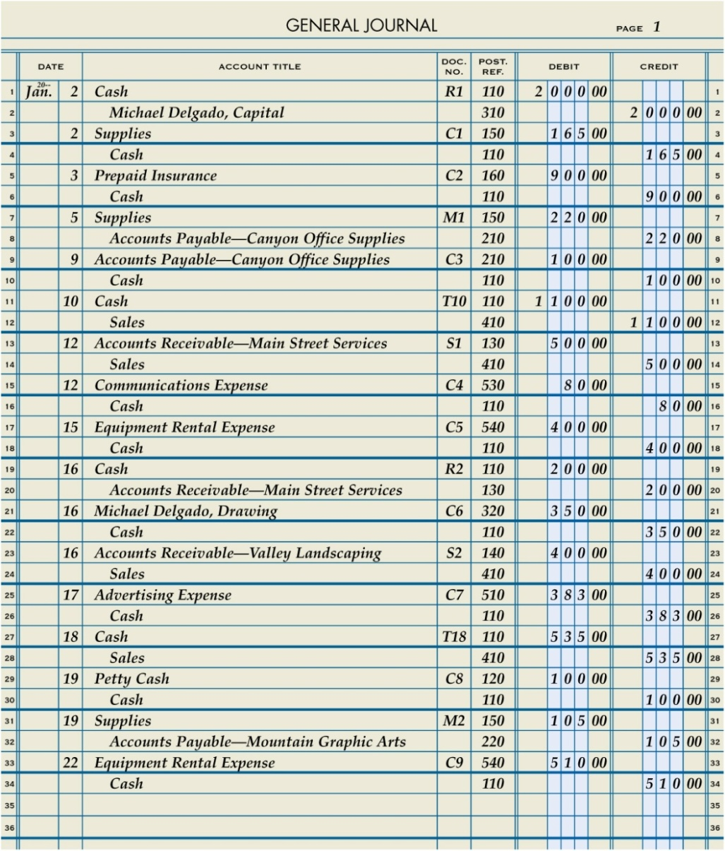
Journal Page with Posting Completed
Lesson 4-2
LO5
SLIDE 7

Slide 8
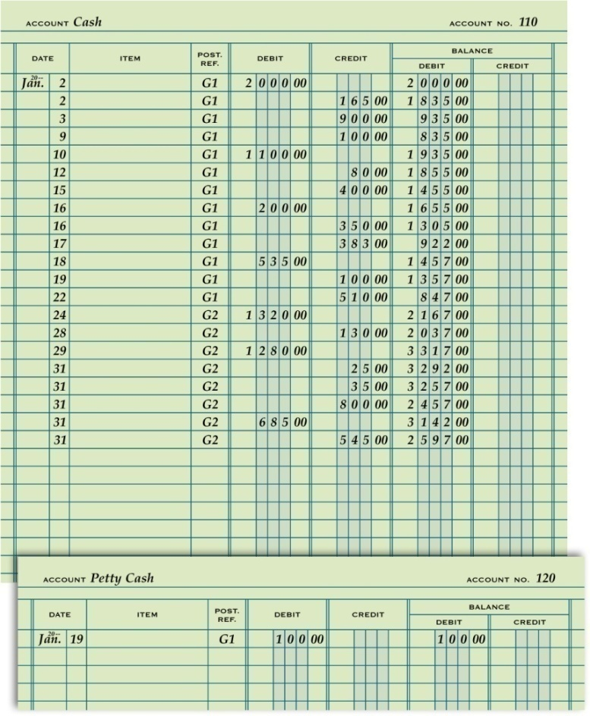
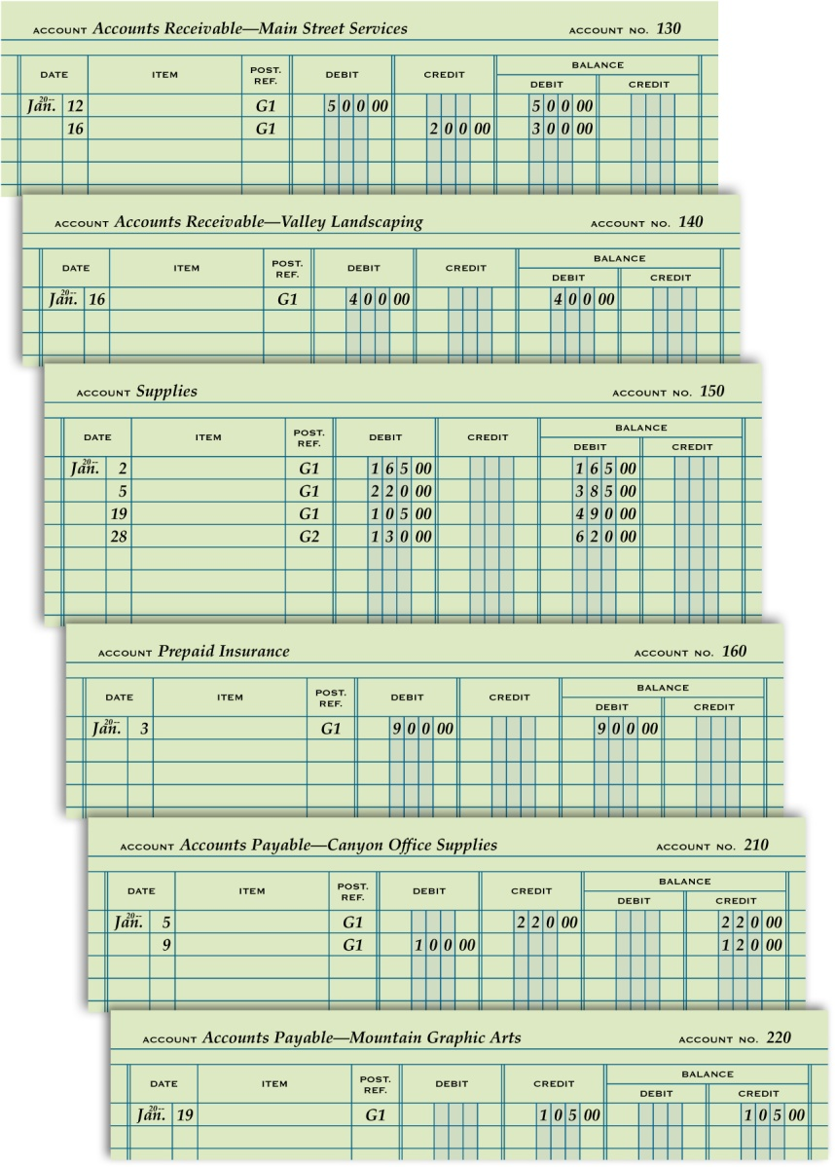
General Ledger with Posting Completed
Lesson 4-2
LO5
SLIDE 8

Slide 9
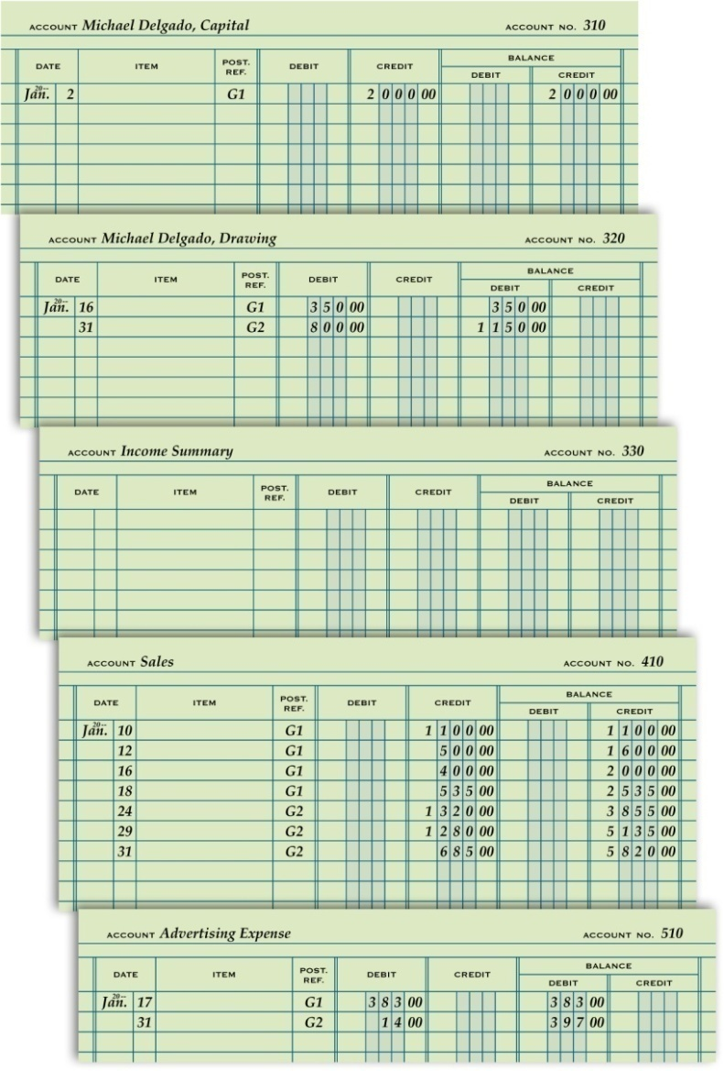
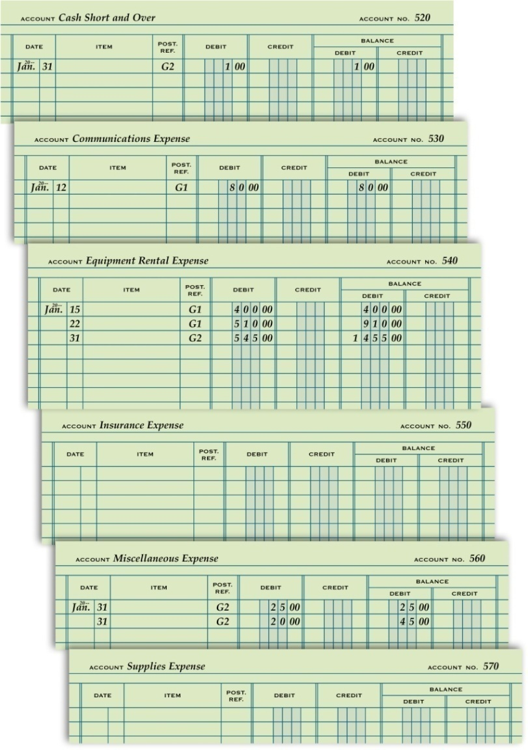
General Ledger with Posting Completed
Lesson 4-2
LO5
SLIDE 9

Slide 10
Proving Cash
Lesson 4-2
LO6
Determining that the amount of cash agrees with the balance of the Cash account in the accounting records is called proving cash.
If the cash balance as shown in the checkbook equals the cash balance in the Cash account, cash is proved.
SLIDE 10

Slide 11
Lesson 4-2 Audit Your Understanding
Lesson 4-2
1. List the five steps of posting from the general journal to the general ledger.
ANSWER
1. Write the date in the Date column of the account.
2. Write the journal page number in the Post. Ref. column of the account.
3. Write the amount in the Debit or Credit column.
4. Calculate and write the new account balance in the Balance Debit or Balance Credit column.
5. Return to the journal and write the account number in the Post. Ref. column of the journal.
SLIDE 11

Slide 12
Lesson 4-2 Audit Your Understanding
Lesson 4-2
2. When both debit and credit amounts have been posted to an account, what determines whether the balance is a debit or a credit?
ANSWER
Whenever the debits in an account exceed the credits, the balance is a debit.
Whenever the credits in an account exceed the debits, the balance is a credit.
SLIDE 12

Slide 13
Lesson 4-2 Audit Your Understanding
Lesson 4-2
3. Which two amounts are compared when proving cash?
ANSWER
The cash balance as shown in the checkbook and the cash balance in the Cash account.
SLIDE 13

