Slide 1
LESSON 5-1 Checking Accounts
Learning Objectives
LO1 Record a deposit on a check stub.
LO2 Endorse checks using blank, special, and restrictive endorsements.
LO3 Prepare a check stub and a check.

Slide 2
How Businesses Use Cash
Lesson 5-1
LO1
Small cash payments
Issues related to cash
Chance of recording errors
Ease of transfer without any question about ownership
Loss as cash is moved from one place to another
Safety measures
SLIDE 2

Slide 3
Checking Account
Lesson 5-1
LO1
A business form ordering a bank to pay cash from a bank account is known as a check.
A bank account from which payments can be ordered by a depositor is called a checking account.
Opening a checking account
Signature card
Deposit slip
SLIDE 3

Slide 4
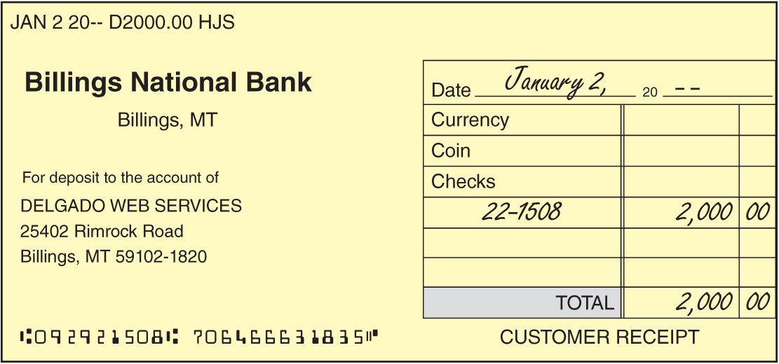
Depositing Cash
Lesson 5-1
LO1
A bank form that lists the checks, currency, and coins an account holder is adding to the bank account is called a deposit slip.
SLIDE 4

Slide 5
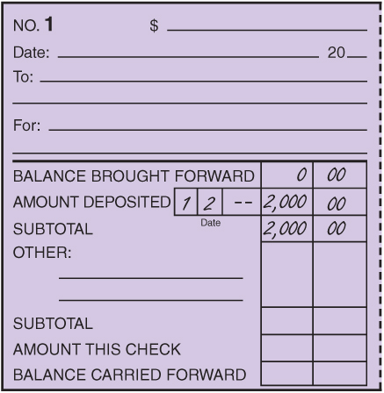
Deposit Recorded on a Check Stub
Lesson 5-1
LO1
1. Write balance brought forward on the check stub.
1
2. Write the date of the deposit on the stub.
3. Write the amount of the deposit on the stub.
4. Calculate the subtotal.
4
2
3
SLIDE 5

Slide 6
Endorsement
Lesson 5-1
LO2
A signature or stamp on the back of a check transferring ownership is called an endorsement.
Three types of commonly used endorsements
Blank endorsement
Special endorsement
Restrictive endorsement
SLIDE 6

Slide 7
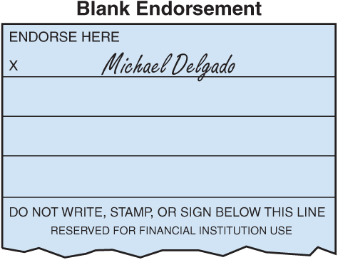
Blank Endorsement
Lesson 5-1
LO2
An endorsement consisting only of the endorser’s signature is called a blank endorsement.
SLIDE 7

Slide 8
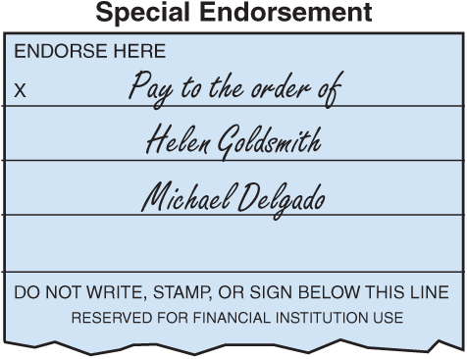
Special Endorsement
Lesson 5-1
LO2
An endorsement indicating a new owner of a check is called a special endorsement.
A special endorsement is sometimes known as an endorsement in full.
SLIDE 8

Slide 9
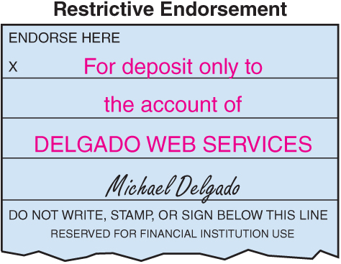
Restrictive Endorsement
Lesson 5-1
LO2
An endorsement restricting further transfer of a check’s ownership is called a restrictive endorsement.
SLIDE 9

Slide 10
Completed Check Stub and Check
Lesson 5-1
LO3
1
2
3
4
5
6
1. Write the amount of the check on the stub.
2. Write the date of the check on the stub.
3. Write to whom the check is to be paid on the stub.
4. Record the purpose of the check on the stub.
5. Write the amount of the check on the stub.
6. Calculate the new checking account balance and record the new balance.
SLIDE 10

Slide 11
Completed Check Stub and Check
Lesson 5-1
LO3
7
8
9
10
11
12
7. Write the date the check is issued.
8. Write to whom the check is to be paid.
9. Write the amount in figures.
10. Write the amount in words.
11. Write the purpose of the check.
12. Sign the check.
SLIDE 11

Slide 12
Recording a Voided Check
Lesson 5-1
LO3
1
2
3
4
5
1. Record the date in the Date column.
2. Write the word VOID in the Account Title column.
3. Write the check number in the Doc. No. column.
4. Place a check mark in the Post. Ref. column.
5. Place a dash in both the Debit and Credit columns.
SLIDE 12

Slide 13
Lesson 5-1 Audit Your Understanding
Lesson 5-1
1. List the three types of endorsements.
ANSWER
Blank endorsement
Special endorsement
Restrictive endorsement
SLIDE 13

Slide 14
Lesson 5-1 Audit Your Understanding
Lesson 5-1
2. List the steps for preparing a check stub.
ANSWER
1. Write the amount of the check after the dollar sign at the top of the stub.
2. Write the date of the check on the Date line.
3. Write to whom the check is to be paid on the To line.
4. Record the purpose of the check on the For line.
5. Write the amount of the check after the words Amt. This Check.
6. Calculate the new checking account balance and record it in the amount column on the last line of the stub.
SLIDE 14

Slide 15
Lesson 5-1 Audit Your Understanding
Lesson 5-1
3. List the steps for preparing a check.
ANSWER
1. Write the date.
2. Write to whom the check is to be paid following the words Pay to the order of.
3. Write the amount in figures following the dollar sign.
4. Write the amount in words and draw a line through the unused space up to the word Dollars.
5. Write the purpose of the check on the line labeled For.
6. Sign the check.
SLIDE 15

