Slide 1
LESSON 5-4 Petty Cash
Learning Objectives
LO9 Establish a petty cash fund.
LO10 Prepare a petty cash report.
LO11 Replenish a petty cash fund.

Slide 2
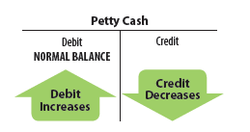
Establishing a Petty Cash Fund
Lesson 5-4
LO9
An amount of cash kept on hand and used for making small payments is called petty cash.
SLIDE 2

Slide 3
Establishing a Petty Cash Fund
Lesson 5-4
LO9
Petty Cash
January 19. Paid cash to establish a petty cash fund, $100.00. Check No. 8.
100.00
Cash
1
Date
2
Debit
4
Source Document
100.00
3
Credit
1. Write the date in the Date column.
2. Write the title of the account to be debited in the Account Title column. Record the amount debited in the Debit column.
3. On the next line, indented, write the title of the amount credited in the Account Title column. Write the credit amount in the Credit column.
4. Write the source document number in the Doc. No. column.
SLIDE 3

Slide 4
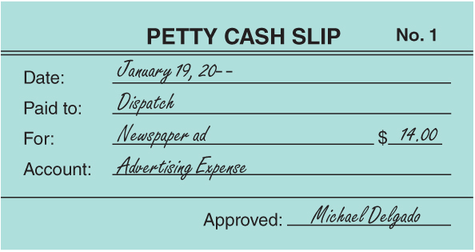
Making Payments from a Petty Cash Fund with a Petty Cash Slip
Lesson 5-4
LO9
A form showing proof of a petty cash payment is called a petty cash slip.
SLIDE 4

Slide 5
Petty Cash Report
Lesson 5-4
LO10
A petty cash on hand amount that is less than the recorded amount is called cash short.
A petty cash on hand amount that is more than the recorded amount is called cash over.
The custodian prepares a petty cash report when the petty cash fund is to be replenished.
SLIDE 5

Slide 6
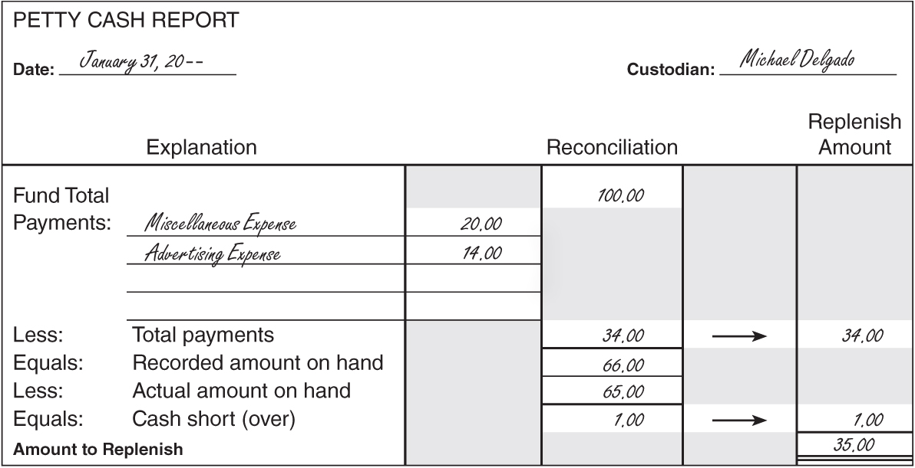
Petty Cash Report
Lesson 5-4
LO10
1
Date and Custodian Name
2
Fund Total
Payments by General Ledger Account
3
4
Total Payments
8
Amount to
Replenish
5
Recorded Amount on Hand
7
Subtract the actual cash on hand from the recorded amount on hand.
6
Actual Cash on Hand
SLIDE 6

Slide 7
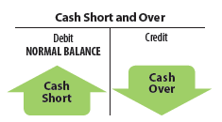
Replenishing Petty Cash
Lesson 5-4
LO11
Account title—Cash Short and Over
Debited when cash is short
Credited when cash is over
Account balance
Either a debit or credit
Usually a debit
Petty cash fund more likely to be short than over
SLIDE 7

Slide 8
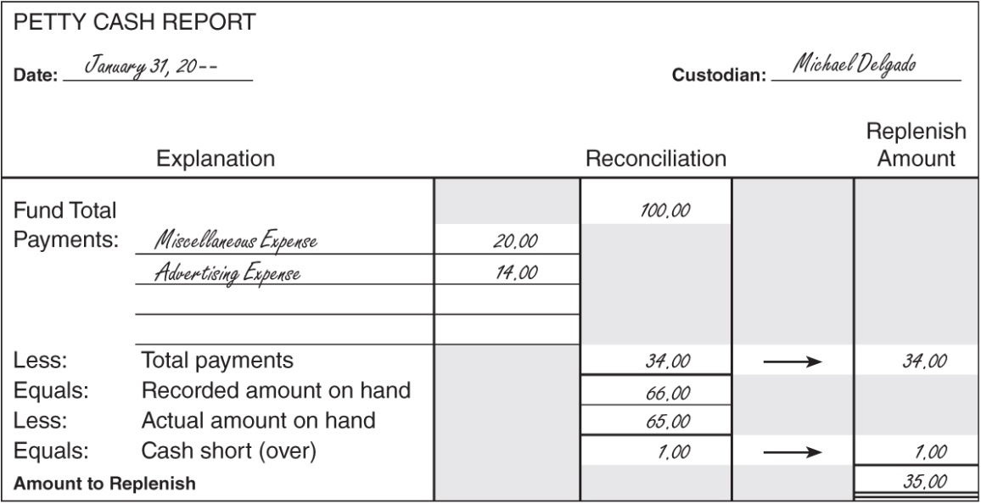
Replenishing Petty Cash
Lesson 5-4
LO11
January 31. Paid cash to replenish the petty cash fund, $35.00: Miscellaneous Expense, $20.00; Advertising, $14.00, Cash Short and Over, $1.00. Check No. 11.
Miscellaneous Expense
20.00
Advertising Expense
14.00
Cash Short and Over
1.00
Cash
35.00
Date
Debits
Credit
Cash Short (a Debit) or Cash Over (a Credit)
1
2
4
3
5
Source Document
SLIDE 8

Slide 9
Lesson 5-4 Audit Your Understanding
Lesson 5-4
1. Why do businesses use petty cash funds?
ANSWER
For making small cash payments for which writing a check is not time- or cost-effective
SLIDE 9

Slide 10
Lesson 5-4 Audit Your Understanding
Lesson 5-4
2. Why is Cash rather than Petty Cash credited when a petty cash fund is replenished?
ANSWER
The check issued to replenish petty cash is a credit to Cash and does not affect Petty Cash.
SLIDE 10

