Slide 1
LESSON 6-2 Planning Adjusting Entries on a Work Sheet
Learning Objectives
LO3 Analyze and explain the adjustments for supplies and prepaid insurance.
LO4 Complete the Adjustments columns of a work sheet.

Slide 2
Planning Adjustments on a Work Sheet
Lesson 6-2
LO3
Cash paid for an expense in one fiscal period that is not used until a later period is called a prepaid expense.
Reporting income when it is earned and expenses when they are incurred is called the accrual basis of accounting.
Generally accepted accounting principles (GAAP) require the use of the accrual basis of accounting.
Reporting income when the cash is received and expenses when the cash is paid is called the cash basis of accounting.
Changes recorded on a work sheet to update general ledger accounts at the end of a fiscal period are called adjustments.
SLIDE 2

Slide 3
Supplies Adjustment on a Work Sheet
Lesson 6-2
LO3
AFTER ADJUSTMENT
Supplies Expense
Adjustment (a) 530.00
Supplies
Jan. 31 Balance 620.00
Adjustment (a) 530.00
(New Balance 90.00)
SLIDE 3

Slide 4
Supplies Adjustment on a Work Sheet
Lesson 6-2
LO3
2
Credit
3
Label
1
Debit
1. Write the debit amount in the Adjustments Debit column on the line with the account title Supplies Expense.
2. Write the credit amount in the Credit column on the line with the account title Supplies.
3. Label the two parts of this adjustment with a small letter a in parentheses.
SLIDE 4

Slide 5
Prepaid Insurance Adjustment on a Work Sheet
Lesson 6-2
LO3
AFTER ADJUSTMENT
Insurance Expense
Adjustment (b) 150.00
Prepaid Insurance
Jan. 31 Balance 900.00
Adjustment (b) 150.00
(New Balance 750.00)
SLIDE 5

Slide 6
Prepaid Insurance Adjustment on a Work Sheet
Lesson 6-2
LO3
2
Credit
3
Label
1
Debit
1. Write the debit amount in the Adjustments Debit column on the line with the account title Insurance Expense.
2. Write the credit amount in the Credit column on the line with the account title Prepaid Insurance.
3. Label the two parts of this adjustment with a small letter b in parentheses.
SLIDE 6

Slide 7
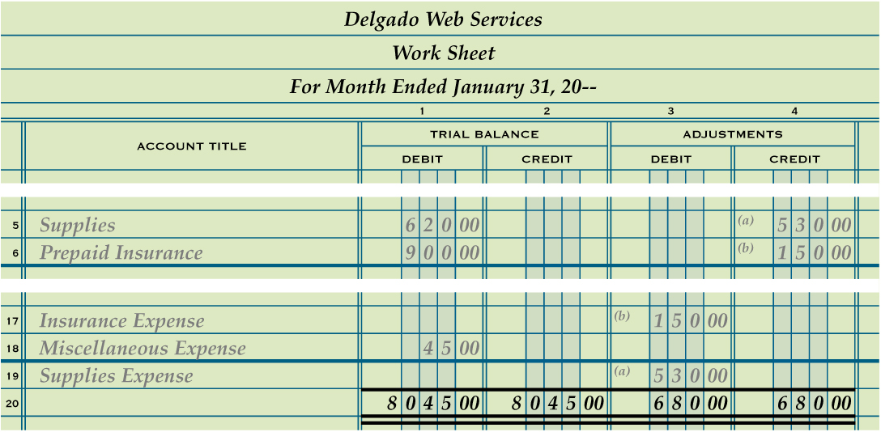
Proving the Adjustments Columns of a Work Sheet
Lesson 6-2
LO4
Single Rule
1
2
Totals
1. Rule a single line across the two Adjustments columns on the same line as the single line for the Trial Balance columns.
3
Double Rule
2. Add both the Adjustments Debit and Credit columns.
3. Rule double lines across both Adjustments columns.
SLIDE 7

Slide 8
Lesson 6-2 Audit Your Understanding
Lesson 6-2
1. Explain how the concept of Matching Expenses with Revenue relates to adjustments.
ANSWER
An expense should be reported in the same fiscal period that it is used to produce revenue.
SLIDE 8

Slide 9
Lesson 6-2 Audit Your Understanding
Lesson 6-2
2. List the four questions asked in analyzing an adjustment on a work sheet.
ANSWER
1. What is the balance of the account to be adjusted?
2. What should the balance be for this account?
3. What must be done to correct the account balance?
4. What adjustment is made?
SLIDE 9

