Slide 1
LESSON 6-3 Completing the Work Sheet and Finding Errors on a Work Sheet
Learning Objectives
LO5 Prepare the Balance Sheet and Income Statement columns of a work sheet.
LO6 Total and rule the work sheet.
LO7 Apply the steps for finding errors on a work sheet.

Slide 2
Extending Balance Sheet Account Balances on a Work Sheet
Lesson 6-3
LO5
A financial statement that reports the value of a business’s assets, liabilities, and owner’s equity on a specific date is called a balance sheet.
SLIDE 2

Slide 3
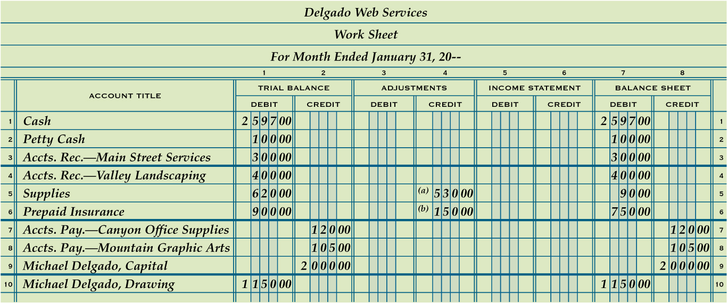
Extending Balance Sheet Account Balances on a Work Sheet
Lesson 6-3
LO5
Debit Balances without Adjustments
1
Debit Balances with Adjustments
2
Credit Balances without Adjustments
3
SLIDE 3

Slide 4
Extending Income Statement Account Balances on a Work Sheet
Lesson 6-3
LO5
A financial statement showing the revenue and expenses for a fiscal period is called an income statement.
SLIDE 4

Slide 5
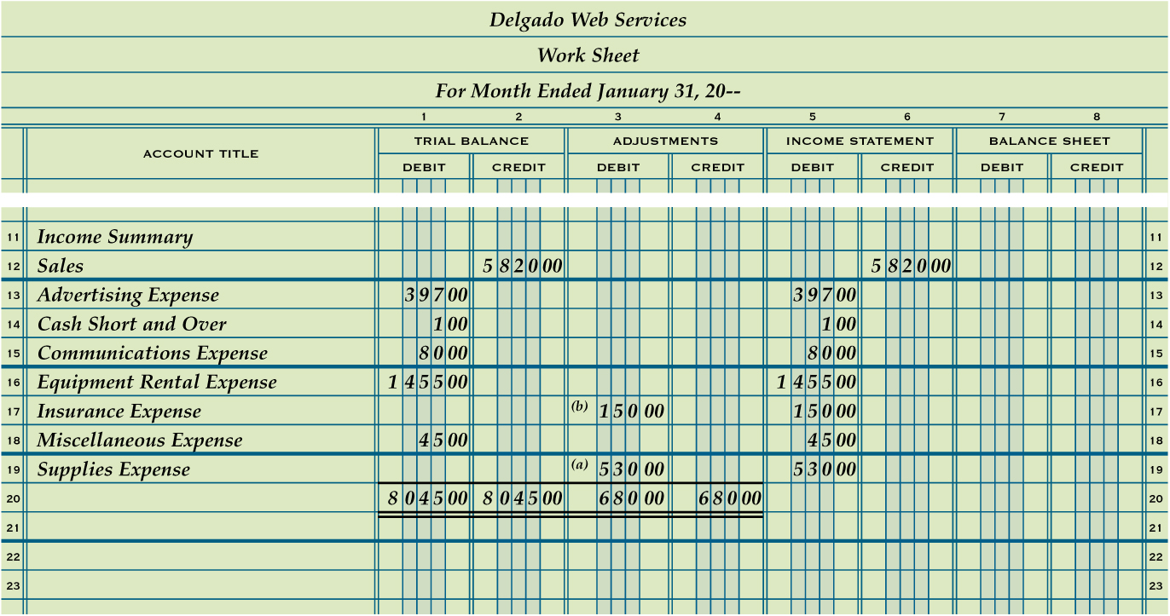
Extending Income Statement Account Balances on a Work Sheet
Lesson 6-3
LO5
Sales Balance
1
Expense Balances with Adjustments
3
Expense Balances without Adjustments
2
SLIDE 5

Slide 6
Recording Net Income and Totaling and Ruling a Work Sheet
Lesson 6-3
LO6
The difference between total revenue and total expenses when total revenue is greater is called net income.
SLIDE 6

Slide 7
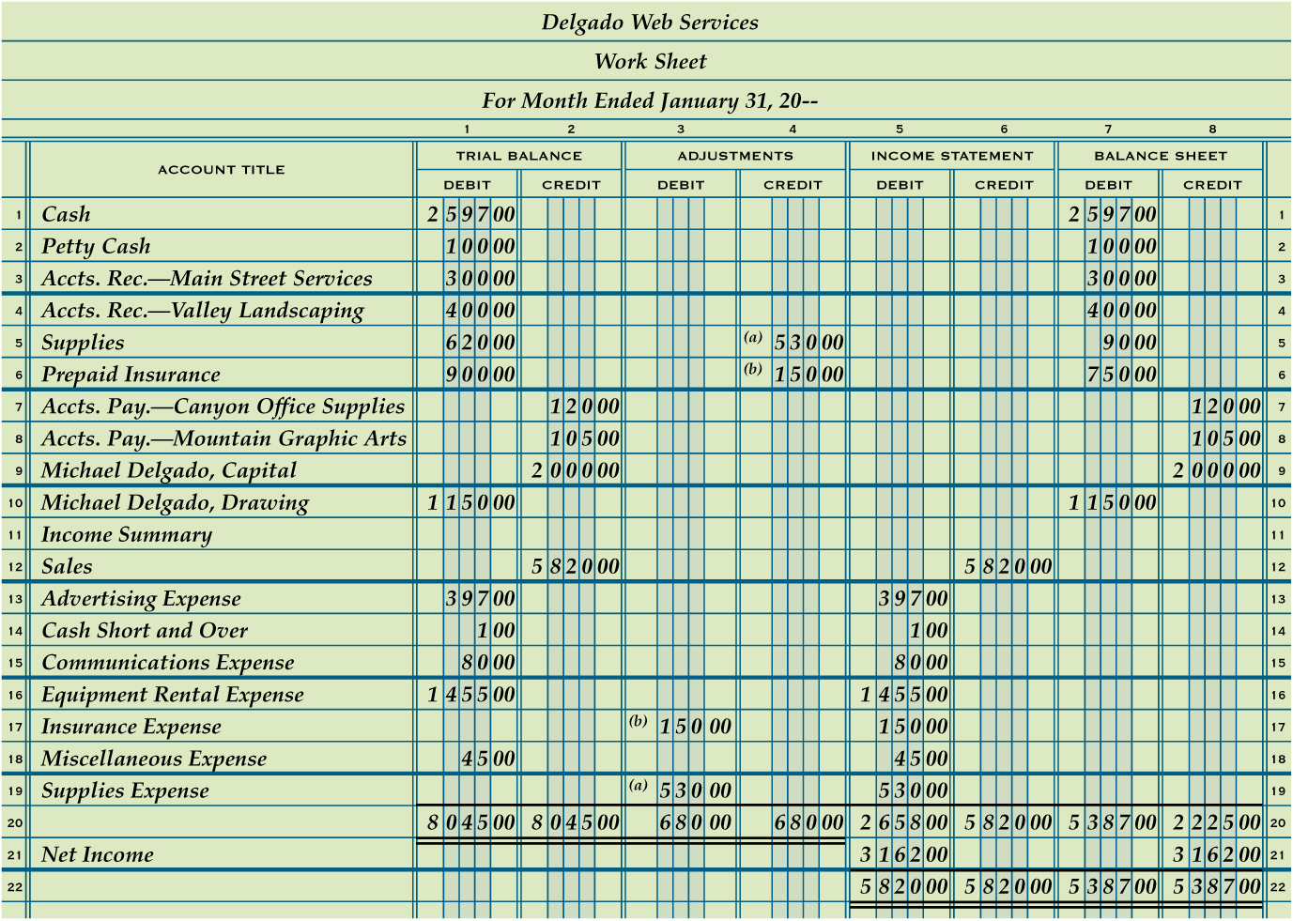
Recording Net Income and Totaling and Ruling a Work Sheet
Lesson 6-3
LO6
1
Single Rule
2
Totals
5
Single Rule
6
Totals
Net Income
3
Double Rule
7
4
Extend Net Income
SLIDE 7

Slide 8
Calculating and Recording a Net Loss on a Work Sheet
Lesson 6-3
LO6
The difference between total revenue and total expenses when total expenses are greater is called a net loss.
SLIDE 8

Slide 9
Calculating and Recording a Net Loss on a Work Sheet
Lesson 6-3
LO6
1
Single Rule
Net Loss
3
4
Extend Net Loss
Totals
2
SLIDE 9

Slide 10
Finding and Correcting Errors on the Work Sheet
Lesson 6-3
LO7
Several different kinds of errors may be made when preparing a work sheet.
Three examples
There may be errors in the accounting records.
There may be errors in calculations.
An amount may be entered in the wrong column.
SLIDE 10

Slide 11
Lesson 6-3 Audit Your Understanding
Lesson 6-3
1. In which Balance Sheet column is net income recorded on the work sheet?
ANSWER
Balance Sheet Credit column
SLIDE 11

Slide 12
Lesson 6-3 Audit Your Understanding
Lesson 6-3
2. In which Balance Sheet column is net loss recorded on the work sheet?
ANSWER
Balance Sheet Debit column
SLIDE 12

Slide 13
Lesson 6-3 Audit Your Understanding
Lesson 6-3
3. What is the first step in checking for arithmetic errors when two column totals are not in balance?
ANSWER
Subtract the smaller total from the larger total to find the difference.
SLIDE 13

Slide 14
Lesson 6-3 Audit Your Understanding
Lesson 6-3
4. What is one way to check for an error caused by transposed numbers?
ANSWER
The difference between two column totals can be divided evenly by 9.
SLIDE 14

Slide 15
Lesson 6-3 Audit Your Understanding
Lesson 6-3
5. What term is used to describe an error that occurs when numbers are moved to the right or left in an amount column?
ANSWER
Slide
SLIDE 15

