Slide 1
LESSON 7-1 Preparing an Income Statement
Learning Objectives
LO1 Prepare an income statement for a service business.
LO2 Calculate and analyze financial ratios using income statement amounts.

Slide 2
Reporting Financial Information
Lesson 7-1
LO1
The area of accounting that focuses on reporting information to external users is called financial accounting.
The area of accounting that focuses on reporting information to internal users is called managerial accounting.
SLIDE 2

Slide 3
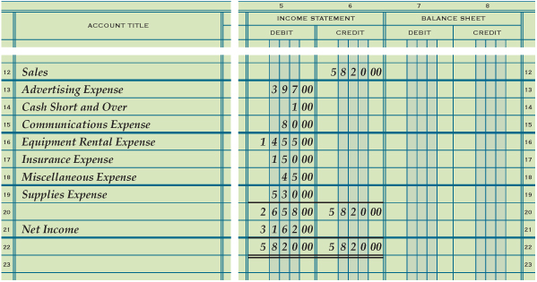
Preparing an Income Statement from Information on a Work Sheet
Lesson 7-1
LO1
Information needed to prepare the income statement is obtained from the work sheet.
Account titles are obtained from the work sheet’s Account Title column.
Account balances are obtained from the work sheet’s Income Statement columns.
SLIDE 3

Slide 4
Heading of an Income Statement
Lesson 7-1
LO1
Center the name of the company on the first line.
1
3
Center the date of the report on the third line.
2
Center the name of the report, Income Statement, on the second line.
SLIDE 4

Slide 5
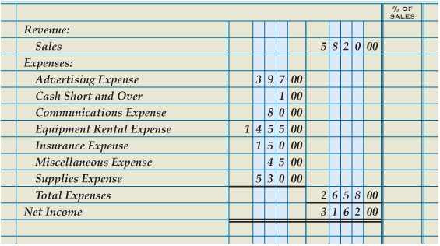
Revenue, Expenses, and Net Income Sections of an Income Statement
Lesson 7-1
LO1
Revenue
1
2
Account Title
6
Expense Amounts
3
Revenue Amount
Expenses
4
Account Titles
5
10
Calculate Net Income
9
Total of Expenses
8
Total Expenses
11
Single Rule
Net Income
12
Single Rule
7
Double Rule
14
13
Record Net Income
SLIDE 5

Slide 6
Analyzing an Income Statement
Lesson 7-1
LO2
A comparison between two components of financial information is called a financial ratio.
The calculation and interpretation of a financial ratio is called ratio analysis.
Reporting an amount on a financial statement as a percentage of another item on the same financial statement is called vertical analysis.
SLIDE 6

Slide 7
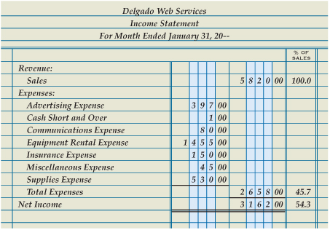
Analyzing an Income Statement
Lesson 7-1
LO2
Total Expenses Ratio
Total Expenses ÷ Total Sales = Total Expenses Ratio
$2,658.00 ÷ $5,820.00 = 45.7%
Net Income Ratio
Net Income ÷ Total Sales = Net Income Ratio
$3,162.00 ÷ $5,820.00 = 54.3%
SLIDE 7

Slide 8
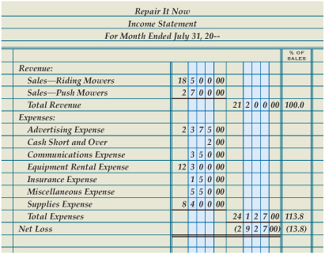
Income Statement with Two Sources of Revenue and a Net Loss
Lesson 7-1
LO2
Revenue
1
3
Revenue Amounts
Account Titles
2
Total Revenue
5
4
Total of Revenue
Net Loss
6
Record Net Loss
7
SLIDE 8

Slide 9
Lesson 7-1 Audit Your Understanding
Lesson 7-1
1. List the four sections of an income statement.
ANSWER
Heading, revenue, expenses, and net income or net loss
SLIDE 9

Slide 10
Lesson 7-1 Audit Your Understanding
Lesson 7-1
2. What is the formula for calculating the total expenses ratio?
ANSWER
Total Expenses divided by Total Sales equals Total Expenses Ratio.
SLIDE 10

Slide 11
Lesson 7-1 Audit Your Understanding
Lesson 7-1
3. What is the formula for calculating the net income ratio?
ANSWER
Net Income divided by Total Sales equals Net Income Ratio.
SLIDE 11

