Slide 1
LESSON 7-2 Preparing a Statement of Owner's Equity and a Balance Sheet
Learning Objectives
LO3 Prepare a statement of owner’s equity.
LO4 Prepare a balance sheet for a service business organized as a proprietorship.

Slide 2
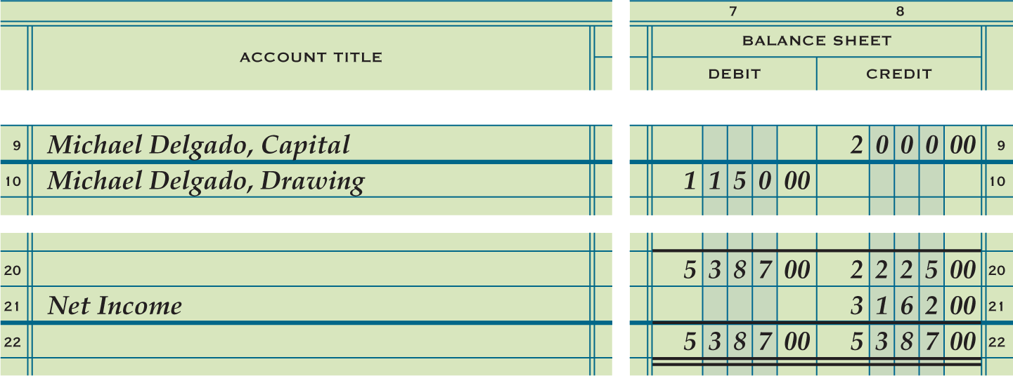
Preparing a Statement of Owner’s Equity
Lesson 7-2
LO3
This document reports the changes in the capital account for a proprietorship for a period of time.
Account titles are obtained from the work sheet’s Account Title column.
Account balances are obtained from the work sheet’s Balance Sheet columns.
SLIDE 2

Slide 3
Heading of a Statement of Owner’s Equity
Lesson 7-2
LO3
Information needed to prepare the balance sheet is obtained from the work sheet.
SLIDE 3

Slide 4
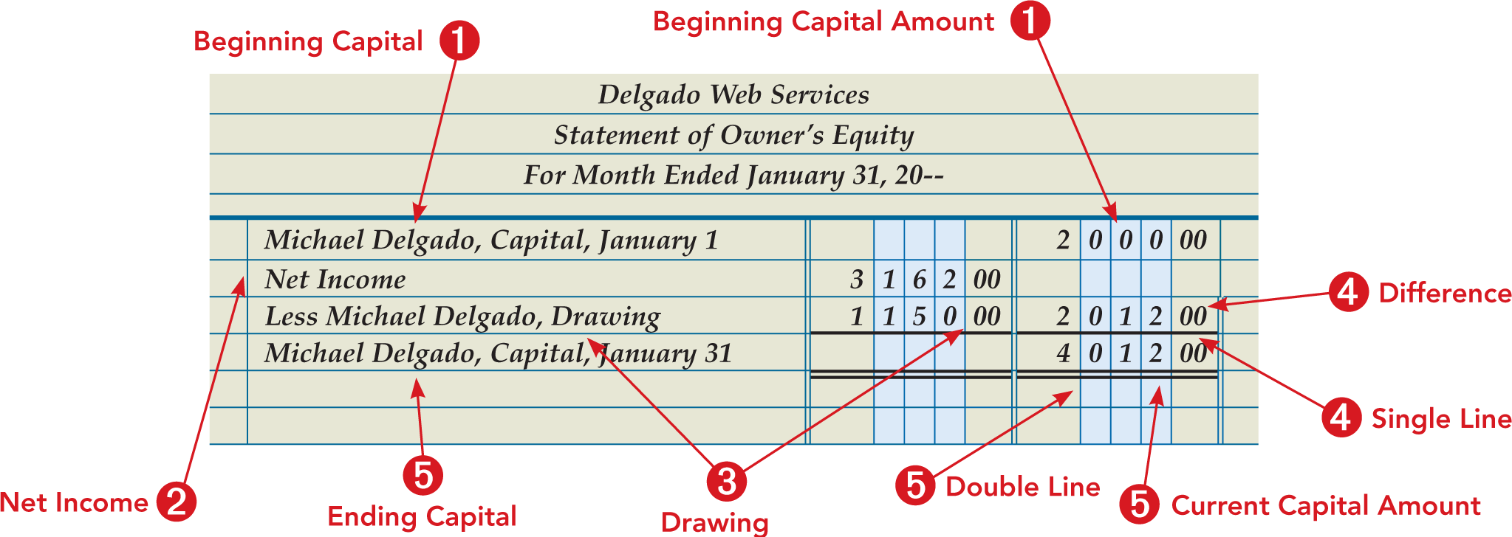
Body of a Statement of Owner’s Equity
Lesson 7-2
LO3
Information needed to prepare the balance sheet is obtained from the work sheet.
SLIDE 4

Slide 5
Statement of Owner’s Equity with a Net Loss
Lesson 7-2
LO3
When a business has a net loss, current capital is calculated
SLIDE 5

Slide 6
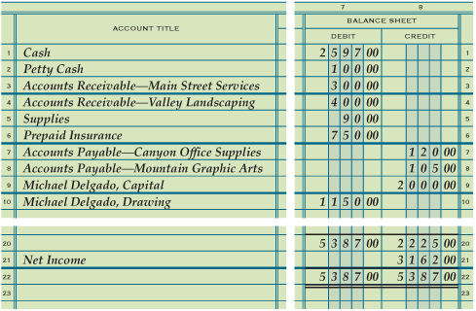
Preparing a Balance Sheet from Information on a Work Sheet
Lesson 7-2
LO4
Information needed to prepare the balance sheet is obtained from the work sheet.
Account titles are obtained from the work sheet’s Account Title column.
Account balances are obtained from the work sheet’s Balance Sheet columns.
SLIDE 6

Slide 7
Heading of a Balance Sheet
Lesson 7-2
LO4
Center the name of the company on the first line.
1
3
Center the date of the report on the third line.
2
Center the name of the report, Balance Sheet, on the second line.
SLIDE 7

Slide 8
Assets and Liabilities Sections of a Balance Sheet
Lesson 7-2
LO4
2
Account Titles
Liability Amounts
6
Account Titles
1
Assets
5
4
Liabilities
3
Asset Amounts
8
Total Liabilities
7
Single Rule
9
Total of Liabilities
SLIDE 8

Slide 9
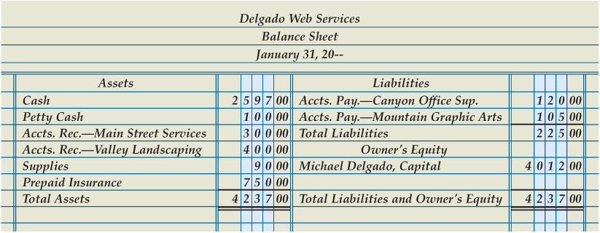
Owner’s Equity Section of a Balance Sheet
Lesson 7-2
LO4
1
Owner’s Equity
2
Account Title
3
Capital Amount
4
Single Rule
5
Total Assets
9
Compare Totals
10
Double Rule
6
Total of Assets
7
Total Liabilities and Owner’s Equity
8
Total of Liabilities and Owner’s Equity
SLIDE 9

Slide 10
Lesson 7-2 Audit Your Understanding
Lesson 7-2
1. List the four sections on a balance sheet.
ANSWER
Heading, assets, liabilities, and owner’s equity
SLIDE 10

Slide 11
Lesson 7-2 Audit Your Understanding
Lesson 7-2
2. What is the formula for calculating current capital?
ANSWER
Capital Account Balance plus Net Income (or less Net Loss) less Drawing Account Balance equals Current Capital.
SLIDE 11

