Slide 1
LESSON 9-2 Accounting for Merchandise Purchases
Learning Objectives
LO4 Describe accounting procedures used in ordering merchandise.
LO5 Discuss the purpose of a special journal.
LO6 Journalize purchases of merchandise on account using a purchases journal.

Slide 2
Measuring Inventory
Lesson 9-2
LO4
A list of assets, usually containing the value of individual items, is called an inventory.
The goods a business has on hand for sale to customers is called merchandise inventory.
SLIDE 2

Slide 3
Perpetual Inventory Method
Lesson 9-2
LO4
An inventory determined by keeping a continuous record of increases, decreases, and the balance on hand of each item of merchandise is called a perpetual inventory.
SLIDE 3

Slide 4
Periodic Inventory Method
Lesson 9-2
LO4
A merchandise inventory evaluated at the end of a fiscal period is called a periodic inventory.
When a periodic inventory is conducted by counting, weighing, or measuring items of merchandise on hand, it is called a physical inventory.
SLIDE 4

Slide 5
Cost of Goods Sold
Lesson 9-2
LO4
The amount a business pays for goods it purchases to sell is called cost of merchandise.
SLIDE 5

Slide 6
Ordering Merchandise
Lesson 9-2
LO4
A form requesting the purchase of merchandise is called a requisition.
A form requesting that a vendor sell merchandise to a business is called a purchase order.
SLIDE 6

Slide 7
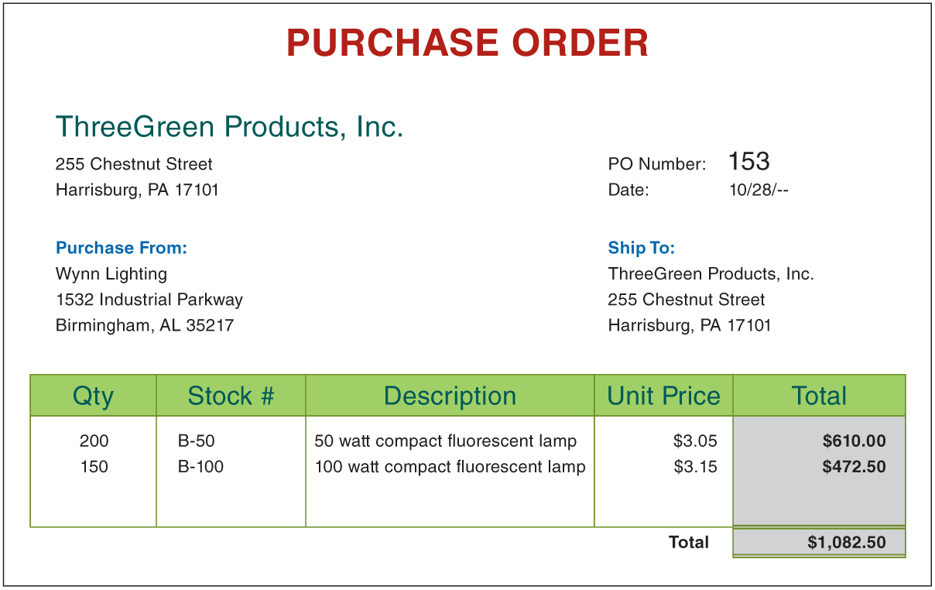
Ordering Merchandise
Lesson 9-2
LO4
SLIDE 7

Slide 8
Using Special Journals
Lesson 9-2
LO5
A journal used to record only one kind of transaction is called a special journal.
Businesses typically use five journals:
Purchases journal—for all purchases of merchandise on account
Cash payments journal—for all cash payments
Sales journal—for all sales of merchandise on account
Cash receipts journal—for all cash receipts
General journal—for all other transactions
SLIDE 8

Slide 9
Purchases Journal
Lesson 9-2
LO6
A transaction in which the items purchased are to be paid for later is called a purchase on account.
A purchases journal is a special journal used to record only purchases of merchandise on account.
A journal amount column headed with an account title is called a special amount column.
SLIDE 9

Slide 10
Purchases Journal
Lesson 9-2
LO6
SLIDE 10

Slide 11
Purchase Invoice
Lesson 9-2
LO6
An invoice used as a source document for recording a purchase on account transaction is called a purchase invoice.
An agreement between a buyer and a seller about payment for merchandise is called the terms of sale.
The date by which an invoice must be paid is called the due date.
SLIDE 11

Slide 12
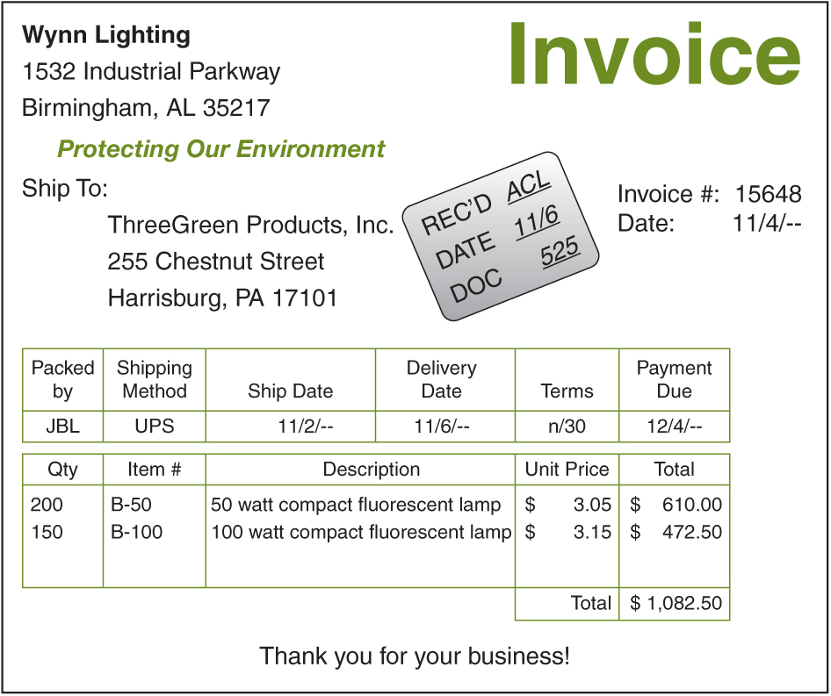
Purchase Invoice
Lesson 9-2
LO6
1. Record the initials of the employee processing the invoice, date received, and the purchase invoice number in the stamp.
1
2. Place a check mark by each of the amounts in the Total column to show that the items have been received and that amounts have been checked and are correct.
3
✓
✓
✓
3. Review the vendor’s terms and the payment due date.
2
SLIDE 12

Slide 13
Purchasing Merchandise on Account
Lesson 9-2
LO6
Purchases
November 6. Purchased merchandise on account from Wynn Lighting, $1,082.50. Purchase Invoice No. 525.
1,082.50
Accounts Payable
1,082.50
1
Date
2
Vendor Name
3
Purchase Invoice Number
4
Amount
1. Write the date in the Date column.
2. Write the vendor account title in the Account Credited column.
3. Write the purchase invoice number in the Purch. No. column.
4. Write the amount of the invoice in the special amount column.
SLIDE 13

Slide 14
Lesson 9-2 Audit Your Understanding
Lesson 9-2
1. What is the difference between a periodic inventory system and a perpetual inventory system?
ANSWER
With a periodic inventory system, the value of the inventory is determined by a physical count. With a perpetual inventory system, the value of the inventory on hand is determined by a continuous record of increases and decreases.
SLIDE 14

Slide 15
Lesson 9-2 Audit Your Understanding
Lesson 9-2
2. When the perpetual inventory system is used, in what account are purchases recorded? In what account are purchases recorded when the periodic inventory system is used?
ANSWER
In a perpetual inventory system, purchases are recorded in the Merchandise Inventory account. In a periodic inventory system, purchases are recorded in the Purchases account.
SLIDE 15

Slide 16
Lesson 9-2 Audit Your Understanding
Lesson 9-2
3. Identify the four special journals typically used by a business.
ANSWER
Purchases journal, cash payments journal, sales journal, cash receipts journal
SLIDE 16

Slide 17
Lesson 9-2 Audit Your Understanding
Lesson 9-2
4. How are special amount columns used in a journal?
ANSWER
Special amount columns are used for frequently occurring transactions.
SLIDE 17

Slide 18
Lesson 9-2 Audit Your Understanding
Lesson 9-2
5. Why are there two account titles in the amount column of the purchases journal?
ANSWER
All transactions for purchasing merchandise on account involve a debit to Purchases and a credit to Accounts Payable.
SLIDE 18

Slide 19
Lesson 9-2 Audit Your Understanding
Lesson 9-2
6. What is the advantage of having special amount columns in a journal?
ANSWER
Using special amount columns eliminates writing general ledger account titles in the Account Title column, which saves time and helps to reduce mistakes.
SLIDE 19

Slide 20
Lesson 9-2 Audit Your Understanding
Lesson 9-2
7. What information is contained on a purchase invoice?
ANSWER
A purchase invoice lists the vendor name and address; the date; the quantity, description, and price of each item; and the total amount of the purchase.
SLIDE 20

