Slide 1
LESSON 9-3 Posting from a Purchases Journal
Learning Objectives
LO7 Post merchandise purchases to an accounts payable ledger and a general ledger.

Slide 2
Posting from a Purchases Journal to an Accounts Payable Ledger
Lesson 9-3
LO7
1
2
3
5
4
1. Write the date in the Date column of the vendor account.
2. Write the journal page number in the Post. Ref. column of the account.
3. Write the credit amount in the Credit column of the vendor account.
4. Add the amount in the Credit column to the previous balance in the Credit Balance column and write the new account balance in the Credit Balance column.
5. Write the vendor number in the Post. Ref. column of the journal.
SLIDE 2

Slide 3
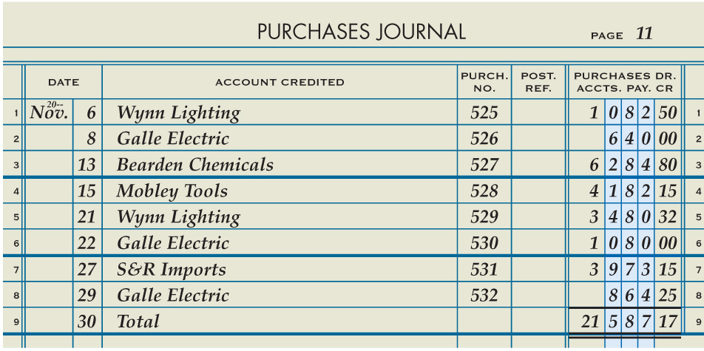
Totaling and Ruling a Purchases Journal
Lesson 9-3
LO7
5
Total Amount
2
Date
3
Total
Single Rule
4
Total Column
Double Rule
1
6
SLIDE 3

Slide 4
Posting the Total of a Purchases Journal to a General Ledger
Lesson 9-3
LO7
1
2
3
5
Account Number
4
5
Journal Number
Account Balance
1
Date
2
3
Debit or Credit
4
SLIDE 4

Slide 5
Lesson 9-3 Audit Your Understanding
Lesson 9-3
1. Why should a business frequently post from the purchases journal to the accounts payable ledger?
ANSWER
Posting frequently to the accounts payable ledger helps ensure that vendor accounts are paid on time and that the business can continue purchasing goods and services on account.
SLIDE 5

Slide 6
Lesson 9-3 Audit Your Understanding
Lesson 9-3
2. Why is it important to record a posting reference in the accounts payable ledger?
ANSWER
It provides an audit trail that allows an employee to trace the transaction back to the journal and page number.
SLIDE 6

Slide 7
Lesson 9-3 Audit Your Understanding
Lesson 9-3
3. Why is the vendor number written in the Post. Ref. column of the purchases journal?
ANSWER
To provide an audit trail to the account where the transaction was posted
SLIDE 7

