Slide 1
LESSON 10-2 Posting from a Sales Journal
Learning Objectives
LO3 Post sales on account to an accounts receivable ledger and a general ledger.

Slide 2
Posting from a Sales Journal to an Accounts Receivable Ledger
Lesson 10-2
LO3
2
1
3
5
4
1. Write the date in the Date column of the vendor account.
2. Write the sales journal page number in the Post. Ref. column of the account.
3. Write the debit amount in the Debit column of the customer account.
4. Add the amount in the Debit column to the previous balance in the Debit Balance column and write the new account balance in the Debit Balance column.
5. Write the customer number in the Post. Ref. column of the sales journal.
SLIDE 2

Slide 3
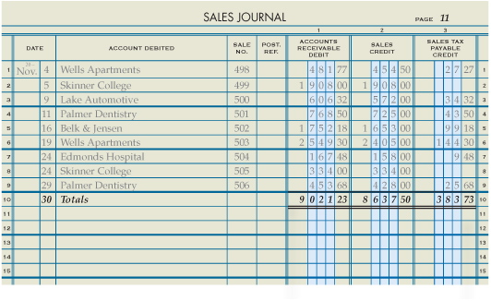
Totaling, Proving, and Ruling a Sales Journal
Lesson 10-2
LO3
2
Date
3
“Totals”
Single Rule
Double Rule
1
Column Totals
4
5
SLIDE 3

Slide 4
Posting Totals of a Sales Journal to a General Ledger
Lesson 10-2
LO3
Date
Journal Number
Debit or Credit
Account Number
1
2
3
5
4
Account Balance
5
1
2
3
4
5
1
2
3
4
SLIDE 4

Slide 5
Lesson 10-2 Audit Your Understanding
Lesson 10-2
1. What accounts are impacted, and how, by the posting of the special columns of a sales journal?
ANSWER
1. Accounts Receivable is debited.
2. Sales is credited.
3. Sales Tax Payable is credited.
SLIDE 5

Slide 6
Lesson 10-2 Audit Your Understanding
Lesson 10-2
2. List the five steps for posting transactions to accounts receivable ledger forms.
ANSWER
1. Write the date.
2. Write the sales journal page number in the Post. Ref. column of the ledger account.
3. Enter the debit and credit amounts.
4. Calculate and record the new account balance.
5. Write the customer account number in the Post. Ref. column of the sales journal.
SLIDE 6

