Slide 1
LESSON 10-3 Accounting for Cash and Credit Card Sales
Learning Objectives
LO4 Record cash and credit card sales using a cash receipts journal.
LO5 Journalize cash receipts on account using a cash receipts journal.

Slide 2
Processing Sales Transactions
Lesson 10-3
LO4
A sale in which the customer pays for the total amount of the sale at the time of the transaction is called a cash sale.
Credit card and debit card sales are treated as cash sales because the business receives its cash in a very short time.
A specialized computer used to collect, store, and report all the information about a sales transaction is called a point-of-sale (POS) terminal.
The report that summarizes the cash and credit card sales of a point-of-sale terminal is called a terminal summary.
SLIDE 2

Slide 3
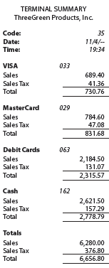
Terminal Summary
Lesson 10-3
LO4
SLIDE 3

Slide 4
Processing Credit Cards
Lesson 10-3
LO4
Sales information for credit card sales is stored in the POS terminals.
A report of credit card sales produced by a point-of-sale terminal is called a batch report.
A batch report can be detailed, showing every credit card sale.
Or, the batch report can be a summary, showing only the number and total of sales by credit card type.
The process of preparing a batch report from a point-of-sale terminal is called batching out.
SLIDE 4

Slide 5
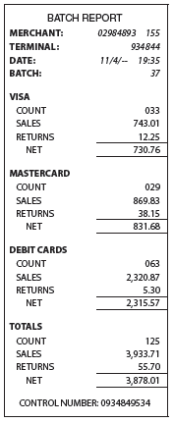
Batch Report
Lesson 10-3
LO4
SLIDE 5

Slide 6
Cash Receipts Journal
Lesson 10-3
LO4
A cash receipts journal is a special journal used to record only cash receipt transactions.
A cash discount on a sale taken by the customer is called a sales discount.
SLIDE 6

Slide 7
Cash and Credit Card Sales
Lesson 10-3
LO4
November 4. Recorded cash and credit card sales, $6,280.00, plus sales tax, $376.80; total, $6,656.80. Terminal Summary 35.
Cash
6,656.80
Sales
6,280.00
Date
Terminal Summary Number
Sales Tax Payable
1
3
376.80
2
4
5
6
7
Check Mark
Check Mark
Sales
Sales Tax Payable
Cash
SLIDE 7

Slide 8
Cash Receipts on Account
Lesson 10-3
LO5
Cash
November 4. Received cash on account from Edmonds Hospital, $2,516.80, covering S448. Receipt No. 610.
2,516.80
Accounts Payable
2,516.80
2
Customer’s Name
1
Date
3
Receipt Number
4
Sales Invoice Amount
Cash Received
5
SLIDE 8

Slide 9
Calculating Cash Receipts on Account with Sales Discount
Lesson 10-3
LO5
Sales
Invoice
Amount
Sales Discount Rate
Sales Discount
×
=
$1,450.00
×
2%
=
$29.00
SLIDE 9

Slide 10
Journalizing Cash Receipts on Account with Sales Discounts
Lesson 10-3
LO5
Cash
November 5. Received cash on account from Palmer Dentistry, $1,421.00, covering Sales Invoice No. 462 for $1,450.00, less 2% discount, $29.00. Receipt No. 611.
1,421.80
Accounts Receivable
1,450.00
Sales Discount
29.00
2
Customer’s Name
4
Original Sales Amount
1
Date
3
Receipt Number
Sales Discount
5
6
Cash Received
SLIDE 10

Slide 11
Lesson 10-3 Audit Your Understanding
Lesson 10-3
1. How does a POS terminal determine the price of an item?
ANSWER
Before any sale is entered, the number, description, price, and quantity on hand of each item of merchandise are stored in the POS terminal.
SLIDE 11

Slide 12
Lesson 10-3 Audit Your Understanding
Lesson 10-3
2. What are the two types of batch reports?
ANSWER
A batch report can be detailed, showing each credit card sale, or a summary of the number and total of sales by credit card type.
SLIDE 12

Slide 13
Lesson 10-3 Audit Your Understanding
Lesson 10-3
3. What is meant by 2/10, n/30 credit terms?
ANSWER
If a customer pays the amount owed within 10 days, the sales invoice amount is reduced 2%. Otherwise, the net amount is due in 30 days.
SLIDE 13

