Slide 1
LESSON 10-4 Posting from a Cash Receipts Journal
Learning Objectives
LO6 Post cash receipts to an accounts receivable ledger and a general ledger.
LO7 Prepare a schedule of accounts receivable.

Slide 2
Posting from a Cash Receipts Journal to an Accounts Receivable Ledger
Lesson 10-4
LO6
Journal Page Number
2
Date
1
Credit
3
5
Customer Number
Account Balance
4
SLIDE 2

Slide 3
Totaling, Proving, and Ruling a Cash Receipts Journal
Lesson 10-4
LO6
Column Title | Debit Totals | Credit Totals
General Debit ………………........ | ―
General Credit …………………….. |  | ―
Accounts Receivable Credit …. |  | $11,641.30
Sales Credit ………………..... ...... |  | 43,119.33
Sales Tax Payable Credit……... |  | 2,381.46
Sales Discount Debit....…........ | $ 72.25
Cash Debit……………….............. | 57,069.84
Totals………………...................... | $57,142.09 | $57,142.09
SLIDE 3

Slide 4
Proving Cash at the End of a Month
Lesson 10-4
LO6
Cash on hand at the beginning of the month ...................... $18,941.69
(Nov. 1 balance of general ledger cash account)
Plus total cash received during the month ........................... 57,069.84 (Cash Debit column total, cash receipts journal)
Equals total ............................................................................. $76,011.53
Less total cash paid during the month .................................. 23,546.38
(Cash Credit column total, cash payments journal)
Equals cash balance on hand at the end of the month ......... $52,465.15
Checkbook balance on the next unused check stub ............. $52,465.15
SLIDE 4

Slide 5
Posting Special Amount Column Totals of a Cash Receipts Journal to a General Ledger
Lesson 10-4
LO6
2
Journal Number
Date
1
Debit or Credit
3
5
Account Number
4
Account Balance
5
5
5
1
2
3
4
1
1
2
2
3
3
4
4
SLIDE 5

Slide 6
Completed Accounts Receivable Ledger
Lesson 10-4
LO6
SLIDE 6

Slide 7
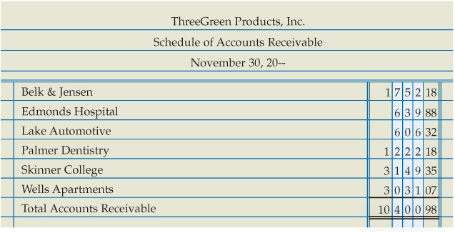
Proving the Accounts Receivable Ledger
Lesson 10-4
LO7
A listing of customer accounts, account balances, and total amount due from all customers is called a schedule of accounts receivable.
Some businesses call the listing the accounts receivable trial balance.
SLIDE 7

Slide 8
Lesson 10-4 Audit Your Understanding
Lesson 10-4
1. From which column of the cash receipts journal are amounts posted individually to the accounts receivable ledger?
ANSWER
Accounts Receivable Credit column
SLIDE 8

Slide 9
Lesson 10-4 Audit Your Understanding
Lesson 10-4
2. What is another name for the schedule of accounts receivable?
ANSWER
Accounts receivable trial balance
SLIDE 9

