Slide 1
LESSON 11-1 Accounting for Purchases Transactions Using a General Journal
Learning Objectives
LO1 Explain the purpose of a general journal.
LO2 Account for purchases returns and allowances.
LO3 Post a general journal to the accounts payable ledger and general ledger.

Slide 2
General Journal
Lesson 11-1
LO1
A journal with two amount columns in which all kinds of entries can be recorded is called a general journal.
Not every transaction can be recorded in a special journal.
SLIDE 2

Slide 3
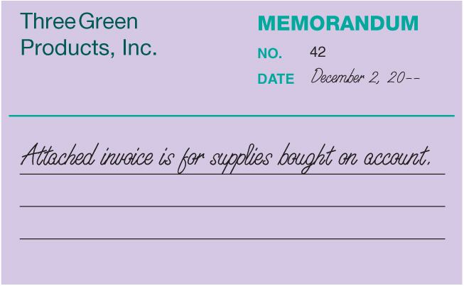
Memorandum for Buying Supplies on Account
Lesson 11-1
LO1
SLIDE 3

Slide 4
Buying Supplies on Account
Lesson 11-1
LO1
Supplies—Store
December 2. Bought store supplies on account from Estes Supply, $165.25. Memorandum No. 42.
165.25
Accounts Payable
165.25
1
Date
2
Account Title
3
Memorandum Number
5
Account Title and Vendor Name
Diagonal Line
6
4
Debit Amount
7
Credit Amount
SLIDE 4

Slide 5
Debit Memorandum for Purchases Returns and Allowances
Lesson 11-1
LO2
Credit allowed for the purchase price of returned merchandise, resulting in a decrease in the customer’s account payable to the vendor, is called a purchases return.
Credit allowed for part of the purchase price of merchandise that is not returned, resulting in a decrease in the customer’s account payable to the vendor, is called a purchases allowance.
A form prepared by the customer showing the price deduction taken by the customer for a return or an allowance is called a debit memorandum.
SLIDE 5

Slide 6
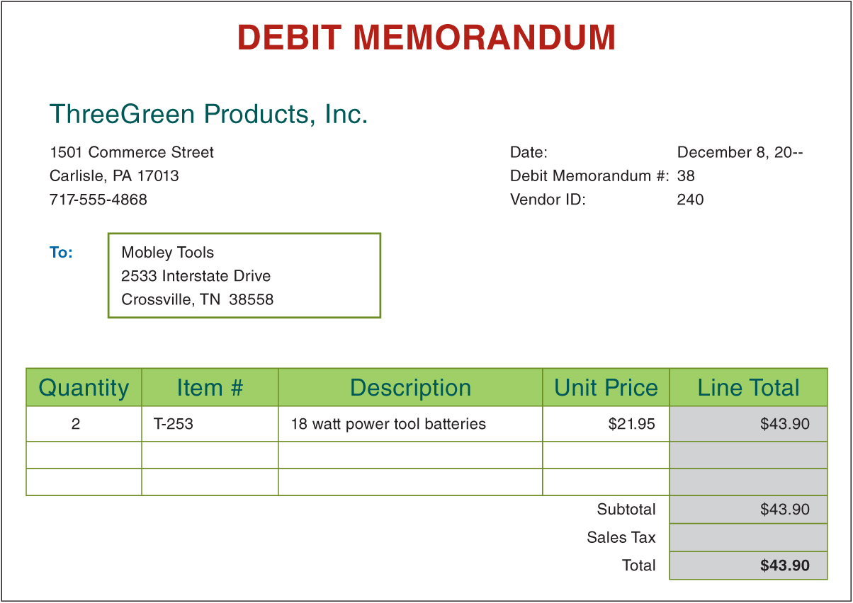
Debit Memorandum for Purchases Returns and Allowances
Lesson 11-1
LO2
SLIDE 6

Slide 7
Journalizing Purchases Returns and Allowances
Lesson 11-1
LO2
Accounts Payable
December 8. Returned merchandise to Mobley Tools, $43.90, covering Purchase Invoice No. 528. Debit Memorandum No. 38.
43.90
Purchases Returns and Allowances
43.90
1
Date
2
Account Title and Vendor Name
Debit Memorandum Number
3
6
Account Title
Diagonal Line
4
5
Debit Amount
7
Credit Amount
SLIDE 7

Slide 8
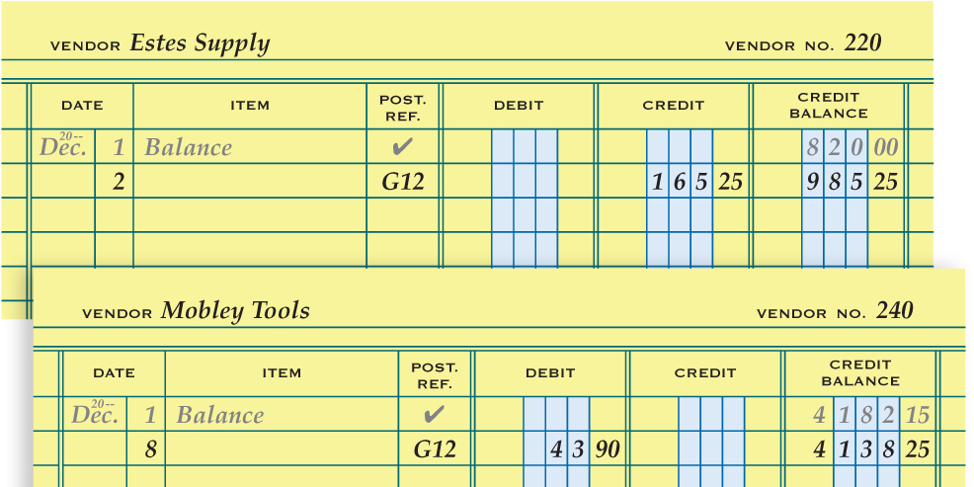
Posting from a General Journal to an Accounts Payable Ledger
Lesson 11-1
LO3
1
Date
Vendor Number
5
3
Debit or Credit Amounts
Journal Page Number
2
4
Account Balance
5
1
2
3
4
SLIDE 8

Slide 9
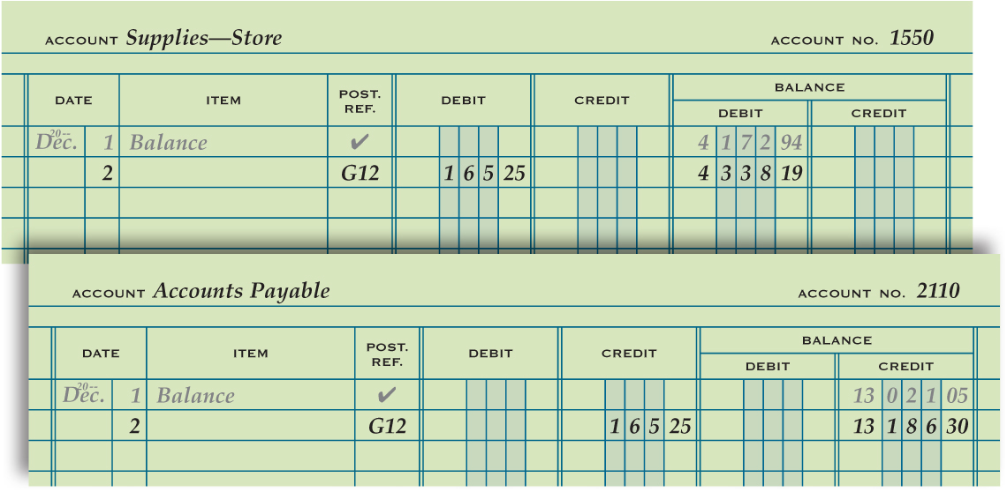
Posting from a General Journal to a General Ledger
Lesson 11-1
LO3
2
Journal Page Number
Date
1
Debit or Credit Amounts
Vendor Number
3
5
4
Account Balance
5
1
2
3
4
SLIDE 9

Slide 10
Lesson 11-1 Audit Your Understanding
Lesson 11-1
1. When is a transaction recorded in a general journal?
ANSWER
When the transaction cannot be recorded in special journal
SLIDE 10

Slide 11
Lesson 11-1 Audit Your Understanding
Lesson 11-1
2. When is the equality of debits and credits proved for a general journal?
ANSWER
After each general journal entry is recorded
SLIDE 11

Slide 12
Lesson 11-1 Audit Your Understanding
Lesson 11-1
3. What is a primary difference between a purchases return and a purchases allowance?
ANSWER
A purchases return is credit allowed for the purchase price of returned merchandise. A purchases allowance is credit allowed for part of the purchase price of merchandise that is not returned, such as for units that are damaged but still usable or of a different quality than that ordered.
SLIDE 12

Slide 13
Lesson 11-1 Audit Your Understanding
Lesson 11-1
4. If purchases returns and allowances decrease the value of Purchases,, why are returns and allowances credited to a separate account?
ANSWER
Better information is provided if purchases returns and allowances are credited to a separate account. A business can then track the amount of purchases returns and allowances in a fiscal period to evaluate the efficiency of its purchasing activities.
SLIDE 13

