Slide 1
LESSON 14-3 Promissory Notes
Learning Objectives
LO6 Record the acceptance of a note receivable.
LO7 Account for the collection of a note receivable.
LO8 Account for a dishonored note receivable.

Slide 2
Understanding Promissory Notes
Lesson 14-3
A written and signed promise to pay a sum of money at a specified time is called a promissory note.
A person or business to whom a liability is owed is called a creditor.
A promissory note signed by a business and given to a creditor is entered in the businesses books as a note payable.
A promissory note that a business accepts from a customer is entered in the business’s books as a note receivable.
Notes payable and notes receivable are frequently referred to simply as notes.
The person or business that signs a note, and thus promises to make payment, is called the maker of a note.
Continued on the next slide.
SLIDE 2

Slide 3
Understanding Promissory Notes
Lesson 14-3
The person or business to whom the amount of a note is payable is called the payee.
The original amount of a note, sometimes referred to as the face amount, is called the principal.
The percent of the principal that is due for the use of the funds secured by a note is called the interest rate.
The date on which the principal of a note is due to be repaid is called the maturity date.
The length of time from the signing date to the maturity date, usually expressed as the number of days, may be referred to as the time of a note, or term.
SLIDE 3

Slide 4
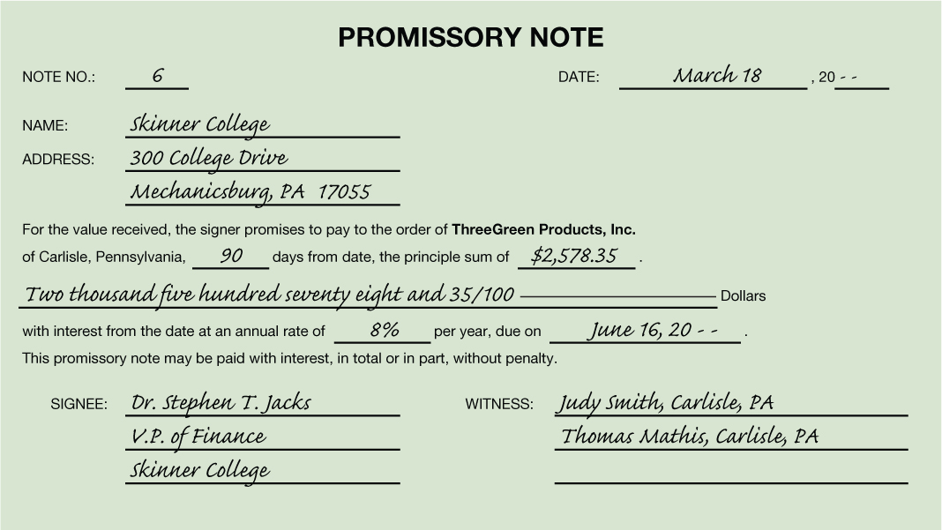
Understanding Promissory Notes
Lesson 14-3
Number Assigned to the Note
Date the Note Is Signed
Time of the Note
Payee
Principal
Maturity Date
Interest Rate
Maker of the Note
Witness
SLIDE 4

Slide 5
Accepting a Note Receivable from a Customer
Lesson 14-3
LO6
March 18. Accepted a 90-day, 8% note from Skinner College for an extension of time on its account, $2,578.35. Note Receivable No. 6.
GENERAL LEDGER
Notes Receivable
Mar. 18 2,578.35
Accounts Receivable
Bal. 20,486.25
(New Bal. 17,907.90)
Mar. 18 2,578.35
ACCOUNTS RECEIVABLE LEDGER
Skinner College
Bal. 2,578.35
(New Bal. 0.00)
Mar. 18 2,578.35
SLIDE 5

Slide 6
Accepting a Note Receivable from a Customer
Lesson 14-3
LO6
March 18. Accepted a 90-day, 8% note from Skinner College for an extension of time on its account, $2,578.35. Note Receivable No. 6.
2
Account Title
Note Receivable Number
4
Debit Amount
3
Date
1
5
Account Title and Customer Name
Diagonal Line
Credit Amount
6
7
SLIDE 6

Slide 7
Interest on Promissory Notes
Lesson 14-3
LO7
An amount paid for the use of money for a period of time is called interest.
Principal | × | Annual Interest Rate | × | Time as Fraction of a Year | = | Interest for Fraction of Year
$2,578.35 | × | 8% | × | 90/360 | = | $51.57
The amount that is due on the maturity date of a note is called the maturity value.
Principal | + | Interest | = | Maturity Value
$2,578.35 | + | $51.57 | = | $2,629.92
SLIDE 7

Slide 8
Maturity Date of Promissory Notes
Lesson 14-3
LO7
Number of days of the first month
Days remaining after this month
1
2
 | Days from the Month | Days Remaining
Term of the Note |  | 90
March 18–March 31 | 13 | 77
April | 30 | 47
May | 31 | 16
June 1–June 16 | 16 | 0
4
Days remaining for the last month
Lesser of the days of the month and the days remaining after the previous month
3
SLIDE 8

Slide 9
Collecting Principal and Interest on a Note Receivable
Lesson 14-3
LO7
When a note receivable reaches its maturity date, the maker of the note is expected to pay the maturity value to the payee.
The interest earned on money loaned is called interest income.
The interest earned on a note receivable is credited to a revenue account titled Interest Income.
SLIDE 9

Slide 10
Collecting Principal and Interest on a Note Receivable
Lesson 14-3
LO7
June 16. Received cash for the maturity value of Note Receivable No. 6, a 90-day, 8% note: principal, $2,578.35, plus interest, $51.57; total, $2,629.92. Receipt No. 782.
Cash
Mar. 18 2,629.92
Notes Receivable
Mar. 18 2,578.35
(New Bal. 0.00)
June 16 2,578.35
Interest Income
June 16 51.57
SLIDE 10

Slide 11
Collecting Principal and Interest on a Note Receivable
Lesson 14-3
LO7
June 16. Received cash for the maturity value of Note Receivable No. 6, a 90-day, 8% note: principal, $2,578.35, plus interest, $51.57; total, $2,629.92. Receipt No. 782.
Account Title
2
3
Receipt Number
4
Principal Amount
Date
1
5
Account Title
6
Interest Amount
Credit Amount
7
SLIDE 11

Slide 12
Recording a Dishonored Note Receivable
Lesson 14-3
LO8
A note that is not paid when due is called a dishonored note.
SLIDE 12

Slide 13
Recording a Dishonored Note Receivable
Lesson 14-3
LO8
June 3. Stout Company dishonored Note Receivable No. 4, a 60-day, 8% note, maturity value due today: principal, $3,000.00; interest, $40.00; total, $3,040.00. Memorandum No. 98.
GENERAL LEDGER
Accounts Receivable
June 3 3,040.00
Notes Receivable
Apr. 4 3,000.00
(New Bal. 17,907.90)
June 3 3,000.00
Notes Receivable
June 3 40.00
ACCOUNTS RECEIVABLE LEDGER
Stout Company
June 3 3,040.00
SLIDE 13

Slide 14
Recording a Dishonored Note Receivable
Lesson 14-3
LO8
June 3. Stout Company dishonored Note Receivable No. 4, a 60-day, 8% note, maturity value due today: principal, $3,000.00; interest, $40.00; total, $3,040.00. Memorandum No. 98.
Account Title, Customer
Name, and Amount
2
Memorandum Number
4
Diagonal Line
3
Date
1
5
Account Title and Principal Amount
6
Account Title and Income Amount
SLIDE 14

Slide 15
Lesson 14-3 Audit Your Understanding
Lesson 14-3
1. What conditions might cause a business to delay payment to a vendor?
ANSWER
The receipt of cash from sales does not occur at the same time and in amounts sufficient to pay for needed purchases and expenses.
SLIDE 15

Slide 16
Lesson 14-3 Audit Your Understanding
Lesson 14-3
2. What is the advantage of a promissory note over an account receivable?
ANSWER
A note can be useful in a court of law as written evidence of a debt.
SLIDE 16

Slide 17
Lesson 14-3 Audit Your Understanding
Lesson 14-3
3. What does an interest rate of 10% mean?
ANSWER
Ten cents will be paid for the use of each dollar borrowed for a full year.
SLIDE 17

Slide 18
Lesson 14-3 Audit Your Understanding
Lesson 14-3
4. What is written in a customer’s account when (1) a note is accepted and (2) a note is dishonored?
ANSWER
The words (1) Accepted note and (2) Dishonored note are written in the Item column of the customer’s account.
SLIDE 18

