Slide 1
LESSON 15-4 Calculating Federal Income Tax
Learning Objectives
LO7 Post adjusting entries.
LO8 Adjust federal income tax payable.
LO9 Prepare an adjusted trial balance.

Slide 2
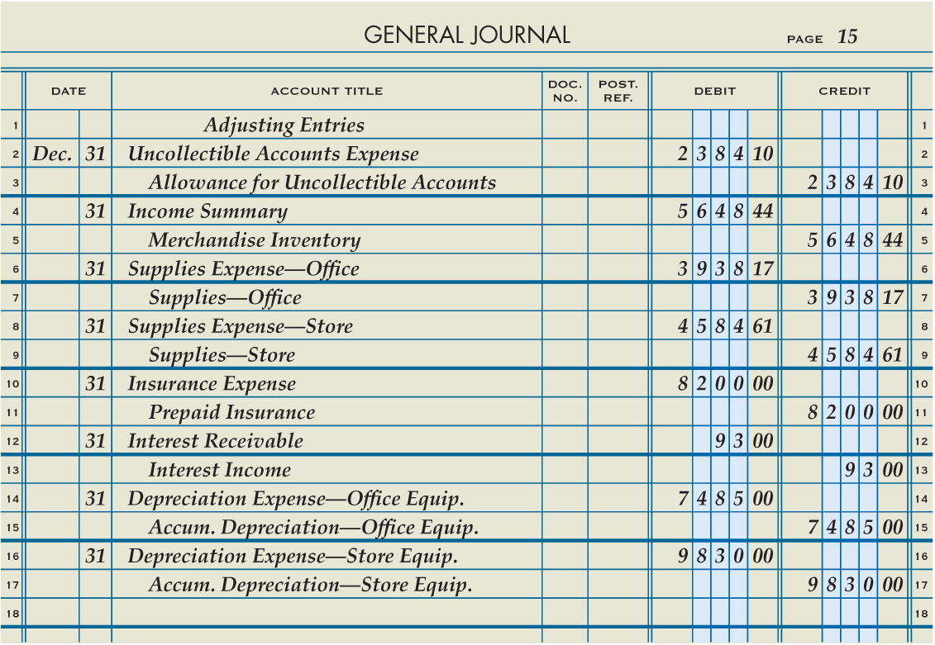
Adjusting Entries
Lesson 15-4
LO7
SLIDE 2

Slide 3
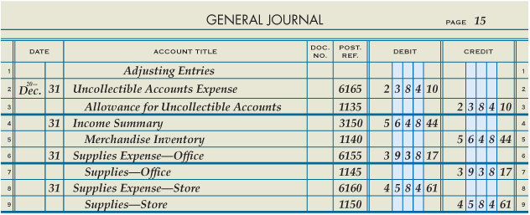
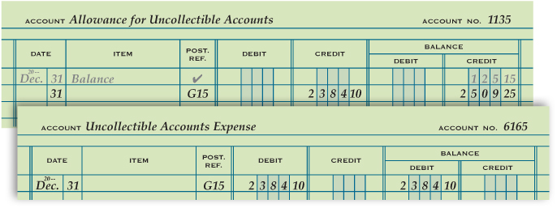
Posting Adjusting Entries
Lesson 15-4
LO7
3
Enter general ledger account numbers in general journal
Post the debit
1
2
Post the credit
3
SLIDE 3

Slide 4
Calculating Income Before Federal Income Taxes
Lesson 15-4
LO8
A trial balance prepared after adjusting entries are posted is called an adjusted trial balance.
SLIDE 4

Slide 5
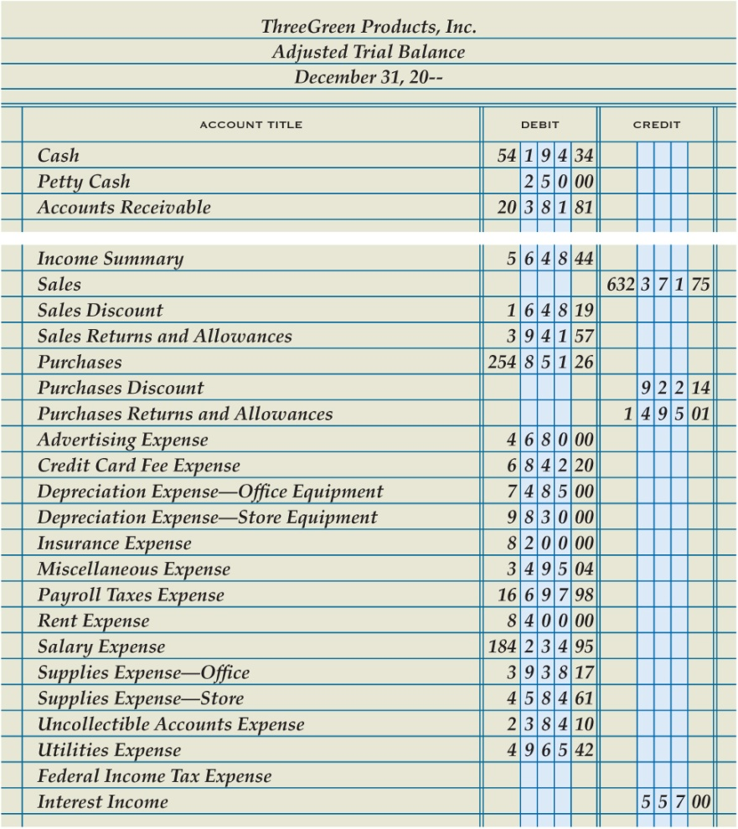
Calculating Income Before Federal Income Taxes
Lesson 15-4
LO8
1. Enter the account titles of all general ledger accounts.
1
2
2. Enter the account balances of all accounts except Federal Income Tax Expense.
3. Calculate the total account balances of income statement credit accounts. Include the account balance of Income Summary if the account has a credit balance.
4. Calculate the total account balances of income statement debit accounts, excluding the balance of Federal Income Tax Expense. Include the account balance of Income Summary if the account has a debit balance.
5. Subtract the total of debits from the total of credits to calculate net income before federal income taxes.
3
4
5
$635,345.90
−
$531,826.93
=
$103,518.97
SLIDE 5

Slide 6
Calculating Federal Income Tax
Lesson 15-4
LO8
Different tax rates are applied to different levels of net income.
Each tax rate and taxable income amount on one line of a tax table is called a tax bracket.
The tax rate associated with a tax bracket is called a marginal tax rate.
SLIDE 6

Slide 7
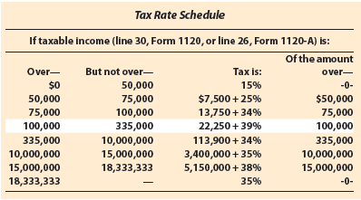
Calculating Federal Income Tax
Lesson 15-4
LO8
Net Income before Federal Income Taxes | − | Of the Amount Over | = | Net Income Subject to Marginal Tax Rate | × | Marginal Tax Rate | = | Marginal Income Tax
$103,518.97 | − | $100,000.00 | = | $3,518.97 | × | 39% | = | $1,372.40
Bracket Minimum Income Tax | + | Marginal Income Tax | = | Federal Income Tax
$22,250.00 | + | $1,372.40 | = | $22,622.40
SLIDE 7

Slide 8
Journalizing the Adjusting Entry for Federal Income Tax Payable
Lesson 15-4
LO8
Federal Income Tax Expense
4/15 5,000.00
6/15 5,000.00
9/15 5,000.00
12/15 5,000.00
12/31 Adj. 3,622.40
(Adj. Bal. 23,622.40)
Federal Income Tax Payable
12/31 Adj. 3,622.40
SLIDE 8

Slide 9
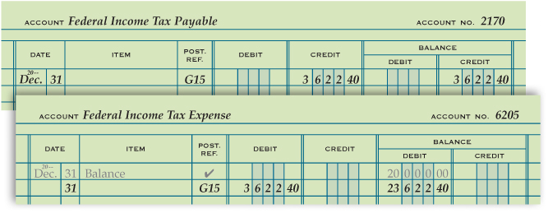
Journalizing the Adjusting Entry for Federal Income Tax Payable
Lesson 15-4
LO8
1
Debit Federal Income Tax Expense
Enter general ledger account numbers in the general journal
3
2
Credit Federal Income Tax Payable
Post the debit to the general ledger
Post the credit to the general ledger
3
3
3
SLIDE 9

Slide 10
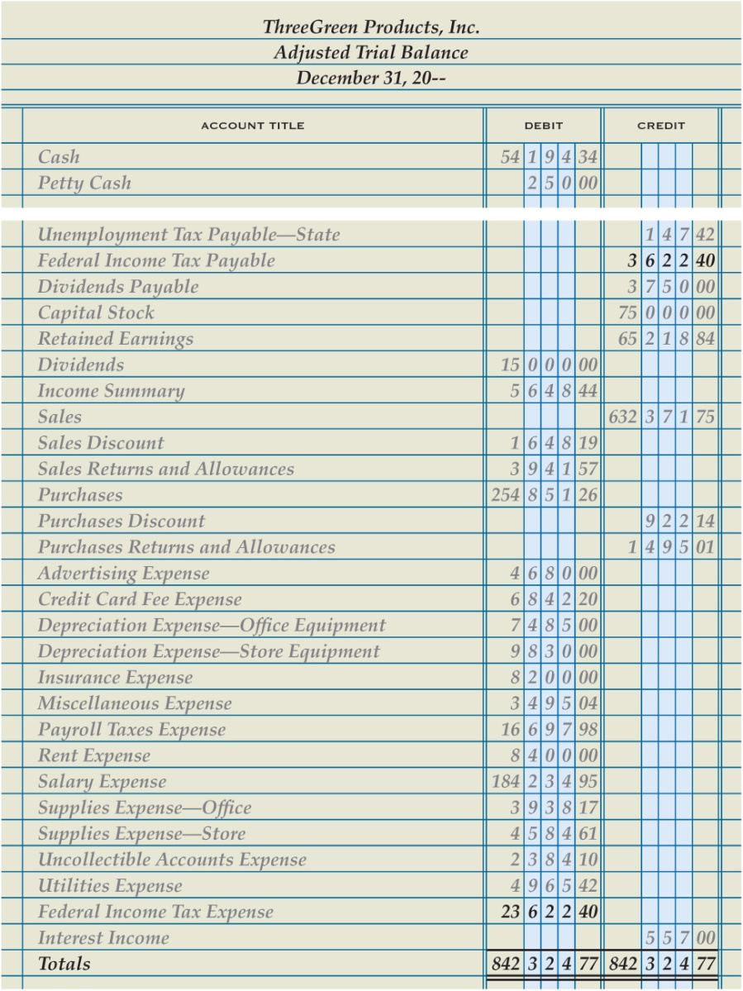
Completing an Adjusted Trial Balance
Lesson 15-4
LO9
1
Enter the adjusted balance of Federal Income Tax Payable
2
Update balance of Federal Income Tax Expense
3
Total, prove, and rule the trial balance
SLIDE 10

Slide 11
Lesson 15-4 Audit Your Understanding
Lesson 15-4
1. How does the trial balance serve as a check list for preparing adjusting entries?
ANSWER
A business can examine each account to determine if the account needs adjustment.
SLIDE 11

Slide 12
Lesson 15-4 Audit Your Understanding
Lesson 15-4
2. In what order can the adjusting entries be journalized?
ANSWER
By the order the accounts appear in the trial balance, beginning with assets or revenue
SLIDE 12

Slide 13
Lesson 15-4 Audit Your Understanding
Lesson 15-4
3. Which accounts are totaled to determine net income before federal income taxes?
ANSWER
All income statement debit accounts, excluding federal income tax expense, and all income statement credit accounts
SLIDE 13

Slide 14
Lesson 15-4 Audit Your Understanding
Lesson 15-4
4. What is the bracket minimum tax and marginal tax rate of the 25% tax bracket?
ANSWER
Bracket minimum tax, $7,500.00
Marginal tax rate, 25%
SLIDE 14

