Slide 1
LESSON 16-2 Preparing a Statement of Stockholders’ Equity
Learning Objectives
LO2 Prepare a statement of stockholders’ equity.

Slide 2
Stockholders’ Equity Information
Lesson 16-2
LO2
A financial statement that shows changes in a corporation’s ownership for a fiscal period is called a statement of stockholders’ equity.
SLIDE 2

Slide 3
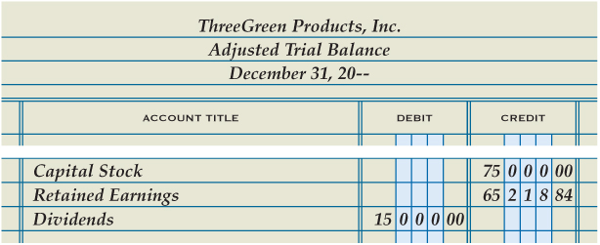
Stockholders’ Equity Information
Lesson 16-2
LO2
SLIDE 3

Slide 4
Capital Stock Section of the Statement of Stockholders’ Equity
Lesson 16-2
LO2
A value assigned to a share of stock and printed on the stock certificate is called par value.
When issuing shares of stock, a corporation can assign any par value allowed by laws in the state in which it incorporates.
SLIDE 4

Slide 5
Capital Stock Section of the Statement of Stockholders’ Equity
Lesson 16-2
LO2
2
Capital Stock Section
1
Heading
Stock Issued during the Year
4
3
Stock at Beginning of Year
5
Total Stock Issued
SLIDE 5

Slide 6
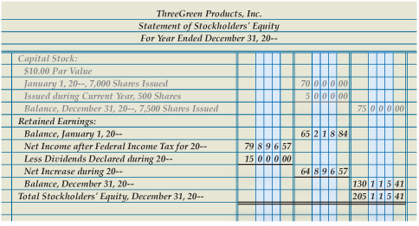
Retained Earnings Section of the Statement of Stockholders’ Equity
Lesson 16-2
LO2
Retained Earnings Section
Net Income after Federal Income Tax
1
3
Beginning Balance
2
Increase in Retained Earnings
5
Dividends Declared
Ending Balance
Total Stockholders’ Equity
4
6
7
SLIDE 6

Slide 7
Lesson 16-2 Audit Your Understanding
Lesson 16-2
1. What financial information does a statement of stockholders’ equity report?
ANSWER
The changes in a corporation’s ownership for a fiscal period
SLIDE 7

Slide 8
Lesson 16-2 Audit Your Understanding
Lesson 16-2
2. What are the two major sections of a statement of stockholders’ equity?
ANSWER
Capital Stock and Retained Earnings
SLIDE 8

Slide 9
Lesson 16-2 Audit Your Understanding
Lesson 16-2
3. Where is the information found to prepare the Capital Stock section of a statement of stockholders’ equity?
ANSWER
In the Capital Stock general ledger account
SLIDE 9

Slide 10
Lesson 16-2 Audit Your Understanding
Lesson 16-2
4. Where is the beginning balance of retained earnings found?
ANSWER
The Retained Earnings amount on the unadjusted trial balance
SLIDE 10

Slide 11
Lesson 16-2 Audit Your Understanding
Lesson 16-2
5. When issuing shares of stock, what par value can a corporation assign to each share?
ANSWER
A corporation can assign any par value allowed by laws in the state in which it incorporates.
SLIDE 11

Slide 12
Lesson 16-2 Audit Your Understanding
Lesson 16-2
6. Where is net income after federal income taxes found?
ANSWER
The income statement
SLIDE 12

