Slide 1
LESSON 16-3 Preparing a Balance Sheet
Learning Objectives
LO3 Prepare a balance sheet for a business organized as a corporation.

Slide 2
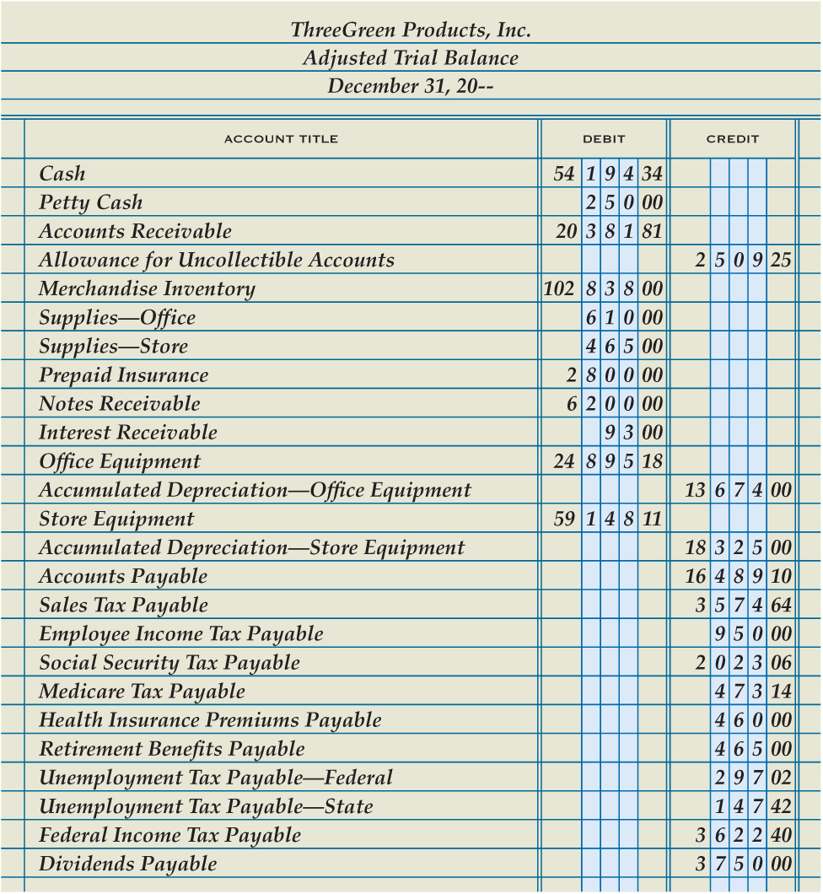
Balance Sheet Information on a Trial Balance
Lesson 16-3
LO3
SLIDE 2

Slide 3
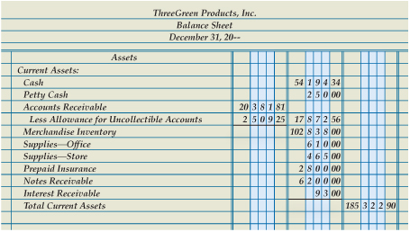
Current Assets Section of a Balance Sheet
Lesson 16-3
LO3
2
Current Assets Section
1
Heading
Book Value of Accounts Receivable
3
4
Remaining Current Asset Accounts
Total Current Assets
5
SLIDE 3

Slide 4
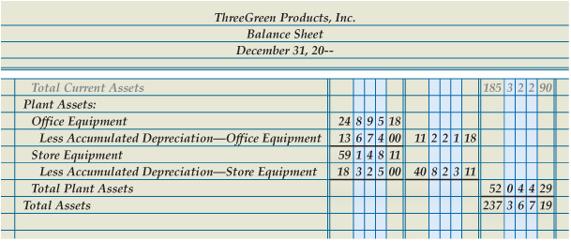
Plant Assets Section of a Balance Sheet
Lesson 16-3
LO3
Plant Assets Section
Book Value of Office Equipment
1
2
Book Value of Store Equipment
Total Assets
3
4
Total Plant Assets
5
SLIDE 4

Slide 5
Liabilities Section of a Balance Sheet
Lesson 16-3
LO3
Liabilities are classified according to the length of time until they are due.
Liabilities due within a short time, usually within a year, are called current liabilities.
Liabilities owed for more than a year are called long-term liabilities.
SLIDE 5

Slide 6
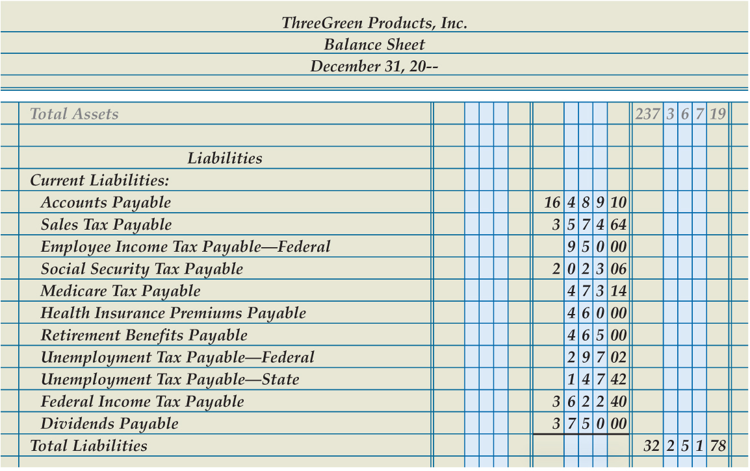
Liabilities Section of a Balance Sheet
Lesson 16-3
LO3
1
Liabilities Section
3
Total Liabilities
2
Account Title and Amount of Each Current Liability
SLIDE 6

Slide 7
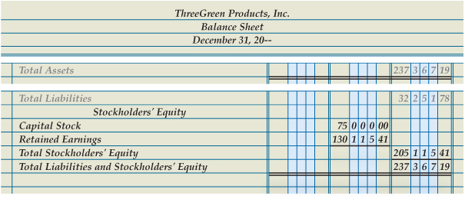
Stockholders’ Equity Section of a Balance Sheet
Lesson 16-3
LO3
Stockholders’ Equity Section
Retained Earnings
1
3
2
Capital Stock
6
Double Rule
Total Stockholders’ Equity
4
5
Total Liabilities and Stockholders’ Equity
SLIDE 7

Slide 8
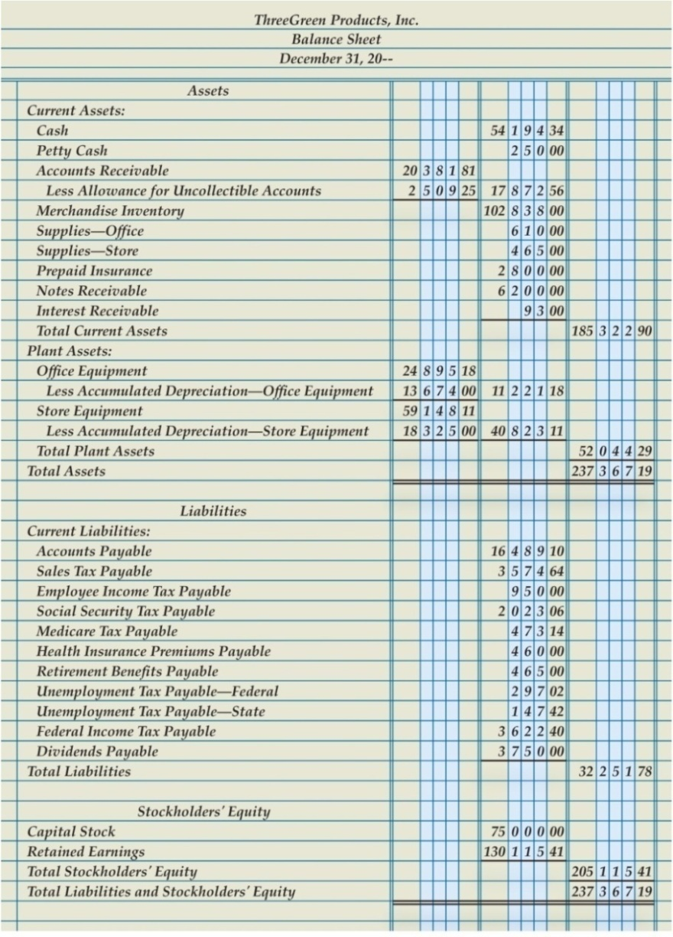
Completed Balance Sheet
Lesson 16-3
LO3
SLIDE 8

Slide 9
Supporting Schedules for a Balance Sheet
Lesson 16-3
LO3
A report prepared to give details about an item on a principal financial statement is called a supporting schedule.
A supporting schedule is sometimes referred to as a supplementary report or an exhibit.
SLIDE 9

Slide 10
Lesson 16-3 Audit Your Understanding
Lesson 16-3
1. How does ThreeGreen classify its assets?
ANSWER
Current assets and plant assets
SLIDE 10

Slide 11
Lesson 16-3 Audit Your Understanding
Lesson 16-3
2. What three items are listed on the balance sheet for an account having a related contra asset account?
ANSWER
The balance of the asset account
The balance of the contra asset account
The book value
SLIDE 11

Slide 12
Lesson 16-3 Audit Your Understanding
Lesson 16-3
3. What is an example of a long-term liability?
ANSWER
Mortgage payable
SLIDE 12

Slide 13
Lesson 16-3 Audit Your Understanding
Lesson 16-3
4. Where are the amounts obtained for the Stockholders’ Equity section of the balance sheet?
ANSWER
From the statement of stockholders’ equity
SLIDE 13

Slide 14
Lesson 16-3 Audit Your Understanding
Lesson 16-3
5. What are two supporting schedules that might accompany a balance sheet?
ANSWER
Schedule of accounts payable and schedule of accounts receivable
SLIDE 14

