Slide 1
LESSON 16-4 Recording Closing Entries for Income Statement Accounts
Learning Objectives
LO4 Prepare closing entries.

Slide 2
Closing Entries
Lesson 16-4
LO4
A corporation records four closing entries:
A closing entry for income statement accounts with credit balances (revenue and contra-cost accounts).
A closing entry for income statement accounts with debit balances (cost, contra revenue, and expense accounts).
A closing entry to record net income or net loss in the Retained Earnings account and close the Income Summary account.
A closing entry for the Dividends account.
SLIDE 2

Slide 3
The Income Summary Account
Lesson 16-4
LO4
Income Summary
Debit
Expenses
Credit
Revenue (greater than expenses)
(Credit balance is the net income)
SLIDE 3

Slide 4
Closing Entry for Accounts with Credit Balances
Lesson 16-4
LO4
Sales
Closing 632,371.75
Bal. 632,371.75
(New Bal. 0.00)
Interest Expense
Adj. (mdse inv.) 5,648.44
Closing 635,345.90
(credit accounts)
SLIDE 4

Slide 5
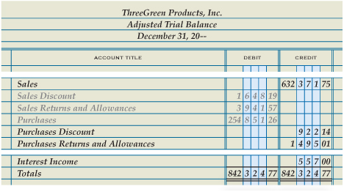
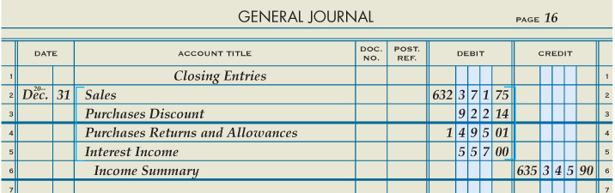
Closing Entry for Accounts with Credit Balances
Lesson 16-4
LO4
Debit to Close
3
3
2
Date
1
Heading
Credit to Income Summary
4
SLIDE 5

Slide 6
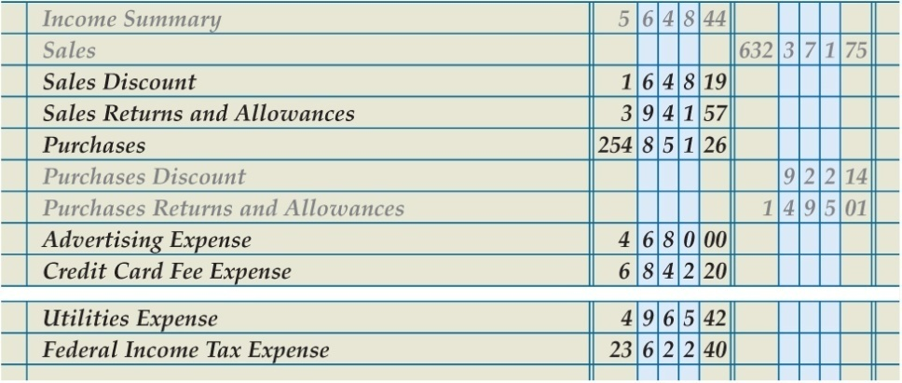
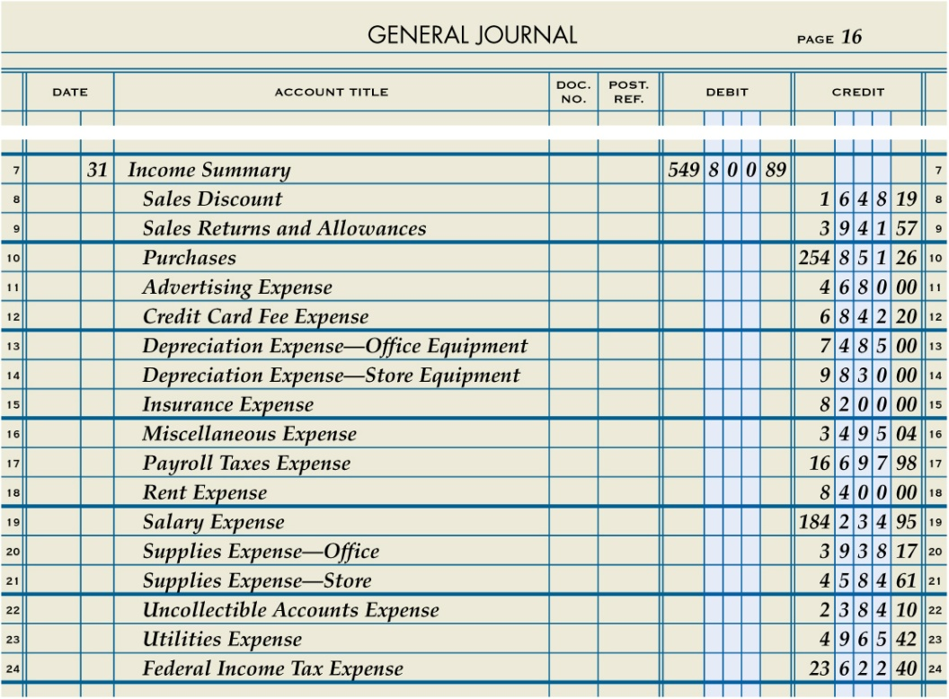
Closing Entry for Income Statement Accounts with Debit Balances
Lesson 16-4
LO4
Credit to Close
3
3
Income summary
Date
1
2
Debit to Income Summary
4
SLIDE 6

Slide 7
Summary of Closing Entry for Income Statement Accounts with Debit Balances
Lesson 16-4
LO4
Purchases
Bal. 254,851.26
(New Bal. 0.00)
Closing 254,851.26
Income Summary
Adj. (mdse. Inv.) 5,643.44
Closing (debit accounts) 549,800.89
Closing (credit accounts) 635,345.90
(New Bal. 79,896.57)
SLIDE 7

Slide 8
Closing Entry to Record Net Income
Lesson 16-4
LO4
Income Summary
Adj. (mdse. inv.) 5,643.44
Closing (debit accounts) 549,800.89
Closing (Retained Earnings) 79,896.57
Closing (credit accounts) 635,345.90
(New Bal. 0.00)
Retained Earnings
Closing (credit accounts) 65,218.84
Closing (Retained Earnings) 79,896.57
(New Bal 145,115.41)
Date
Debit Income Summary
Credit Retained Earnings
SLIDE 8

Slide 9
Closing Entry for Dividends
Lesson 16-4
LO4
Retained Earnings
Closing (Dividends) 15,000.00
Bal. 65,218.84
Closing (Income Summary) 79,896.57
(New Bal. 130,115.41)
Dividends
Bal. 15,000.00
(New Bal. 0.00)
Closing (Retained Earnings) 15,000.00
Date
Debit Retained Earnings
Credit Dividends
SLIDE 9

Slide 10
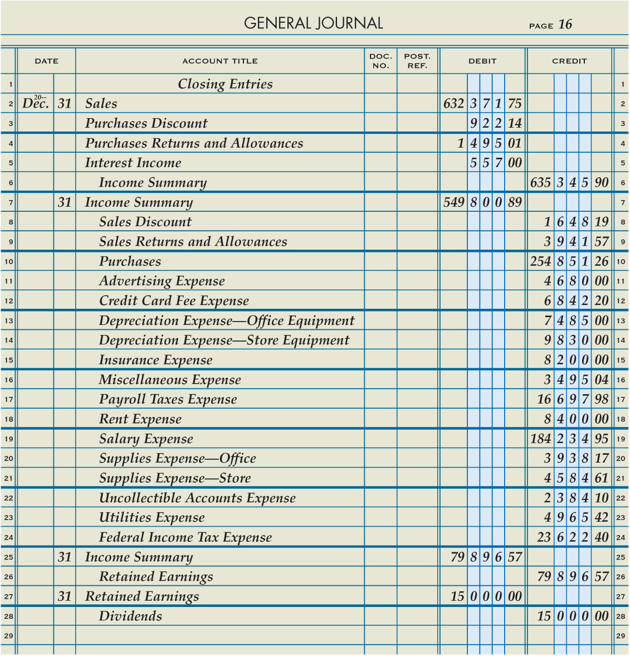
Completed Closing Entries for a Corporation Recorded in a Journal
Lesson 16-4
LO4
SLIDE 10

Slide 11
Lesson 16-4 Audit Your Understanding
Lesson 16-4
1. Where is the information obtained to journalize closing entries for revenue, cost, and expenses?
ANSWER
From the adjusted trial balance
SLIDE 11

Slide 12
Lesson 16-4 Audit Your Understanding
Lesson 16-4
2. What is the name of the temporary account used to summarize the closing entries for revenue, cost, and expenses?
ANSWER
Income Summary
SLIDE 12

