Slide 1
LESSON 16-5 Preparing a Post-Closing Trial Balance
Learning Objectives
LO5 Prepare a post-closing trial balance.

Slide 2
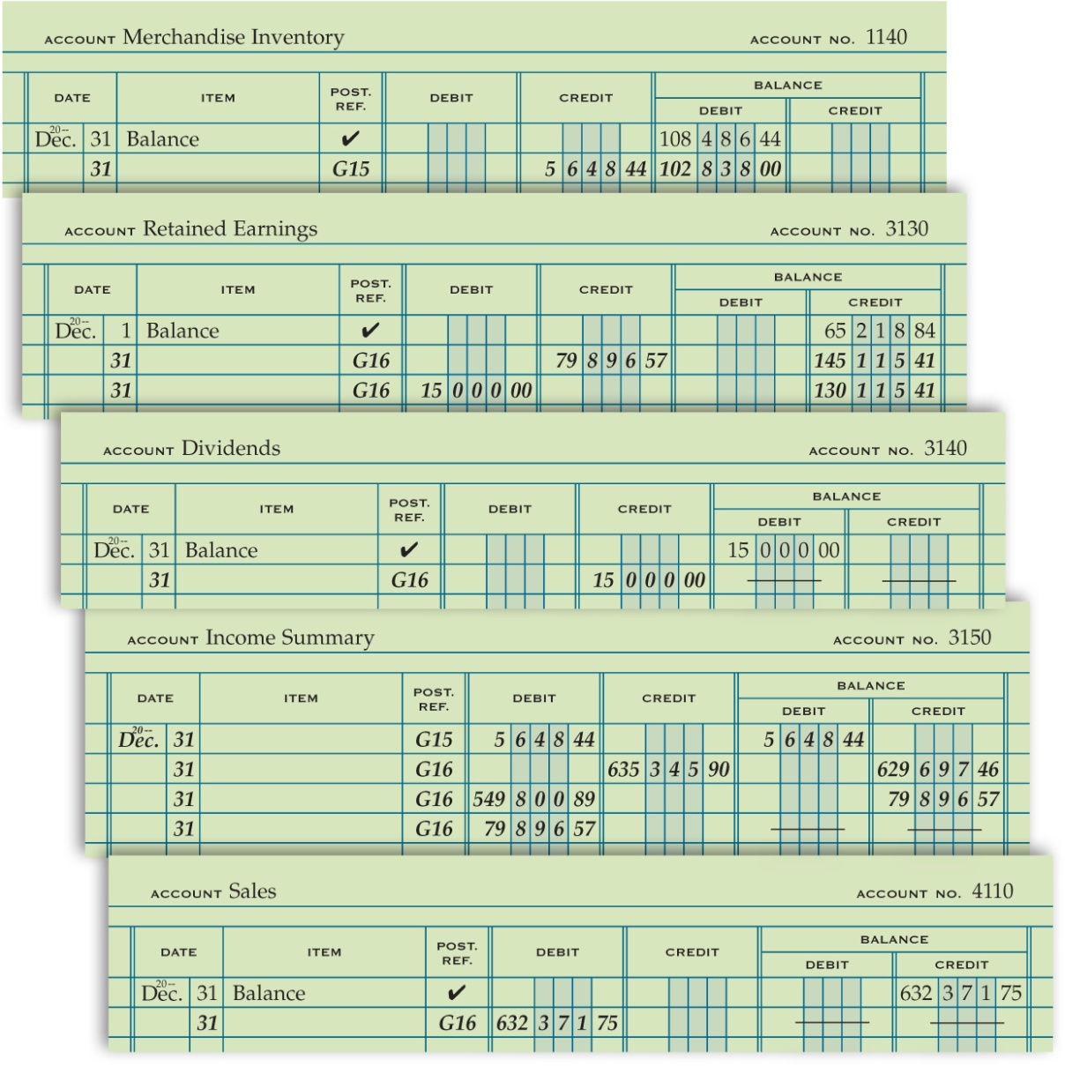
General Ledger After Closing Entries Are Posted
Lesson 16-5
LO5
SLIDE 2

Slide 3
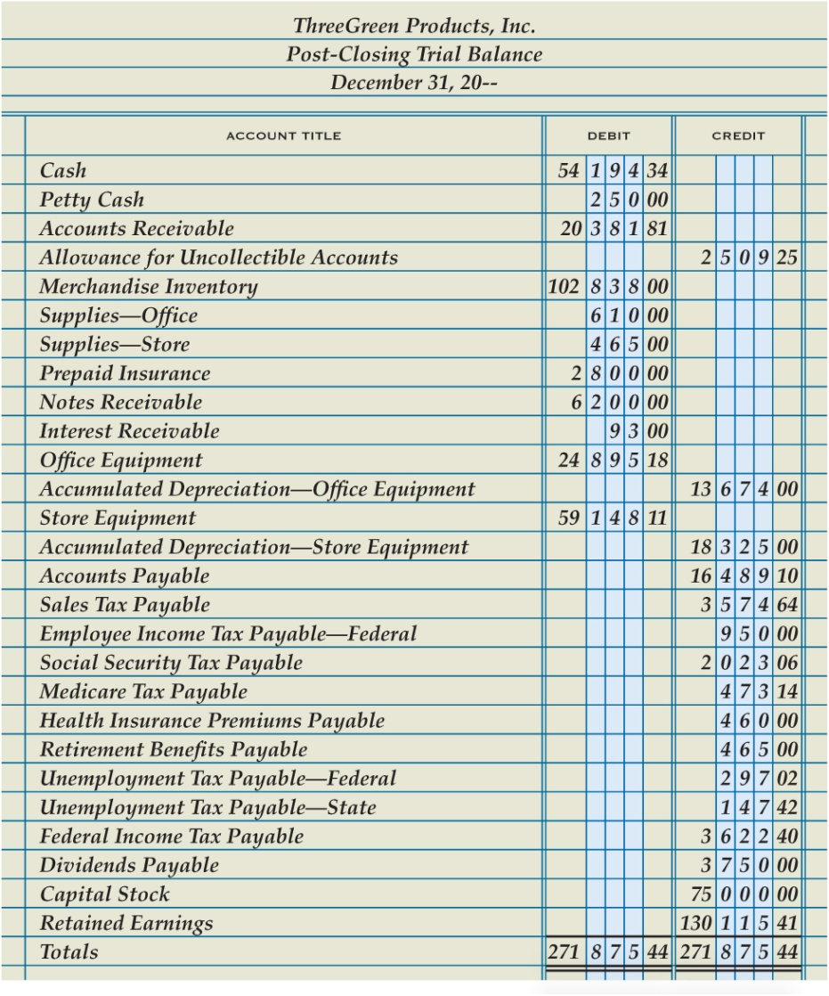
Post-Closing Trial Balance
Lesson 16-5
LO5
1
Heading
Accounts with Balances
Account Balances
2
3
6
Double Rule
Totals
4
Column Totals
5
SLIDE 3

Slide 4
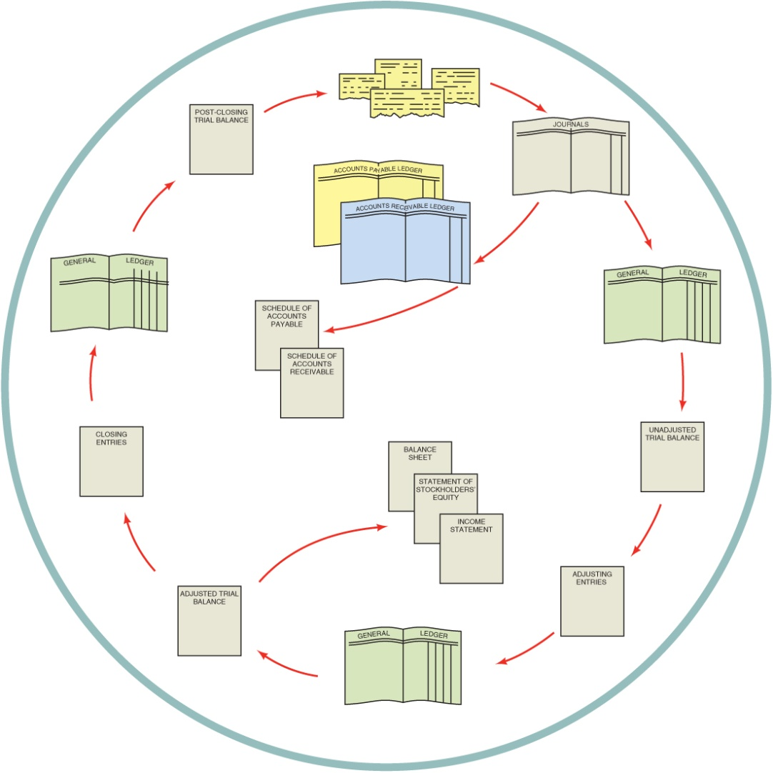
Accounting Cycle for a Merchandising Business Organized as a Corporation
Lesson 16-5
LO5
1. Source documents are checked for accuracy, and transactions are analyzed.
1
2. Transactions are recorded in journals.
2
12
3. Journal entries are posted to the accounts payable ledger, the accounts receivable ledger, and the general ledger.
3
4. Schedules of accounts payable and accounts receivable are prepared from the subsidiary ledgers.
3
4
5. An unadjusted trial balance is prepared from the general ledger.
11
5
6. Adjusting entries are journalized.
9
7. Adjusting entries are posted to the general ledger.
10
8. An adjusted trial balance is prepared from the general ledger.
6
9. Financial statements are prepared from the adjusted trial balance.
8
7
10. Closing entries are journalized.
11. Closing entries are posted to the general ledger.
12. A post-closing trial balance is prepared from the general ledger.
SLIDE 4

Slide 5
Lesson 16-5 Audit Your Understanding
Lesson 16-5
1. Which accounts and balances are listed on a post-closing trial balance? In what order are they listed?
ANSWER
General ledger accounts that have balances. Accounts are listed in the same order as they appear in the general ledger.
SLIDE 5

Slide 6
Lesson 16-5 Audit Your Understanding
Lesson 16-5
2. What is the purpose of preparing a post-closing trial balance?
ANSWER
To prove the equality of debits and credits in the general ledger
SLIDE 6

Slide 7
Lesson 16-5 Audit Your Understanding
Lesson 16-5
3. What two steps in the accounting cycle occur after adjusting entries are posted to the general ledger?
ANSWER
1. An adjusted trial balance is prepared from the general ledger.
2. Financial statements are prepared from the adjusted trial balance.
SLIDE 7

