Slide 1
LESSON 17-1 Vertical Analysis of an Income Statement
Learning Objectives
LO1 Analyze an income statement using vertical analysis.

Slide 2
Vertical Analysis Ratios
Lesson 17-1
LO1
Vertical analysis ratios measure the relationship between one financial statement item and another item on the same financial statement.
On the income statement, vertical analysis ratios focus on the ability of a business to earn a profit.
A ratio that measures the ability of a business to generate income is called a profitability ratio.
Continued on the next slide.
SLIDE 2

Slide 3
Vertical Analysis Ratios
Lesson 17-1
LO1
Vertical analysis ratios on an income statement are examples of profitability ratios.
Managers use vertical analysis ratios to help make business decisions.
For vertical analysis to be an effective tool, a business must set a target, or standard, for each ratio.
A standard used to compare financial performance is called a benchmark.
SLIDE 3

Slide 4
Factors Used to Determine Benchmark Ratios
Lesson 17-1
LO1
Actual ratios from prior fiscal periods
Industry standards published by industry organizations
Business plans
Unexpected events
SLIDE 4

Slide 5
Analyzing Trends with Vertical Analysis
Lesson 17-1
LO1
Financial statements that provide information for multiple fiscal periods are called comparative financial statements.
An analysis of changes over time is called trend analysis.
Net income after federal income tax as a percent of net sales is called profit margin.
SLIDE 5

Slide 6
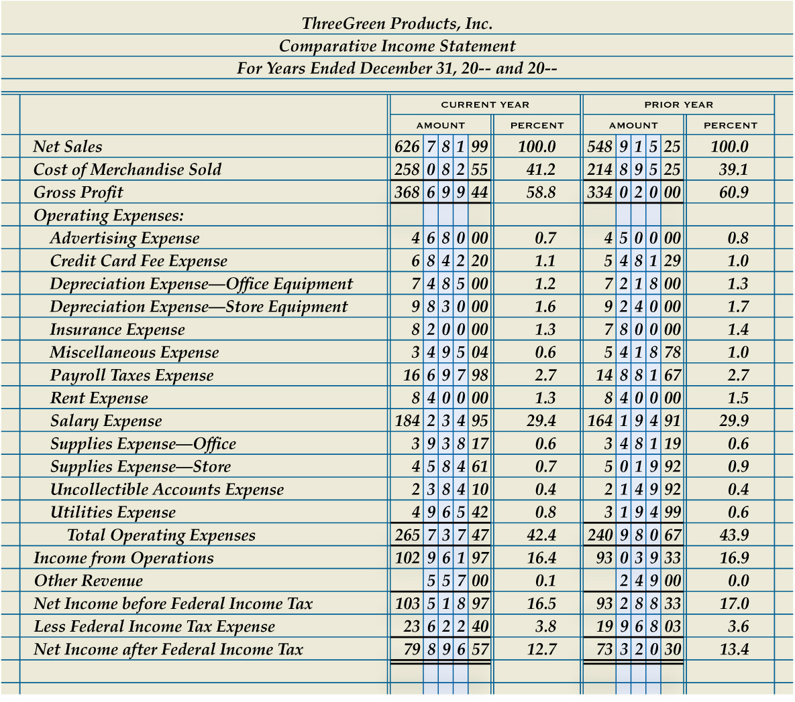
Analyzing Trends with Vertical Analysis
Lesson 17-1
LO1
SLIDE 6

Slide 7
Using Vertical Analysis to Analyze Gross Profit
Lesson 17-1
LO1
Gross profit as a percent of net sales is called gross margin.
This ratio is also referred to as gross profit margin.
SLIDE 7

Slide 8
Correcting an Unfavorable Gross Margin
Lesson 17-1
LO1
Increase unit sales prices
Decrease the unit cost of merchandise
SLIDE 8

Slide 9
Using Vertical Analysis to Analyze Operating Expenses
Lesson 17-1
LO1
Income from operations as a percent of net sales is called the operating margin.
This ratio is also referred to as the rate of return on sales.
Total operating expenses as a percent of net sales is called the operating expense ratio.
SLIDE 9

Slide 10
Correcting an Unfavorable Operating Expense Ratio
Lesson 17-1
LO1
Reduce operating expenses
Modify the benchmark
Increase net sales
SLIDE 10

Slide 11
Lesson 17-1 Audit Your Understanding
Lesson 17-1
1. Identify four factors that management can use to determine benchmark financial ratios.
ANSWER
1. Actual ratios from prior fiscal periods
2. Industry standards published by industry organizations
3. Business plans
4. Unexpected events
SLIDE 11

Slide 12
Lesson 17-1 Audit Your Understanding
Lesson 17-1
2. Why should a business be cautious about increasing the markup on merchandise purchased for sale?
ANSWER
If the increase in markup is too large, a decrease in sales revenue could occur for two reasons: (1) the sales price may exceed what customers are willing to pay or (2) customers may elect to purchase from competing businesses having lower prices.
SLIDE 12

Slide 13
Lesson 17-1 Audit Your Understanding
Lesson 17-1
3. What are two practices that can be used to reduce the cost of merchandise?
ANSWER
Purchase merchandise in larger quantities or from other vendors offering a lower cost
SLIDE 13

Slide 14
Lesson 17-1 Audit Your Understanding
Lesson 17-1
4. Should managers interested in reducing operating expenses focus more on the operating expense ratio or the operating margin?
ANSWER
Operating expense ratio
SLIDE 14

Slide 15
Lesson 17-1 Audit Your Understanding
Lesson 17-1
5. What are three possible actions to correct an unfavorable operating expense ratio?
ANSWER
Reduce operating expenses
Modify the benchmark
Increase net sales
SLIDE 15

