Slide 1
LESSON 17-3 Horizontal Analysis
Learning Objectives
LO4 Perform horizontal analysis on an income statement.
LO5 Perform horizontal analysis on a balance sheet.

Slide 2
Analyzing Trends with Horizontal Analysis
Lesson 17-3
LO4
A comparison of one item on a financial statement with the same item on a previous period’s financial statement is called horizontal analysis.
Current Period | − | Prior Period | = | Increase (Decrease)
$242,584.00 | − | $221,489.00 | = | $21,095.00
Increase (Decrease) | ÷ | Prior Period | = | Horizontal Analysis Ratio
$21,095.00 | ÷ | $221,489.00 | = | 9.5%
SLIDE 2

Slide 3
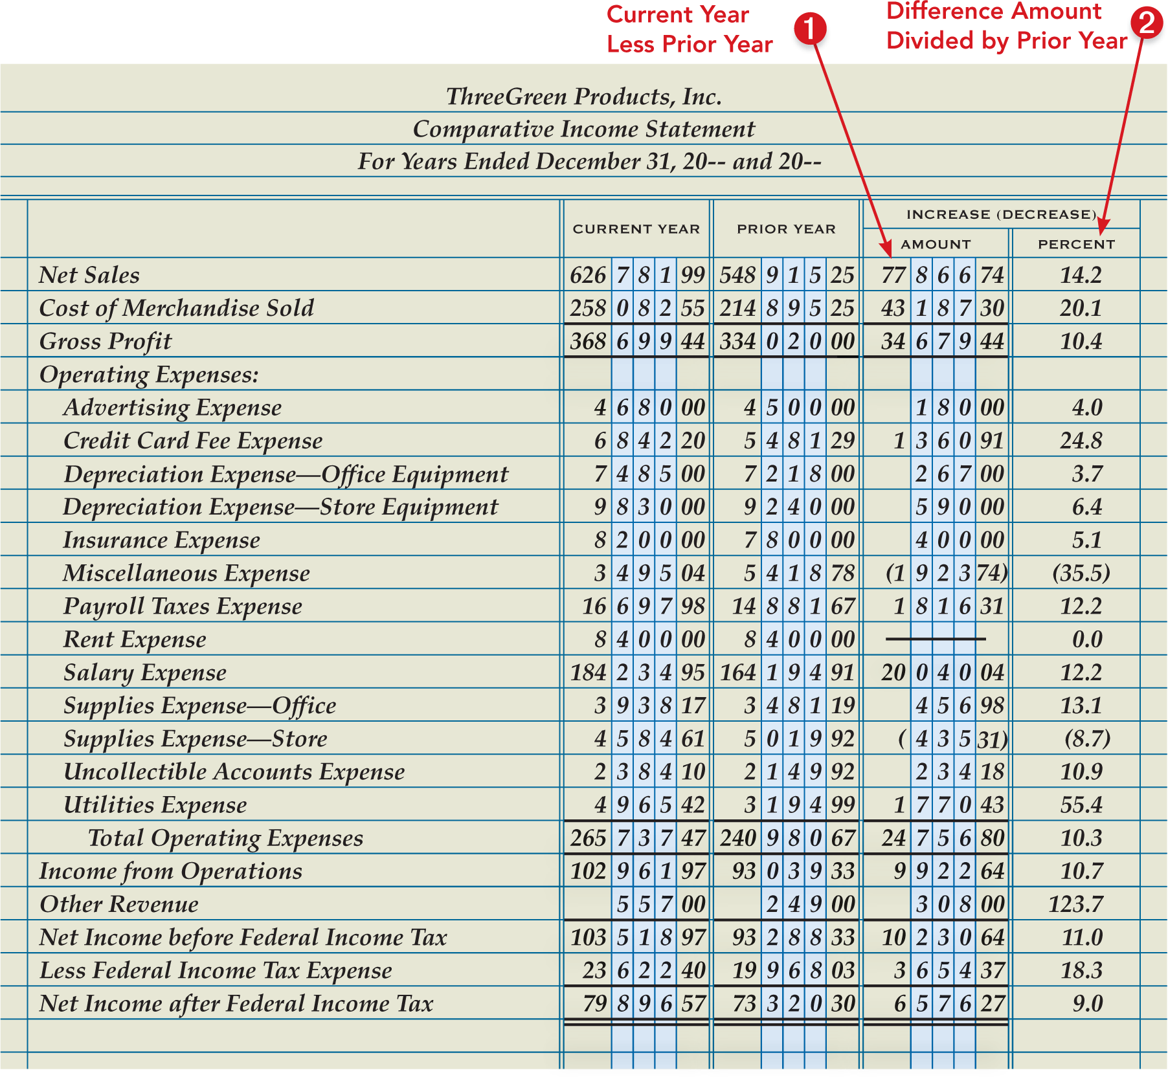
Horizontal Analysis of an Income Statement
Lesson 17-3
LO4
SLIDE 3

Slide 4
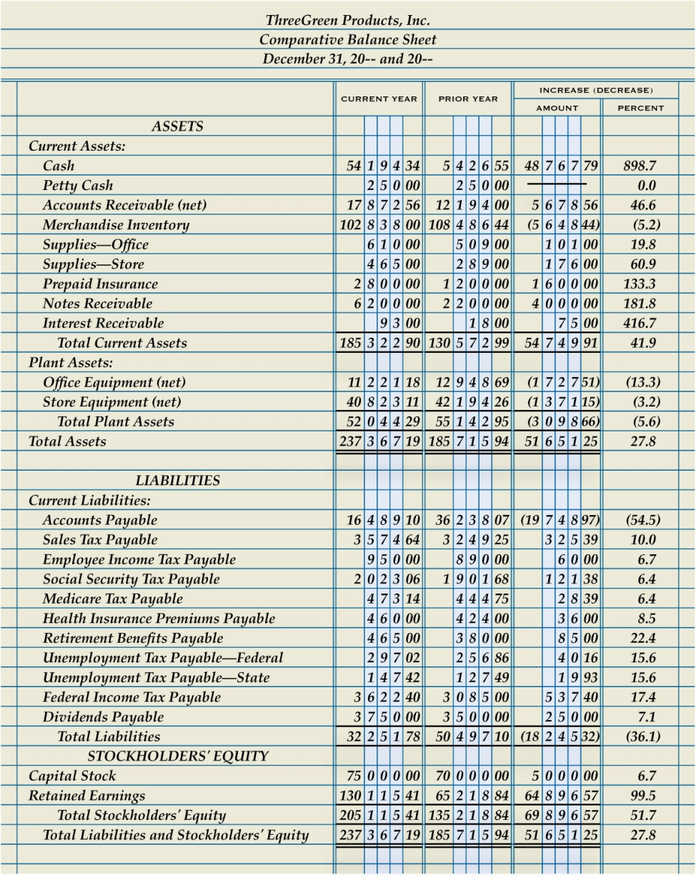
Horizontal Analysis of a Balance Sheet
Lesson 17-3
LO4
SLIDE 4

Slide 5
Lesson 17-3 Audit Your Understanding
Lesson 17-3
1. How could a 2.0% decrease in supplies expense be an unfavorable trend?
ANSWER
If management took actions that should have decreased supplies expense by significantly more than 2.0%, then only a 2% decrease would be unfavorable.
SLIDE 5

Slide 6
Lesson 17-3 Audit Your Understanding
Lesson 17-3
2. How does a publicly held corporation use horizontal analysis when reporting to the Securities and Exchange Commission?
ANSWER
The document filed with the Securities and Exchange Commission contains a section titled Management’s Discussion and Analysis of Financial Condition and Results of Operations and Results of Operations. Management often uses these ratios to explain the current year’s results of operations compared to previous years.
SLIDE 6

