Slide 1
LESSON 19-5 Declining-Balance Method of Depreciation
Learning Objectives
LO11 Calculate depreciation using the double declining-balance method.

Slide 2
Calculating Depreciation Using the Double Declining-Balance Method
Lesson 19-5
LO11
Any method of depreciation that records greater depreciation expense in the early years and less depreciation expense in the later years is called accelerated depreciation.
The declining-balance method of depreciation is a type of accelerated depreciation that multiplies the book value of an asset by a constant depreciation rate to determine annual depreciation.
A declining-balance rate that is two times the straight-line rate is called the double declining-balance method of depreciation.
SLIDE 2

Slide 3
Calculating Depreciation Using the Double Declining-Balance Method
Lesson 19-5
LO11
Estimated Depreciation Expense | ÷ | Years of Estimated Useful Life | = | Straight-Line Rate of Depreciation
100% | ÷ | 5 | = | 20%
Straight-Line Rate of Depreciation | × | Multiply by Two | = | Double Declining-Balance Rate of Depreciation
20% | × | 2 | = | 40%
SLIDE 3

Slide 4
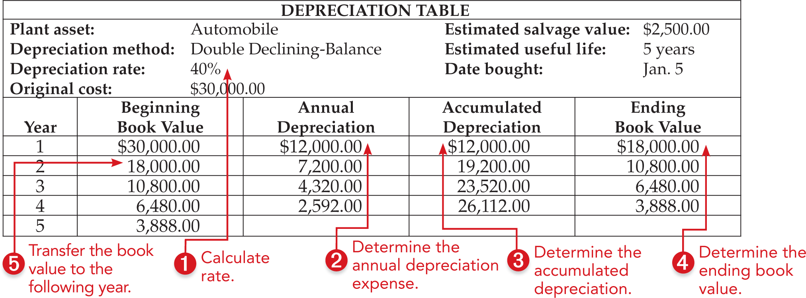
Calculating Depreciation Using the Double Declining-Balance Method
Lesson 19-5
LO11
SLIDE 4

Slide 5
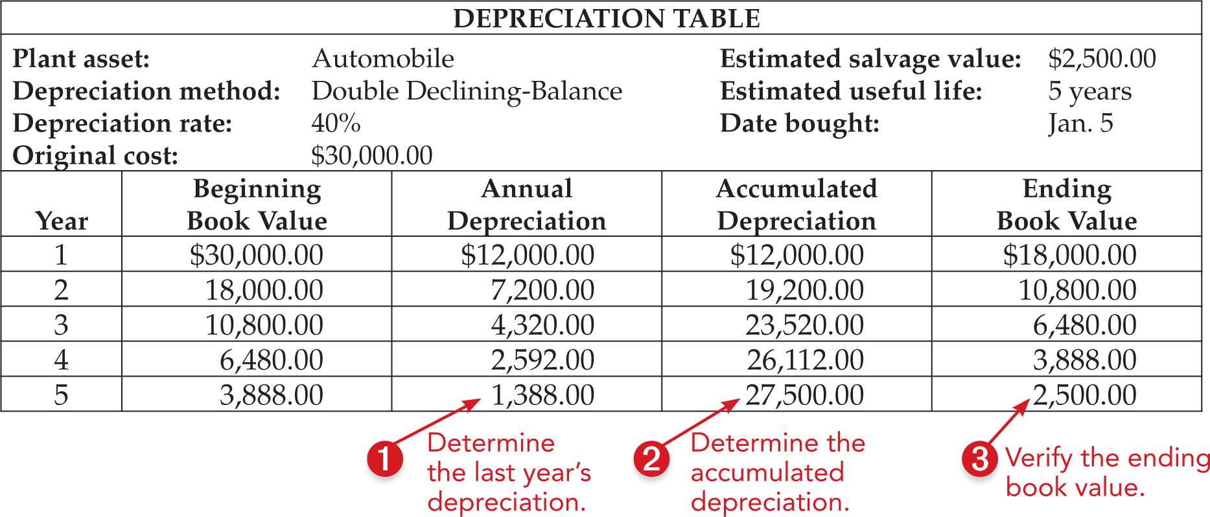
Calculating Depreciation Expense in the Final Year
Lesson 19-5
LO11
SLIDE 5

Slide 6
Accelerated Depreciation Methods
Lesson 19-5
LO11
The double declining-balance method of depreciation is one method of accelerated depreciation.
All accelerated methods have one thing in common—more depreciation is charged in the first year than in the later years.
GAAP allows each business to choose either straight-line or accelerated depreciation for financial reporting.
But, once chosen, the business should use the same method from year to year.
SLIDE 6

Slide 7
Modified Accelerated Cost Recovery System (MACRS)
Lesson 19-5
LO11
The U.S. Internal Revenue Service has published rules that must be applied when calculating the amount of depreciation expense that is used to compute a business’s federal income tax obligation.
Those rules are called the Modified Accelerated Cost Recovery System (MACRS).
MACRS is an accelerated depreciation method.
SLIDE 7

Slide 8
Comparing Two Methods of Depreciation
Lesson 19-5
LO11
Plant Asset: Automobile Original Cost: $6,000.00
Depreciation Method: Comparison of Two Methods Estimated Salvage Value: $500.00
Estimated Useful Life: 5 years
SLIDE 8

Slide 9
Lesson 19-5 Audit Your Understanding
Lesson 19-5
1. When calculating depreciation expense using the declining-balance method, what number stays constant each fiscal period?
ANSWER
Depreciation rate
SLIDE 9

Slide 10
Lesson 19-5 Audit Your Understanding
Lesson 19-5
2. What is the declining-balance method that uses twice the straight-line rate?
ANSWER
Double declining-balance method
SLIDE 10

Slide 11
Lesson 19-5 Audit Your Understanding
Lesson 19-5
3. What change occurs in the annual depreciation expense calculated using the declining-balance method?
ANSWER
Depreciation expense declines each year
SLIDE 11

Slide 12
Lesson 19-5 Audit Your Understanding
Lesson 19-5
4. An asset is never depreciated below what amount?
ANSWER
Its estimated salvage value
SLIDE 12

