Slide 1
Opener
1.
What is the scale factor of the dilation?
3.
What would be the length of segment F'G' if dilated by a scale factor of 1.5?
C
A
A'
B
G
F
B'
C
2.
What would be the length of segment E'D' if dilated by a scale factor of 3?
C
E
D

Slide 2
Opener
1.
What is the scale factor of the dilation?
Scale factor:
A'
C
A
B
B'

Slide 3
Opener
2.
What would be the length of segment E'C' if dilated by a scale factor of 3?
C
E
D

Slide 4
Opener
3.
What would be the length of segment F'G' if dilated by a scale factor of 1.5?
G
F
C

Slide 5
Essential Question
Learning Objective
What does it mean to say that two figures are similar?
Given a figure, I will perform a dilation transformation and describe how scale factor determines new lengths.

Slide 6
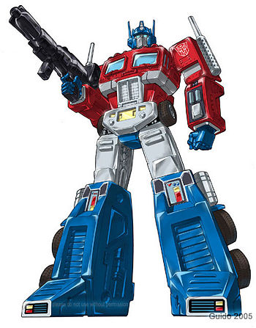
Transformations
Reflections
Translations
Rotations
Dilations

Slide 7
9.7 Dilations
what you've learned:
What is perimeter and area
how to calculate perimeter and area of rectangles, squares, and triangles
undefined terms: point, line, plane
defined terms: segment, ray, angle, parallel, perpendicular
angle pair relationships: complementary, supplementary, linear pair, vertical angles
Transformations: reflections, translations, rotations.
Congruence
Triangle congruence shortcuts: SSS, SAS, ASA
Triangle Facts: Triangle Sum, 3rd Angles ≅
Constructions: ≅ segments, ≅ triangles, perpendicular bisectors, ≅ angles, angle bisectors, parallel segments, equilateral triangles, regular hexagon, square
you should know:
Transformation: Dilations

Slide 8
Key Terms:
Dilations - a kind of transformation that increases or decreases the size of a figure.
(doesn't make a congruent copy)

Slide 9
ED =
3
E'D' =
6
E'
Distance from center (C) to points was _____________
E
doubled
2
Scale factor:
C
D
D'

Slide 10
C
4
GH =
G'H' =
8
G
H
Distance from center (C) to points was _____________
G'
H'
doubled
2
Scale factor:

Slide 11
C
J
J'
JK =
2
J'K' =
6
K
Distance from center (C) to points was _____________
tripled
K'
3
Scale factor:

Slide 12
MN =
6
C
3
M'N' =
M'
N'
Distance from center (C) to points was _____________
halved
M
N
.5 or ½
Scale factor:

Slide 13
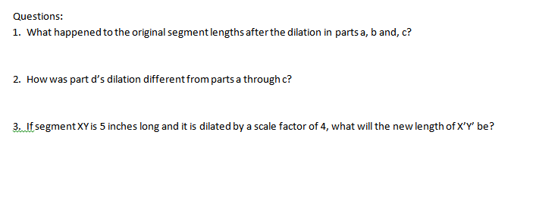

Slide 14
Key Terms:
Scale factor -

Slide 15
Key Terms:
Scale factor - the ratio of the side length of an image to the corresponding side length of its preimage.

Slide 20
Essential Question
Learning Objective
What does it mean to say that two figures are similar?
Given a figure, I will perform a dilation transformation and describe how scale factor determines new lengths.

Slide 21
Closure
Explain the relationship between scale factor and the length of the dilated segment.
focus words: scale factor, dilated

Slide 22
Closure
Explain the relationship between scale factor and the length of the dilated segment.
The scale factor of a dilation tells you how much bigger or smaller the dilated segments will be. You can use multiplication to determine the exact lengths. For example, a side length of 4 dilated by a scale factor of 3, will have an image side length of 12.

Slide 23
HW
none

Slide 25
HW
PDF Online

Slide 27
C
G
H
E
C
D
C
J
C
K
M
N

