Slide 1
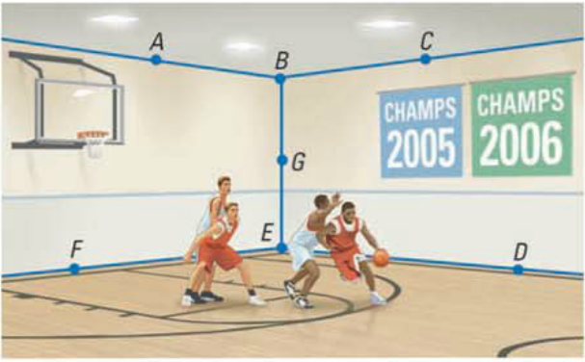
Opener
1. What are the three undefined terms?
2. Based on the picture below name a point, plane, segment, and ray.
3. Based on the scene above, give a representation of each undefined term. (hint** ignore the labeled points and blue segments)

Slide 2
Opener
1. What are the three undefined terms?

Slide 3
Opener
2. Based on the picture below name a point, plane, segment, and ray.

Slide 4
Opener
3. Based on the scene above, give a representation of each undefined term. (hint** ignore the labeled points and blue segments)
Points
each player's head
the basketball
Lines
lines on court
edges of walls
Planes
backboard
court floor
walls / ceiling

Slide 5
Think / Record / Report
Red
How are the symbols for lines and segments different?
Blue
How are the symbols for lines and rays different?
THINK
RECORD
REPORT
Key Vocab:
arrowheads
endpoint
Sentence Starter:
"The difference between..."

Slide 6
Essential Question
Learning Objective
How do you define an angle and its various types?
Given an angle, I will define it and describe the difference between acute, right, obtuse, and straight angles.

Slide 7
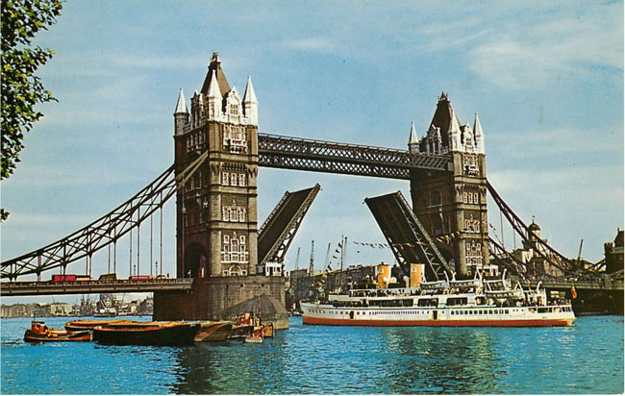
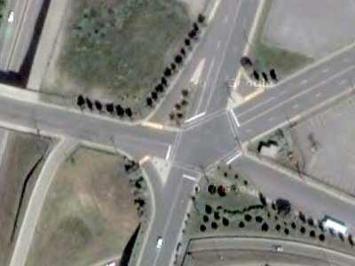
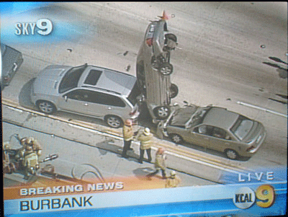

Slide 8
1.4 Angles
what you've learned:
What is perimeter and area
how to calculate perimeter and area of rectangles, squares, and triangles
undefined terms
segments and rays
you should know:
definition of angle and how classify them

Slide 10
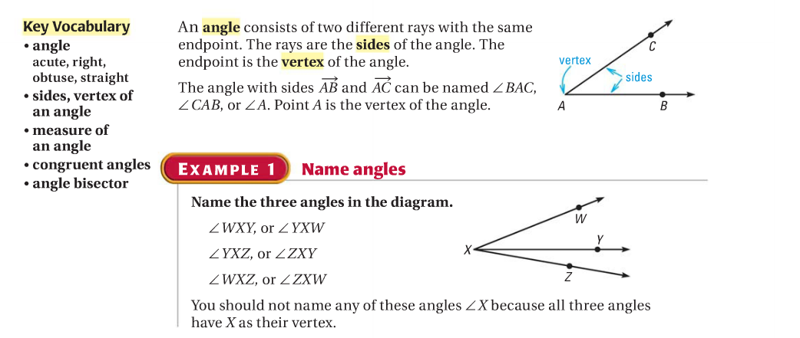

Slide 15
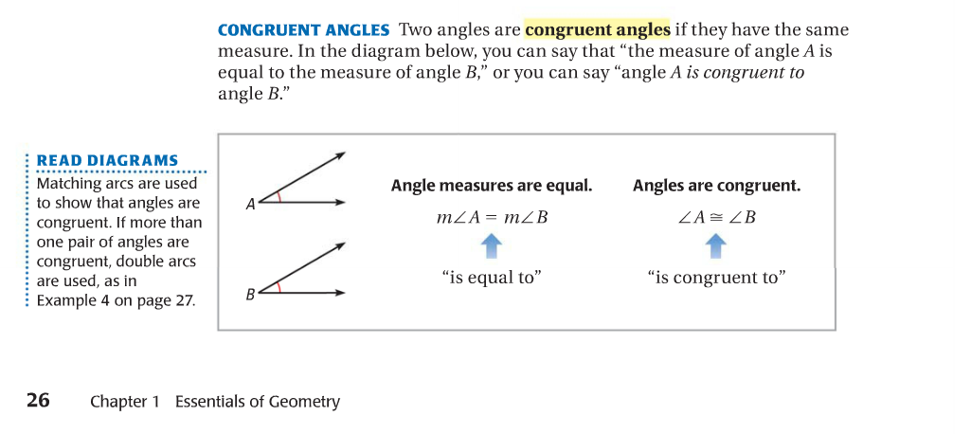

Slide 19
Essential Question
Learning Objective
How do you define an angle and its various types?
Given an angle, I will define it and describe the difference between acute, right, obtuse, and straight angles.

Slide 20
Closure
acute, right, obtuse, or straight?

Slide 21
Closure
acute, right, obtuse, or straight?

Slide 22
Closure
acute, right, obtuse, or straight?

Slide 23
Closure
acute, right, obtuse, or straight?

Slide 24
HW
PDF Online
Classify Angles

