Slide 1
Opener
New section For Notes…...9.3 Reflections

Slide 2
Essential Question
Learning Objective
How can shapes be moved on a plane?
Given a figure, I will perform a reflection transformation.

Slide 3
Transformations

Slide 4
9.3 Transformations:
Reflections
what you've learned:
What is perimeter and area
how to calculate perimeter and area of rectangles, squares, and triangles
undefined terms: point, line, plane
defined terms: segment, ray, angle, parallel, perpendicular
angle pair relationships: complementary, supplementary, linear pair, vertical angles
you should know:
reflections

Slide 5
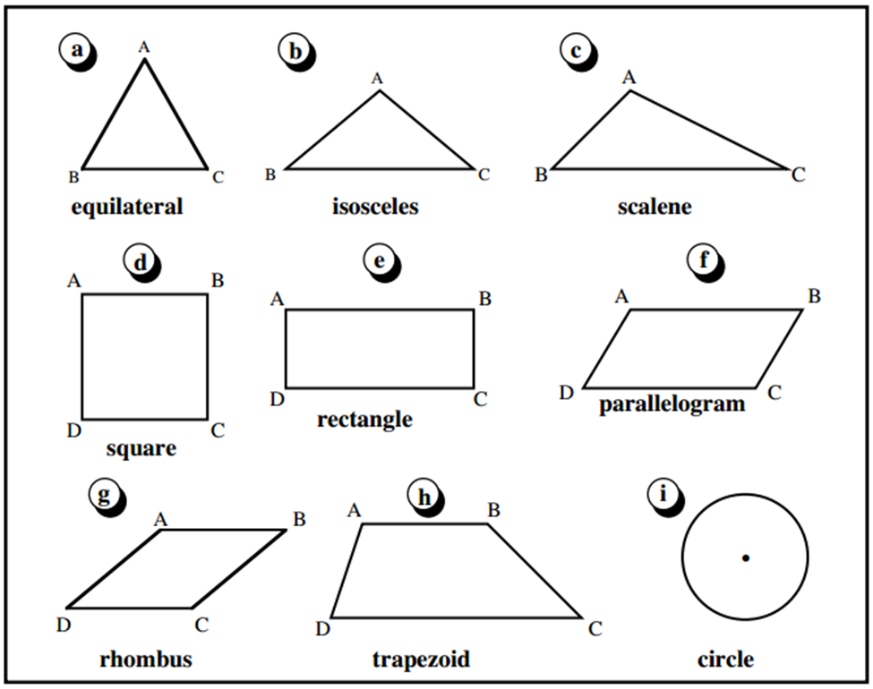
infinite
Lines of Symmetry…..What are they? Explain..

Slide 6
A line that allows a figure to be mapped onto itself.

Slide 7
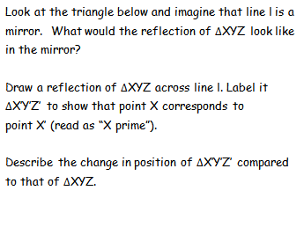
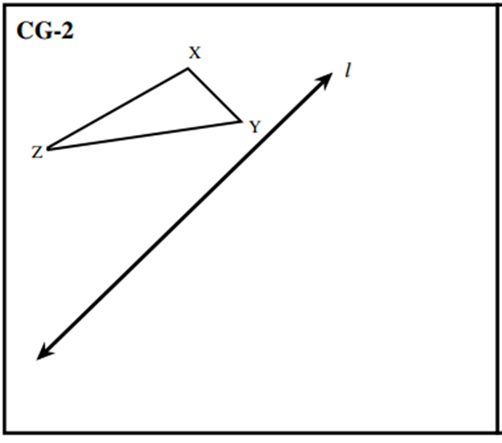
Y'
X'
Z'
Flipped?
Backwards?
Reversed?
Mirrored?
Reflected?

Slide 8
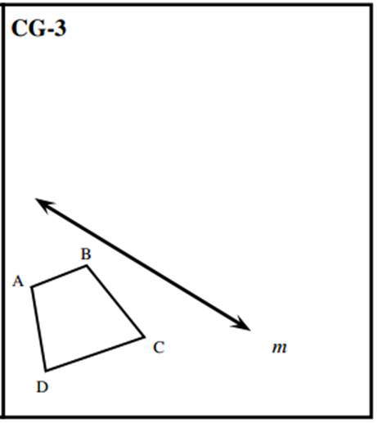
D'
A'
B'
C'

Slide 9
D'
A'
B'
They are parallel to each other.
C'
They all seem perpendicular to line m. Also, line m seems to cut
each segment in half.

Slide 11
Reflect Across the Y-Axis.
C'
C
Reflect Across the X-Axis
B'
B
A'
A
A’
What do you notice about the X, Y coordinates in each scenario? Any Patterns
B’
C’

Slide 15
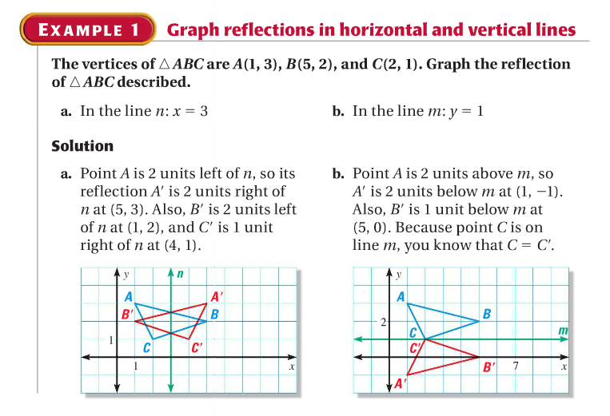
Do the patterns you discovered still hold true?

Slide 16
Quick Check
Find the coordinates for the following:
A = 5,4 reflect it over Y-axis
A’= -5,4
B= 4,3 Reflect it over Y=2
B’ = 4,1
C= -3,-5 Reflect it over the X-Axis
C’= -3,5
Bonus: Find The Pre-Image given an Image A’=(4,4) that was reflected Across the Y-Axis.
A=-4,4

Slide 17
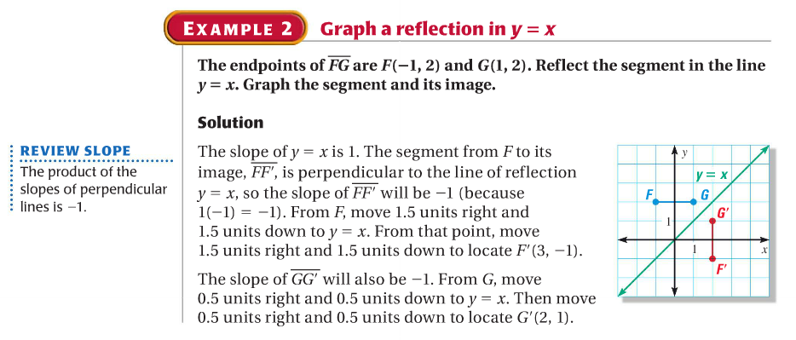

Slide 18
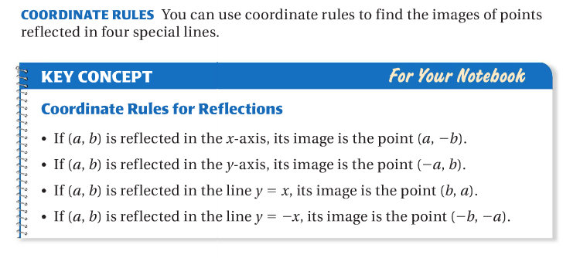

Slide 19
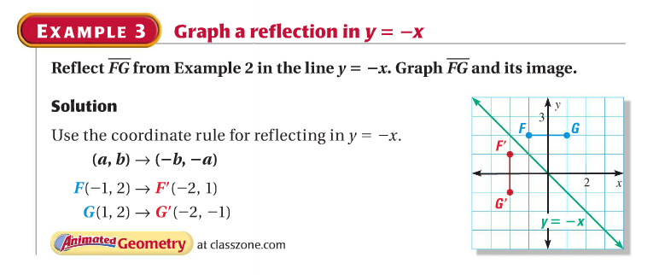

Slide 20
Essential Question
Learning Objective
How can shapes be moved on a plane?
Given a figure, I will perform a reflection transformation.

Slide 21
Closure
Quick Write
In your own words….How can rigid shapes be moved on a coordinate plane? What would be a reason why we would want to transform a shape on a plane?

Slide 22
HW
PDF

Slide 25
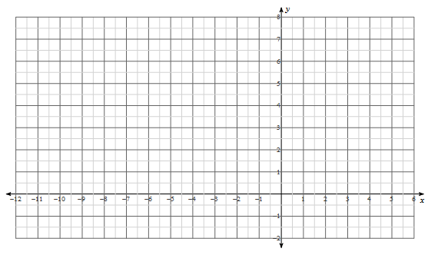
A
B
C

