Slide 1
5-Min Check
Triangle ABC is reflected over X = -2
A’,-5,4
B’-1,6
C’ 3,6
What are the coordinates of the pre-image?
A. 1,4
B. -3,6
C -7,6

Slide 3
Essential Question
Learning Objective
How can shapes be moved on a plane?
Given a figure, I will perform a translation and rotation transformation.

Slide 4
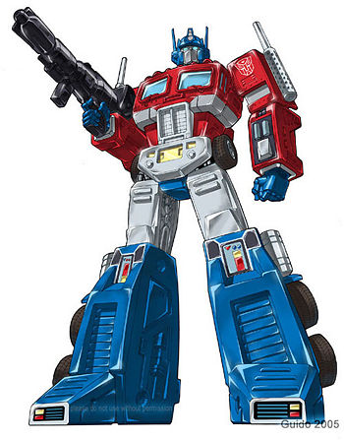
Transformations
Translations & Rotations

Slide 5
Transformations:
Translations (9.1)
& Rotations (9.4)
What you've learned:
What is perimeter and area
how to calculate perimeter and area of rectangles, squares, and triangles.
undefined terms: point, line, plane
defined terms: segment, ray, angle, parallel, perpendicular
angle pair relationships: complementary, supplementary, linear pair, vertical angles
Transformations: reflections
You should know:
Translations & Rotations

Slide 6
A. -5,2
C. 1,1
B. 2,-4

Slide 7
Pre-Image
A -5,2
B 2,-4
C 1,1
A. -5,2
C. 1,1
Image
A’ -1,0
B’ 6, -6
C’ 5, -1
B. 2,-4

Slide 8
A’ = 2 , 5
B’ = 9 , -1
C’ = 8 , 4
A. -5,2
C. 1,1
B. 2,-4

Slide 11
Think…Ink….Share

Slide 12
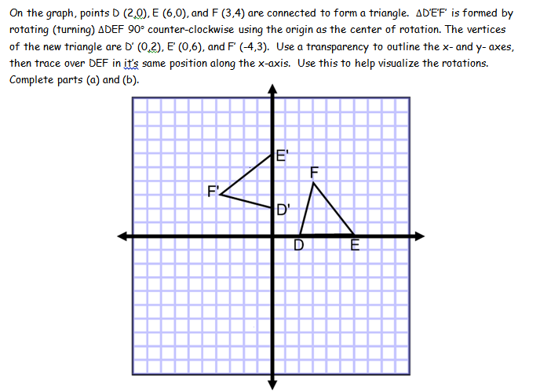

Slide 13
Closure
Now that we have discussed rules for rotating 90 & 180 degrees…….What would be the rule for a 270 degree rotation? 360 degree rotation?

Slide 14
So what are some rules?
90 degree rotations we flip our X, Y and determine the new quadrant as it will determine negative or positive values.
Ex: Rotate (5,3) 90degrees.
We rotate counter clockwise unless otherwise noted.
First determine where the point is located. (5,3) is in Quad 1.
Rotating 90 puts it in Quad 2
To get in quad two the X coordinate is negative and Y coordinate must be positive.
Flip the original coordinates (5,3)>>>>> (-3,5) and use the new quad to see which is negative or positive.
180 degree rotation are easy. We just reverse the signs. There is no need to flip your (X,Y)
For example 5,3 >>>>>>>> 180 degrees is -5,-3

Slide 15
Essential Question
Learning Objective
How can shapes be moved on a plane?
Given a figure, I will perform a translation and rotation transformation.

Slide 16
HW
PDF

Slide 17
E'
F
F'
D'
D
E

