Slide 1
Opener
Factor the polynomial completely.
1. 12x3+6x+20x2+10
$2\left(3x+5\right)(2x^{2}+1$)
Simplify the right side of the equation……..FIND THE X INTERCEPTS
2. y = (x + 4)(x + 8)
X ints are -4 and -8
3. y = (x + c)(x + d)
X ints are -C and -D

Slide 2
(0, 0) & (6, 0)
2
5
(8, 0) & (1, 0)
(- , 0) & (-3, 0)

Slide 3
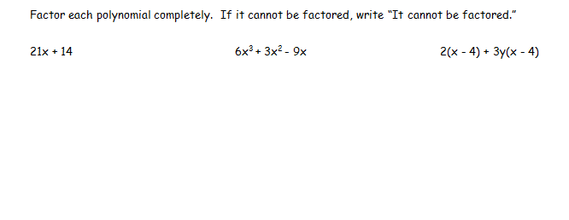
7(3x + 2)
3x(2x2 + x - 3)
(x - 4)(2 + 3y)

Slide 4
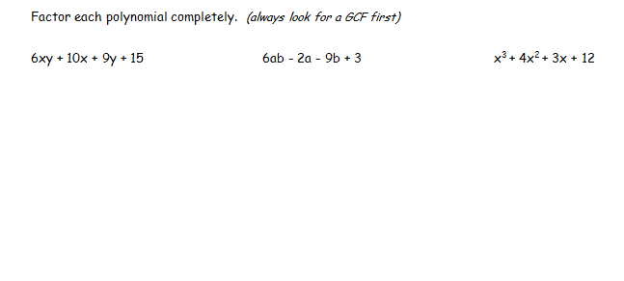
(3y + 5)(2x + 3)
(3b - 1)(2a - 3)
(x + 4)(x2 + 3)

Slide 5
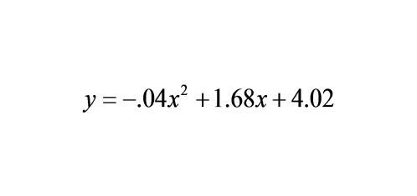
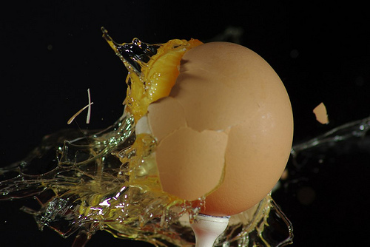
You have entered a contest to be a human target for an egg-toss competition for charity. You are standing 40 feet away from the egg-thrower. The donor's egg toss is modeled by the equation:
Does this have a GCF? Can this be factored by grouping?
Are you splattered with egg?

Slide 6
Essential Question
Learning Objective
How do you take a quadratic function and determine its factors?
Given a quadratic trinomial, I will factor it into its binomial factors.

Slide 7
Quadratic Functions
(factoring to find x-intercepts)
you should know:
how to factor a quadratic trinomial into its binomial factors
ax2+bx+c

Slide 8
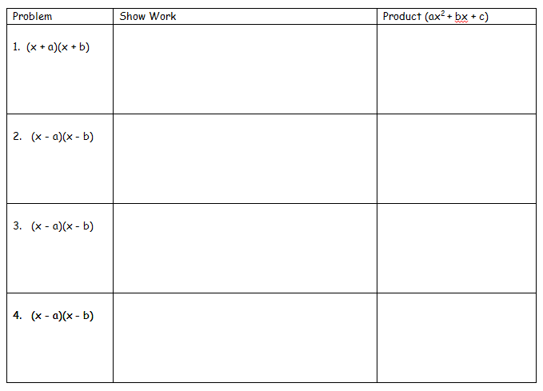

Slide 9
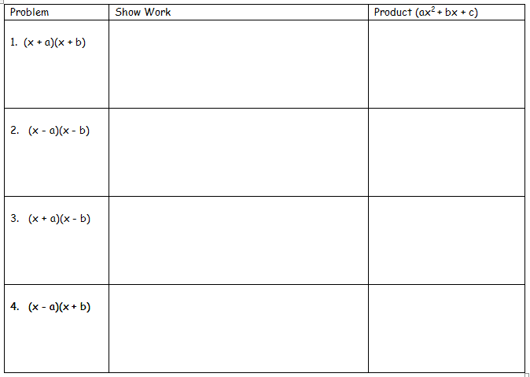
x2+bx+ax+ab
x2+ax+bx+ab
x2+(a+b)x+ab
x2+(a+b)x+ab
x2-bx-ax+ab
x2+(-bx)+(-ax)+ab
x2+(-a+-b)x+ab
x2+(-ax)+(-bx)+ab
x2+(-a+-b)x+ab
x2-bx+ax+ab
x2+(-bx)+ax+ab
x2+(a+-b)x+ab
x2+ax+(-bx)+ab
x2+(a+-b)x+ab
x2+bx-ax+ab
x2+bx+(-ax)+ab
x2+(-ax)+bx+ab
x2+(-a+b)x+ab
x2+(-a+b)x+ab

Slide 10
x2+(a+b)x+ab
x2+(-a+-b)x+ab
x2+(a+-b)x+ab
x2+(-a+b)x+ab

Slide 11
x2+(a+b)x+ab
x2+(-a+-b)x+ab
x2+(a+-b)x+ab
x2+(-a+b)x+ab

Slide 13
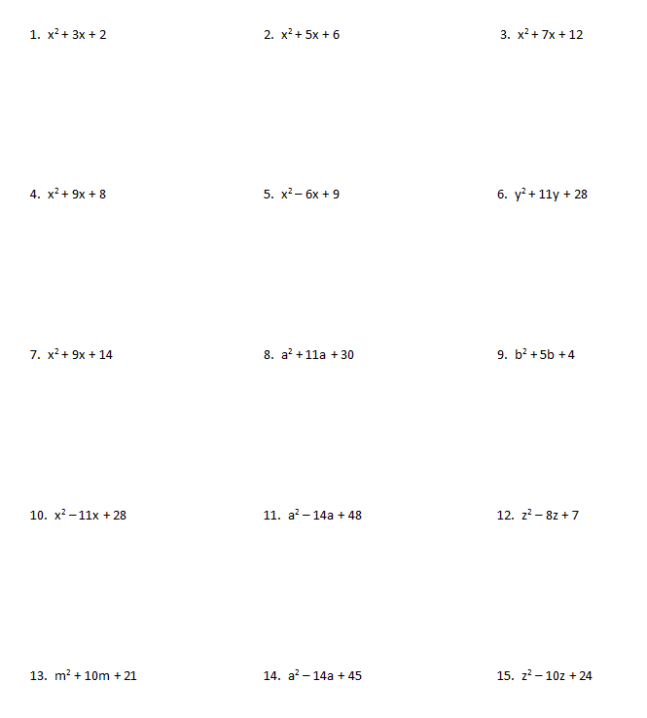

Slide 14
"WE DO" TIME

Slide 15
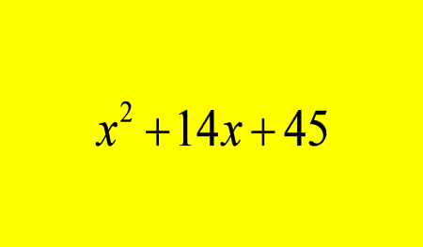
Problem
Factor completely.

Slide 16
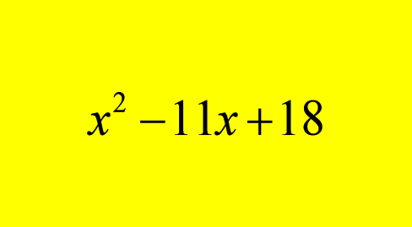
Problem
Factor completely.

Slide 17
Problem
Factor completely.

Slide 18
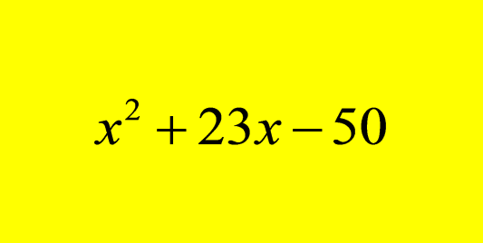
Problem
Factor completely.

Slide 19
Essential Question
Learning Objective
How do you take a quadratic function and determine its factors?
Given a quadratic trinomial, I will factor it into its binomial factors.

Slide 20
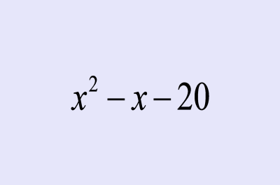
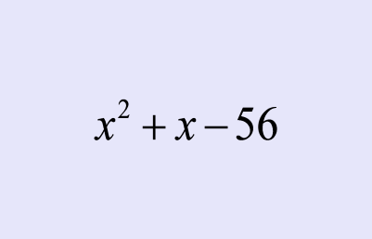
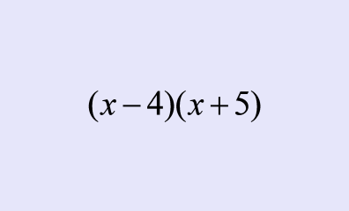
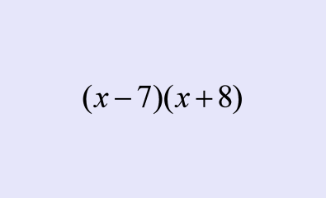
Closure
Which one is incorrectly factored and why?
#1
#2

Slide 21
HW
Math II
Factoring Trinomials PDF

Slide 23
real life situations using parabolas:
antennas
projectiles
cannon balls
bouncing balls
catapults
potato shooters
pumpkin tosses
kicked balls
craters
bridge arches

Slide 24
link to interactive graphs

Slide 25
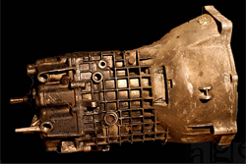

Slide 26
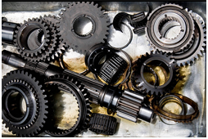

Slide 27
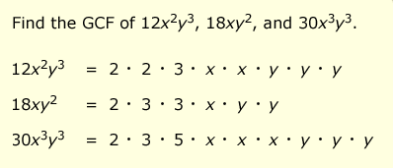

Slide 28
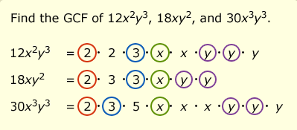

Slide 29
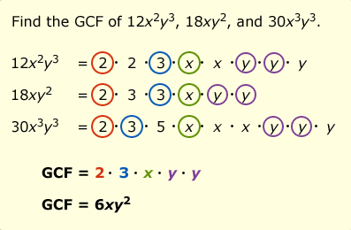

Slide 32
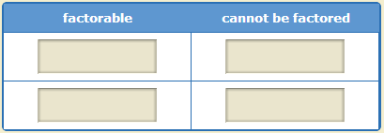

Slide 33
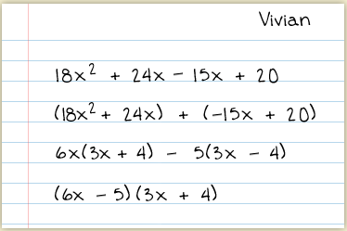

Slide 34
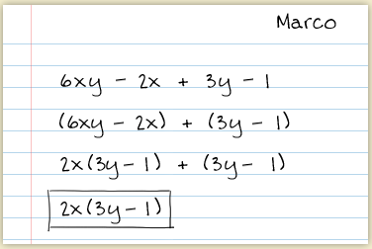

Slide 35
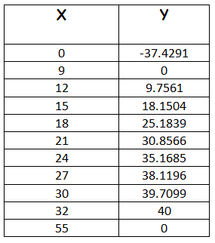

Slide 36
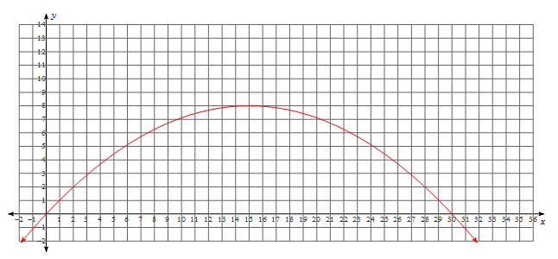

Slide 37
