Slide 1
To find the distance between the boats, you need to know the x-intercepts. Therefore, you factor the quadratic expression to find the binomials factors.
(2,0)
(12,0)
y = $X^{2}$-14x+24
y = (x-12)(x-2)
x-intercepts:
The distance between the boats is 10 yards.
(12, 0)(2, 0)
12-2 = 10

Slide 2
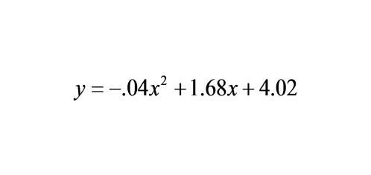
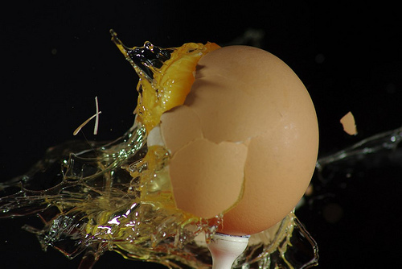
You have entered a contest to be a human target for an egg-toss competition for charity. You are standing 40 feet away from the egg-thrower. The donor's egg toss is modeled by the equation:
Are you splattered with egg?

Slide 3
Essential Question
Learning Objective
What is the form of a perfect square trinomial and how can it be used to complete a square when the C-term is unknown?
Given a quadratic trinomial, I will determine if it is a perfect square, and if not I will complete the square.

Slide 4
Quadratic Functions
(factoring to find x-intercepts)
what you've learned:
how to factor out a GCF
how to factor by grouping
how to factor into binomial when a=1
how to factor into binomials when a≠1
you should know:
how to complete the square
ax2+bx+c

Slide 5
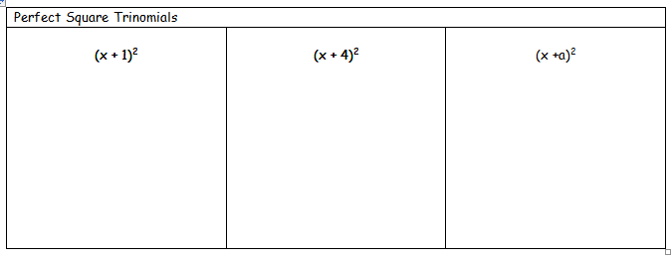
Evaluate the first two binomial expressions.

Slide 6
Evaluate the first two binomial expressions.
(x+1)(x+1)
(x+4)(x+4)
$X^{2}$+x+x+1
$X^{2}$+4x+4x+16
$X^{2}$+2x+1
$X^{2}$+8x+16

Slide 7
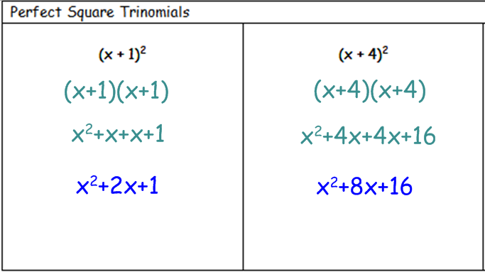

Slide 8
Evaluate the last expression.

Slide 9
Evaluate the first two binomial expressions.
(x+a)(x+a)
x2+ax+ax+a2
x2+2ax+a2

Slide 10
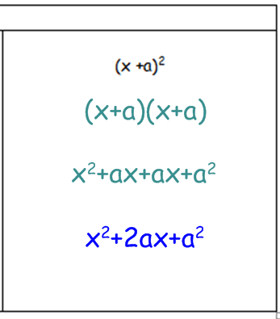

Slide 11
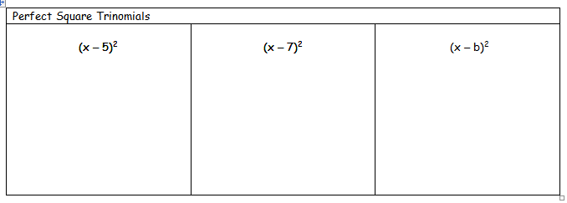
Evaluate all three binomial expressions.

Slide 12
Evaluate all three binomial expressions.
(x-5)(x-5)
(x-7)(x-7)
(x-b)(x-b)
$x^{2}$-5x-5x+25
$x^{2}$-7x-7x+49
$x^{2}$-bx-bx+$b^{2}$
$X^{2}$-10x+25
$X^{2}$-2bx+$b^{2}$
$X^{2}$-14x+49

Slide 13
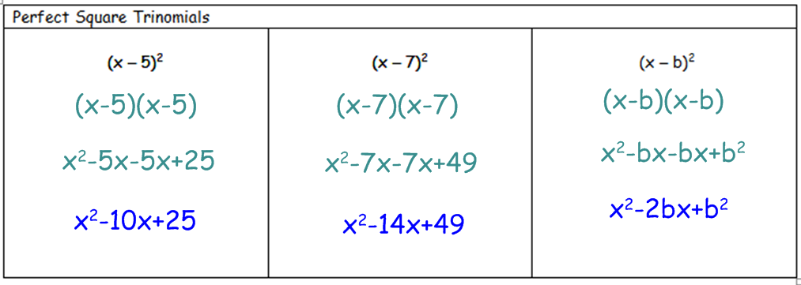

Slide 15
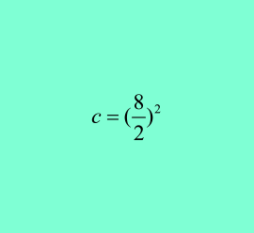
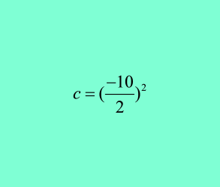
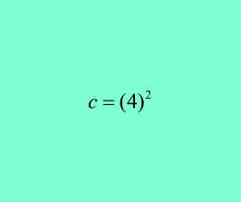
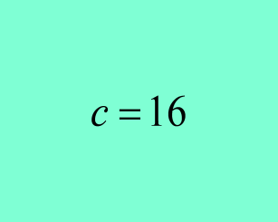
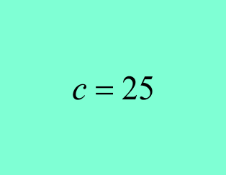
Divide the b-term by 2 and then square it.
$X^{2}$+8x+16
$X^{2}$-10x+25
b= 8
b= -10

Slide 16
Divide the b-term by 2 and then square it.
$X^{2}$+2ax+$a^{2}$
$X^{2}$-2bx+$b^{2}$

Slide 18
36
81
100
9
4
144

Slide 19
Now write the perfect square trinomial in its factored binomial form.
36
81
100
$$(x+{6)}^{2}$$
9
4
144

Slide 20
Now write the perfect square trinomial in its factored binomial form.
36
81
100
(x+6)^2
(x+9)^2
(x+10)^2
9
4
144
(x-3)^2
(x-2)^2
(x-12)^2

Slide 22
$X^{2}$+30x+9
($X^{2}$+30x+___) = -9
($X^{2}$+30x+___)=____- 9
(${15}^{2}$
(${15}^{2}$
($X^{2}$+30x+___)=____- 9
225
225
(x+15)$^2$ = 216
X+15 = ±√216
X= -15 ± 14.6969
-.3031 and -29.6969 are the X-Intercepts

Slide 23
"WE DO" TIME

Slide 24
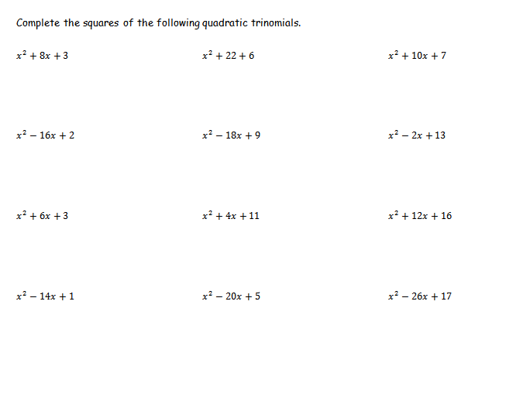

Slide 25
Essential Question
Learning Objective
What is the form of a perfect square trinomial and how can it be used to complete a square when the C-term is unknown?
Given a quadratic trinomial, I will determine if it is a perfect square, and if not I will complete the square.

Slide 26
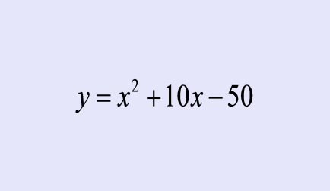
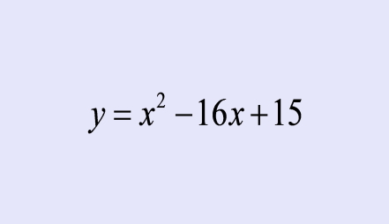
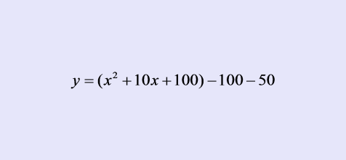
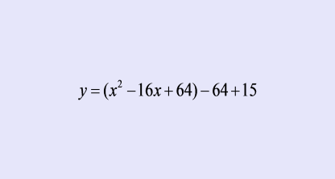
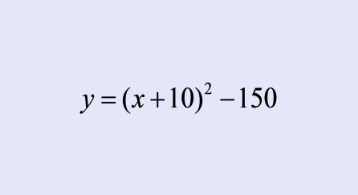
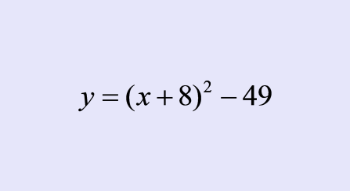
Closure
Which one is incorrect and why?
#1
#2

Slide 27
HW
None

Slide 29
real life situations using parabolas:
antennas
projectiles
cannon balls
bouncing balls
catapults
potato shooters
pumpkin tosses
kicked balls
craters
bridge arches

Slide 30
link to interactive graphs

