Slide 1
LESSON 3-1 Recording Transactions and the General Journal
Learning Objectives
LO1 Define what a journal is and explain why it is used to record transactions.
LO2 Compare and contrast different types of source documents.
LO3 Identify the four parts of a journal entry.

Slide 2
Journals and Journalizing
Lesson 3-1
LO1
A form for recording transactions in chronological order is called a journal.
Recording transactions in a journal is called journalizing.
SLIDE 2

Slide 3
General Journal
Lesson 3-1
LO1
SLIDE 3

Slide 4
A General Journal
Lesson 3-1
LO1
Accuracy
Chronological record
Double-entry accounting
Information for each transaction recorded in a journal is called an entry.
The recording of debit and credit parts of a transaction is called double-entry accounting.
SLIDE 4

Slide 5
Source Documents
Lesson 3-1
LO2
A business paper from which information is obtained for a journal entry is called a source document.
SLIDE 5

Slide 6
Checks
Lesson 3-1
LO2
A business form ordering a bank to pay cash from a bank account is called a check.
SLIDE 6

Slide 7
Invoices
Lesson 3-1
LO2
A form describing the goods or services sold, the quantity, the price, and the terms of sale is called an invoice.
SLIDE 7

Slide 8
Sales Invoice
Lesson 3-1
LO2
An invoice used as a source document for recording a sale on account is called a sales invoice.
A sales invoice is also referred to as a sales ticket or a sales slip.
SLIDE 8

Slide 9
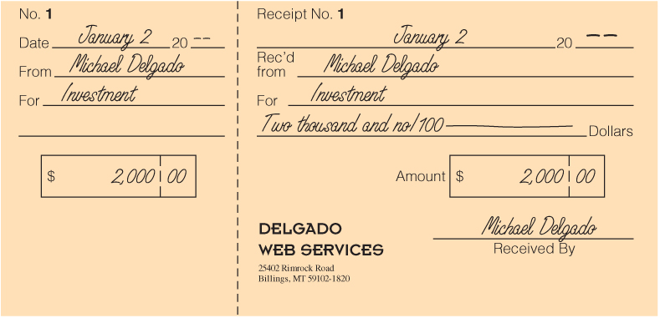
Receipts
Lesson 3-1
LO2
A business form giving written acknowledgement for cash received is called a receipt.
SLIDE 9

Slide 10
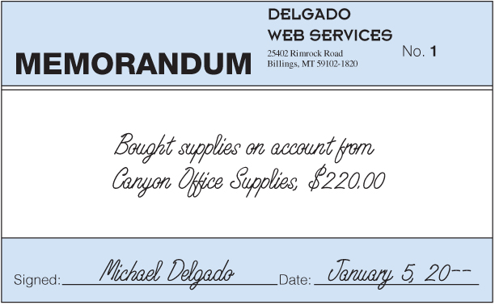
Memorandums
Lesson 3-1
LO2
A form on which a brief message is written to describe a transaction is called a memorandum.
SLIDE 10

Slide 11
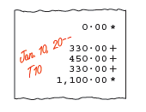
Calculator Tapes
Lesson 3-1
LO2
SLIDE 11

Slide 12
Preparing Journal Entries
Lesson 3-1
LO2
Book of original entry
Permanent record
Record using ink not pencil
Use “00” to denote even dollar amounts
SLIDE 12

Slide 13
Received Cash from Owner as an Investment
Lesson 3-1
LO3
Cash
January 2. Received cash from owner as an investment, $2,000.00. Receipt No. 1.
2,000.00
Michael Delgado, Capital
1
Date
2
Debit
Source Document
4
2,000.00
3
Credit
1. Write the date in the Date column.
2. Write the title of the account debited in the Account Title column. Write the debit amount in the Debit column.
3. On the next line, indented about one centimeter, write the title of the account credited in the Account Title column. Write the credit amount in the Credit column.
4. Write the source document number in the Doc. No. column.
SLIDE 13

Slide 14
Paid Cash for Supplies
Lesson 3-1
LO3
January 2. Paid cash for supplies, $165.00. Check No. 1.
Supplies
165.00
Cash
1
Date
2
Debit
Source Document
4
165.00
3
Credit
1. Write the date in the Date column.
2. Write the title of the account debited in the Account Title column. Write the debit amount in the Debit column.
3. On the next line, indented about one centimeter, write the title of the account credited in the Account Title column. Write the credit amount in the Credit column.
4. Write the source document number in the Doc. No. column.
SLIDE 14

Slide 15
Lesson 3-1 Audit Your Understanding
Lesson 3-1
1. In what order are transactions recorded in a journal?
ANSWER
By date
SLIDE 15

Slide 16
Lesson 3-1 Audit Your Understanding
Lesson 3-1
2. Why are source documents important?
ANSWER
Source documents are one way to verify the accuracy of a specific journal entry.
SLIDE 16

Slide 17
Lesson 3-1 Audit Your Understanding
Lesson 3-1
3. List the four parts of a journal entry.
ANSWER
Date
Debit
Credit
Source document
SLIDE 17

