Slide 1
LESSON 4-3 Journalizing Correcting Entries and Correcting Posting Errors
Learning Objectives
LO7 Analyze incorrect journal entries and prepare correcting entries.
LO8 Demonstrate how to correct errors made during the posting process.

Slide 2
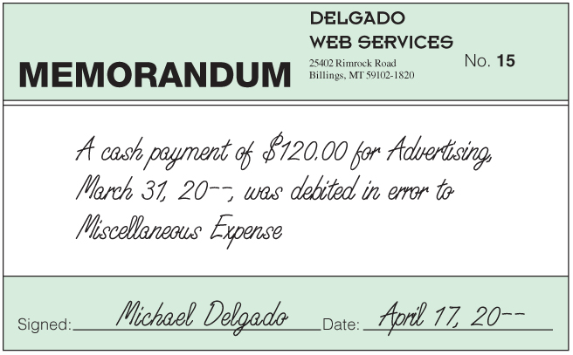
Memorandum for a Correcting Entry
Lesson 4-3
LO7
An incorrect journal entry should be corrected with an additional journal entry, called a correcting entry.
A memorandum is prepared as the source document describing the correction to be made.
SLIDE 2

Slide 3
Journal Entry to Record a Correcting Entry
Lesson 4-3
LO7
Advertising Expense
April 17. Discovered that a payment of cash for advertising in March was journalized and posted in error as a debit to Miscellaneous Expense instead of Advertising Expense, $120.00. Memorandum No. 15.
120.00
Miscellaneous Expense
120.00
Date
1
Debit
2
4
Source Document
3
Credit
SLIDE 3

Slide 4
Correcting an Error in Posting to the Wrong Account
Lesson 4-3
LO8
2
1
1. Draw a line through the entire incorrect entry.
2. Record the posting in the correct account. Recalculate the account balance.
SLIDE 4

Slide 5
Correcting an Incorrect Amount
Lesson 4-3
LO8
1
2
3
1. Draw a line through the incorrect amount.
2. Write the correct amount just above the incorrect amount in the same space.
3. Recalculate the account balance.
SLIDE 5

Slide 6
Correcting an Amount Posted to the Wrong Column
Lesson 4-3
LO8
5
4
6
4. Draw a line through the incorrect item in the account.
5. Record the posting in the correct amount column.
6. Recalculate the account balance.
SLIDE 6

Slide 7
Lesson 4-3 Audit Your Understanding
Lesson 4-3
1. What is a correcting entry?
ANSWER
A journal entry made to correct an error in the ledger
SLIDE 7

Slide 8
Lesson 4-3 Audit Your Understanding
Lesson 4-3
2. When is a correcting entry necessary?
ANSWER
When a transaction has been improperly journalized and posted to the ledger
SLIDE 8

Slide 9
Lesson 4-3 Audit Your Understanding
Lesson 4-3
3. What are the three steps for correcting an incorrect amount posted to an account?
ANSWER
1. Draw a line through the incorrect amount.
2. Write the correct amount just above the correction in the same space.
3. Recalculate the account balance.
SLIDE 9

Slide 10
Lesson 4-3 Audit Your Understanding
Lesson 4-3
4. What are the three steps for correcting an amount posted to an incorrect column?
ANSWER
1. Draw a line through the incorrect item in the account.
2. Record the posting in the correct amount column.
3. Recalculate the account balance.
SLIDE 10

