Slide 1
LESSON 5-2 Bank Reconciliation
Learning Objectives
LO4 Complete a bank statement reconciliation.
LO5 Record and journalize a bank service charge.

Slide 2
Bank Statement
Lesson 5-2
LO4
A report of deposits, withdrawals, and bank balances sent to a depositor by a bank is called a bank statement.
A check that has been paid by the bank is called a canceled check.
SLIDE 2

Slide 3
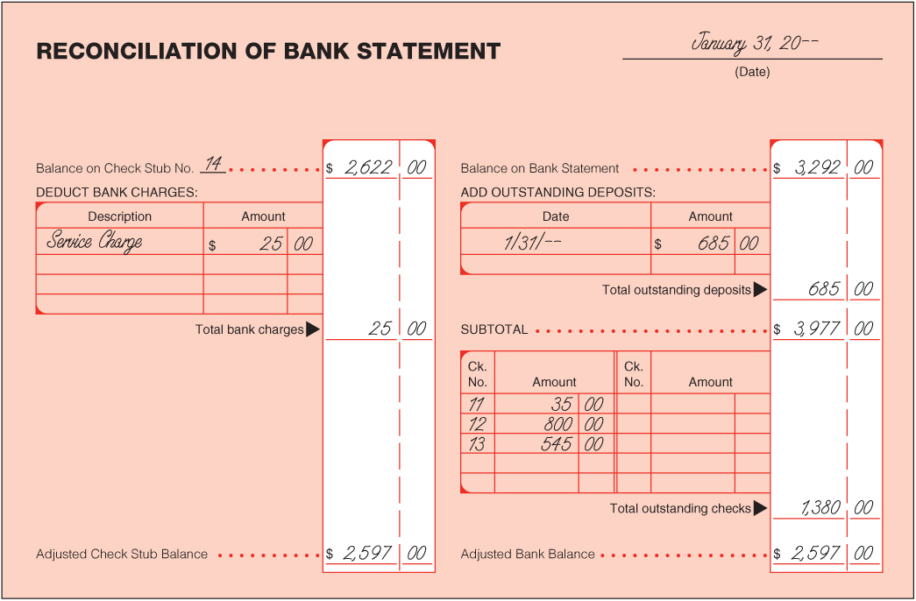
Bank Statement Reconciliation
Lesson 5-2
LO4
2
Check Stub Balance
1
Date
Bank Statement Balance
5
Service Charge
3
6
Outstanding Deposits
7
Subtotal
8
Outstanding Checks
Adjusted Bank Balance
9
4
Adjusted Check Stub Balance
10
Compare Adjusted Balances
SLIDE 3

Slide 4
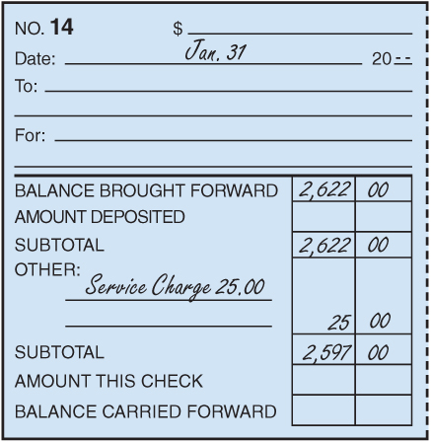
Recording a Bank Service Charge on a Check Stub
Lesson 5-2
LO5
2
3
1
1. Write Service Charge on the check stub under the heading Other.
2. Write the amount of the service charge in the amount column.
3. Calculate and record the new subtotal on the Subtotal line.
SLIDE 4

Slide 5
Journalizing a Bank Service Charge
Lesson 5-2
LO5
January 31. Received bank statement showing January bank service charge, $25.00. Memorandum No. 3.
Miscellaneous Expense
25.00
Cash
1
Date
2
Debit
4
Source Document
25.00
3
Credit
1. Write the date in the Date column.
2. Write the title of the account to be debited in the Account Title column. Record the amount debited in the Debit column.
3. On the next line, indented, write the title of the amount credited in the Account Title column. Write the credit amount in the Credit column.
4. Write the source document number in the Doc. No. column.
SLIDE 5

Slide 6
Lesson 5-2 Audit Your Understanding
Lesson 5-2
1. List four reasons why a depositor’s records and a bank’s records may differ.
ANSWER
1. A service charge may not have been recorded in the depositor’s business records.
2. Outstanding deposits may be recorded in the depositor’s records but not on a bank statement.
3. Outstanding checks may be recorded in the depositor’s records but not on a bank statement.
4. A depositor may have made a math or recording error.
SLIDE 6

Slide 7
Lesson 5-2 Audit Your Understanding
Lesson 5-2
2. If a check mark is placed on the check stub of each canceled check, what does a check stub with no check mark indicate?
ANSWER
An outstanding check
SLIDE 7

