Slide 1
LESSON 5-3 Dishonored Checks and Electronic Banking
Learning Objectives
LO6 Complete recordkeeping for a dishonored check.
LO7 Journalize an electronic funds transfer.
LO8 Journalize a debit card transaction.

Slide 2
Recording a Dishonored Check on a Check Stub
Lesson 5-3
LO6
A check that a bank refuses to pay is called a dishonored check.
A check dishonored by the bank because of insufficient funds in the account of the maker of the check is called a non-sufficient funds check.
A non-sufficient funds check is also known as an NSF check.
SLIDE 2

Slide 3
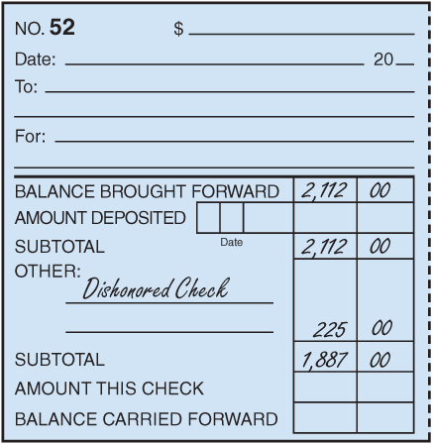
Recording a Dishonored Check on a Check Stub
Lesson 5-3
LO6
2
1
3
1. Write Dishonored Check under the heading Other.
2. Write the total of the dishonored check in the amount column. This is the amount of the dishonored check plus the service fee.
3. Calculate and record the new subtotal.
SLIDE 3

Slide 4
Journalizing a Dishonored Check
Lesson 5-3
LO6
August 29. Received notice from the bank of a dishonored check from Valley Landscaping, $185.00, plus $40.00 fee; total, $225.00. Memorandum No. 52.
Accts. Rec.—Valley Landscaping
225.00
Cash
225.00
1
Date
2
Debit
4
Source Document
3
Credit
1. Write the date in the Date column.
2. Write the title of the account to be debited in the Account Title column. Record the amount debited in the Debit column.
3. On the next line, indented, write the title of the amount credited in the Account Title column. Write the credit amount in the Credit column.
4. Write the source document number in the Doc. No. column.
SLIDE 4

Slide 5
Journalizing an Electronic Funds Transfer
Lesson 5-3
LO7
A computerized cash payments system that transfers funds without the use of checks, currency, or other paper documents is called electronic funds transfer (EFT).
SLIDE 5

Slide 6
Journalizing an Electronic Funds Transfer
Lesson 5-3
LO7
Accts. Pay.—Murniak Enterprises
June 5. Paid cash on account to Murniak Enterprises, $380.00, using EFT. Memorandum No. 18.
380.00
Cash
380.00
1
Date
2
Debit
4
Source Document
3
Credit
1. Write the date in the Date column.
2. Write the title of the account to be debited in the Account Title column. Record the amount debited in the Debit column.
3. On the next line, indented, write the title of the amount credited in the Account Title column. Write the credit amount in the Credit column.
4. Write the source document number in the Doc. No. column.
SLIDE 6

Slide 7
Journalizing a Debit Card Transaction
Lesson 5-3
LO8
A bank card that automatically deducts the amount of a purchase from the checking account of the cardholder is called a debit card.
SLIDE 7

Slide 8
Journalizing a Debit Card Transaction
Lesson 5-3
LO8
Supplies
June 8. Purchased supplies, $75.00, using debit card. Memorandum No. 21.
75.00
Cash
1
Date
2
Debit
4
Source Document
75.00
3
Credit
1. Write the date in the Date column.
2. Write the title of the account to be debited in the Account Title column. Record the amount debited in the Debit column.
3. On the next line, indented, write the title of the amount credited in the Account Title column. Write the credit amount in the Credit column.
4. Write the source document number in the Doc. No. column.
SLIDE 8

Slide 9
Lesson 5-3 Audit Your Understanding
Lesson 5-3
1. List six reasons why a bank may dishonor a check.
ANSWER
1. The check appears to be altered.
2. The signature on the check does not match the signature on the signature card.
3. The amounts written in figures and in words do not agree.
4. The check is postdated.
5. The person who wrote the check has stopped payment on it.
6. The account of the person who wrote the check has insufficient funds to pay the check.
SLIDE 9

Slide 10
Lesson 5-3 Audit Your Understanding
Lesson 5-3
2. What account is credited when electronic funds transfer is used to pay cash on account?
ANSWER
Cash
SLIDE 10

Slide 11
Lesson 5-3 Audit Your Understanding
Lesson 5-3
3. What account is credited when a debit card is used to purchase supplies?
ANSWER
Cash
SLIDE 11

