Slide 1
LESSON 6-1 Creating a Work Sheet
Learning Objectives
LO1 Prepare the heading of a work sheet.
LO2 Prepare the trial balance section of a work sheet.

Slide 2
Consistent Reporting
Lesson 6-1
LO1
The accounting concept Consistent Reporting is applied when the same accounting procedures are followed in the same way in each accounting period.
SLIDE 2

Slide 3
Fiscal Periods
Lesson 6-1
LO1
The length of time for which a business summarizes its financial information and reports its financial performance is called a fiscal period.
A fiscal period is also known as an accounting period.
A fiscal period consisting of twelve consecutive months is called a fiscal year.
SLIDE 3

Slide 4
Work Sheet
Lesson 6-1
LO1
A columnar accounting form used to summarize the general ledger information needed to prepare financial statements is called a work sheet.
SLIDE 4

Slide 5
Reasons Accountants Use a Work Sheet
Lesson 6-1
LO3
Summarize general ledger account balances to prove that debits equal credits
Plan needed changes to general ledger accounts to bring account balances up to date
Separate general ledger account balances according to the financial statements to be prepared
Calculate the amount of net income or net loss for a fiscal period
SLIDE 5

Slide 6
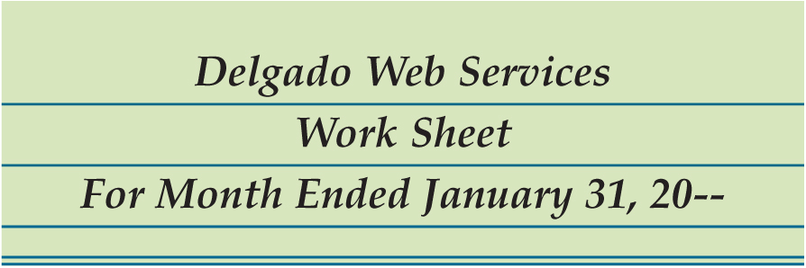
Preparing the Heading of a Work Sheet
Lesson 6-1
LO1
1
Name of Company
2
Name of Report
3
Date of Report
SLIDE 6

Slide 7
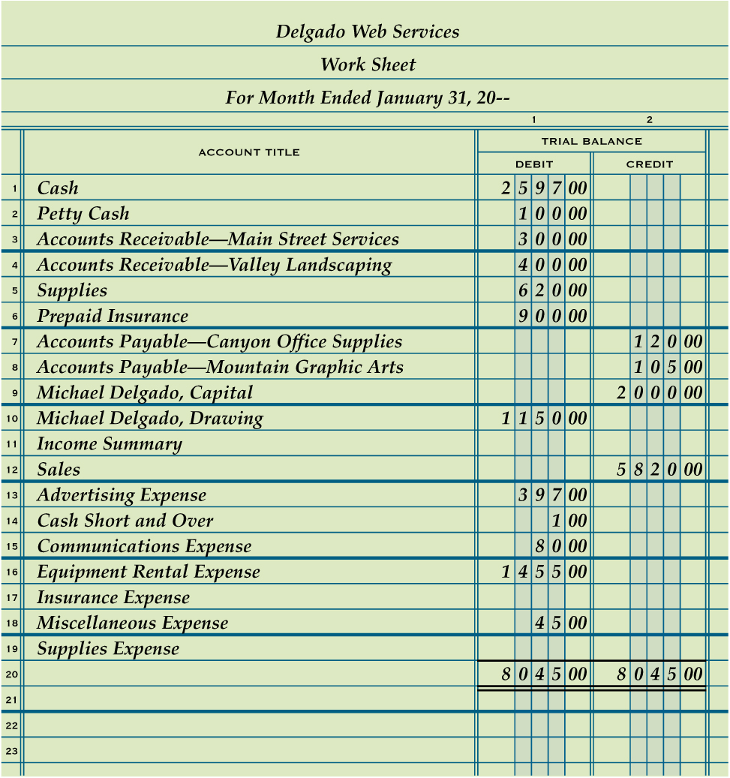
Preparing a Trial Balance on a Work Sheet
Lesson 6-1
LO2
2
1. Write the general ledger account titles in the work sheet’s Account Title column.
2. Write the general ledger debit account balances in the Trial Balance Debit column. Write the general ledger credit account balances in the Trial Balance Credit column.
1
3. Rule a single line across the two Trial Balance columns below the last line on which an account title is written.
4. Add both the Trial Balance Debit and Credit columns.
3
5. Write each column’s total below the single line.
4
6. Rule double lines across both Trial Balance columns.
5
6
SLIDE 7

Slide 8
Lesson 6-1 Audit Your Understanding
Lesson 6-1
1. What is written on the three-line heading on a work sheet?
ANSWER
Name of the business, name of report, and date of report
SLIDE 8

Slide 9
Lesson 6-1 Audit Your Understanding
Lesson 6-1
2. Which general ledger accounts are listed in the Trial Balance columns of a work sheet?
ANSWER
All general ledger accounts are listed in the Trial Balance columns of a work sheet, even if some accounts do not have balances.
SLIDE 9

