Slide 1
LESSON 6-4 Journalizing and Posting Adjusting Entries
Learning Objectives
LO8 Journalize and post the adjusting entries for supplies and prepaid insurance.

Slide 2
Adjusting Entry for Supplies
Lesson 6-4
LO8
Journal entries recorded to update general ledger accounts at the end of a fiscal period are called adjusting entries.
SLIDE 2

Slide 3
Adjusting Entry for Supplies
Lesson 6-4
LO8
Supplies Expense
Adj. (a) 530.00
Supplies
Jan. 31 Bal. 620.00
Adj. (a) 530.00
(New Bal. 90.00)
1
Heading
3
Debit
2
Date
4
Credit
SLIDE 3

Slide 4
Adjusting Entry for Prepaid Insurance
Lesson 6-4
LO8
Insurance Expense
Adj. (b) 150.00
Prepaid Insurance
Jan. 31 Bal. 900.00
Adj. (b) 150.00
(New Bal. 750.00)
1
Heading
3
Debit
2
Date
4
Credit
SLIDE 4

Slide 5
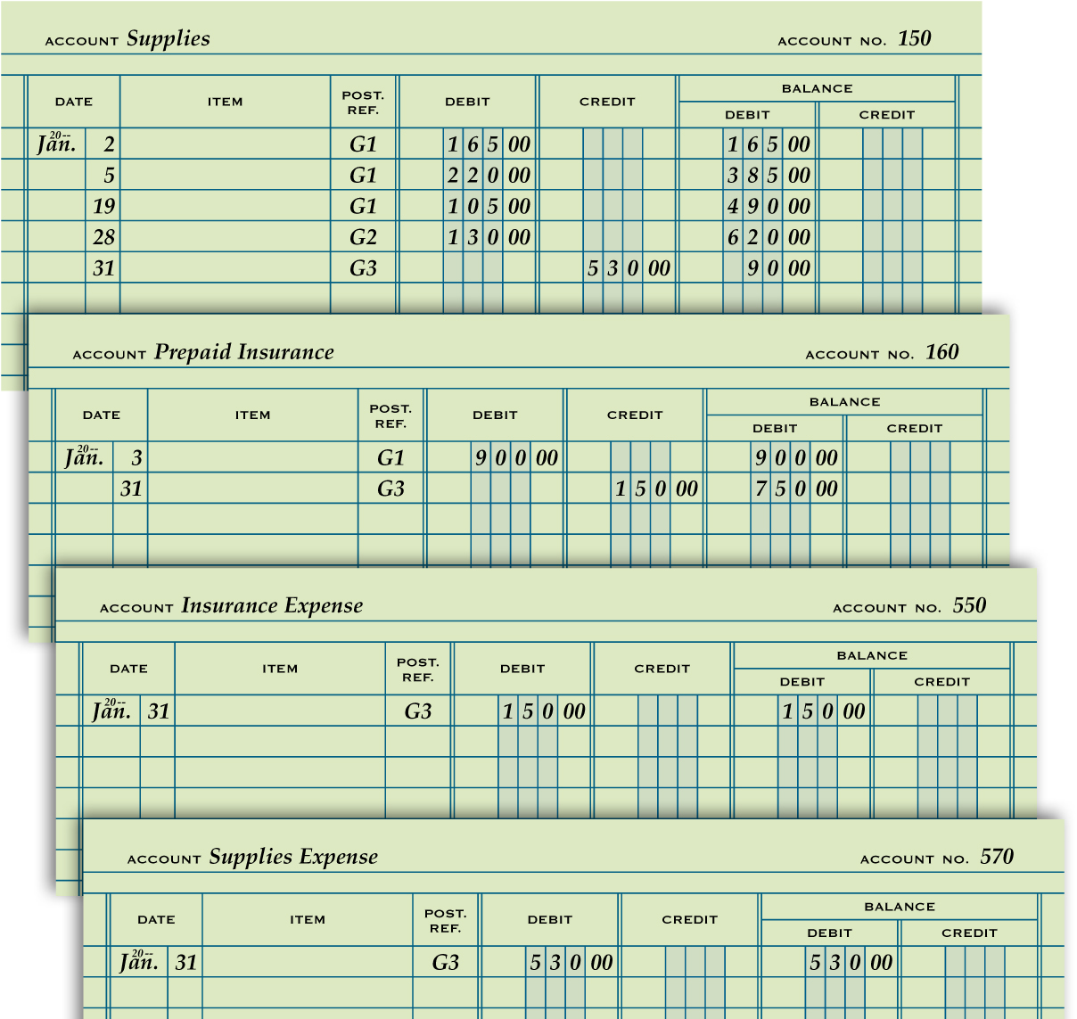
Partial Ledger Accounts after Posting Adjusting Entries
Lesson 6-4
LO8
SLIDE 5

Slide 6
Lesson 6-4 Audit Your Understanding
Lesson 6-4
1. Why are adjusting entries journalized?
ANSWER
To update general ledger accounts at the end of a fiscal period
SLIDE 6

Slide 7
Lesson 6-4 Audit Your Understanding
Lesson 6-4
2. Where is the information obtained to journalize adjusting entries?
ANSWER
Balance Sheet Credit column
SLIDE 7

Slide 8
Lesson 6-4 Audit Your Understanding
Lesson 6-4
3. What accounts are increased from zero balances after adjusting entries for supplies and prepaid insurance are journalized and posted?
ANSWER
Supplies Expense
Insurance Expense
SLIDE 8

