Slide 1
LESSON 9-1 Subsidiary Ledgers and Controlling Accounts
Learning Objectives
LO1 Distinguish among service, retail merchandising, and wholesale merchandising businesses.
LO2 Identify differences between a sole proprietorship and a corporation.
LO3 Explain the relationship between a subsidiary ledger and a controlling account.

Slide 2
Merchandising Businesses
Lesson 9-1
LO1
Goods that a business purchases to sell are called merchandise.
A business that purchases and resells goods is called a merchandising business.
A merchandising business that sells to those who use or consume the goods is called a retail merchandising business.
A wholesale merchandising business buys and resells merchandise primarily to other merchandising businesses.
SLIDE 2

Slide 3
Forming a Corporation
Lesson 9-1
LO2
A corporation is an organization with the legal rights of a person which many persons or other corporations may own.
The assets or other financial resources available to a business are called capital.
Continued on next slide.
SLIDE 3

Slide 4
Forming a Corporation
Lesson 9-1
Continued from previous slide.
LO2
Each unit of ownership in a corporation is called a share of stock.
The owner of one or more shares of stock is called a stockholder.
The total shares of ownership in a corporation are called capital stock.
Continued on next slide.
SLIDE 4

Slide 5
Forming a Corporation
Lesson 9-1
Continued from previous slide.
LO2
The articles of incorporation, a legal document that identifies basic characteristics of a corporation, is a part of the application submitted to a state to become a corporation.
A state approves the formation of a corporation by issuing a charter, the legal right for a business to conduct operations as a corporation.
SLIDE 5

Slide 6
Subsidiary Ledgers and Controlling Accounts
Lesson 9-1
LO3
A business from which merchandise, supplies, or other assets are purchased is called a vendor.
A ledger that is summarized in a single general ledger account is called a subsidiary ledger.
Accountants often refer to a subsidiary ledger as a subledger.
The subsidiary ledger containing vendor accounts is called an accounts payable ledger.
An account in a general ledger that summarizes all accounts in a subsidiary ledger is called a controlling account.
SLIDE 6

Slide 7
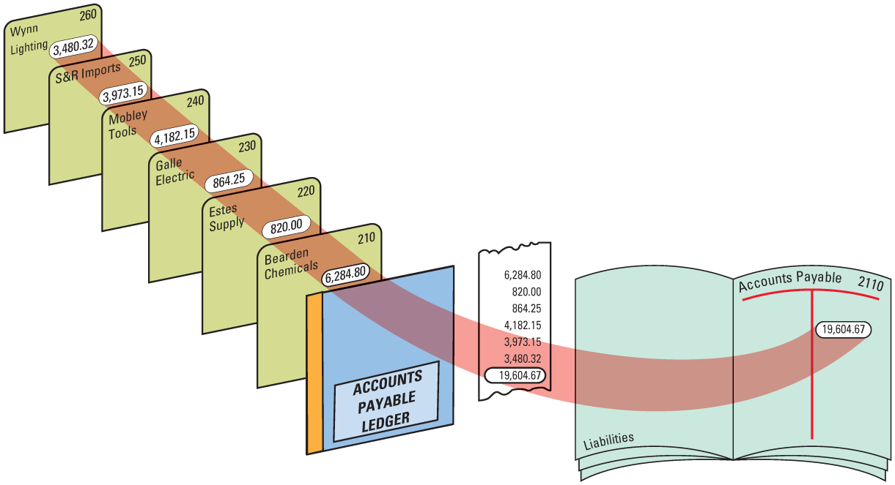
Subsidiary Ledgers and Controlling Accounts
Lesson 9-1
LO3
SLIDE 7

Slide 8
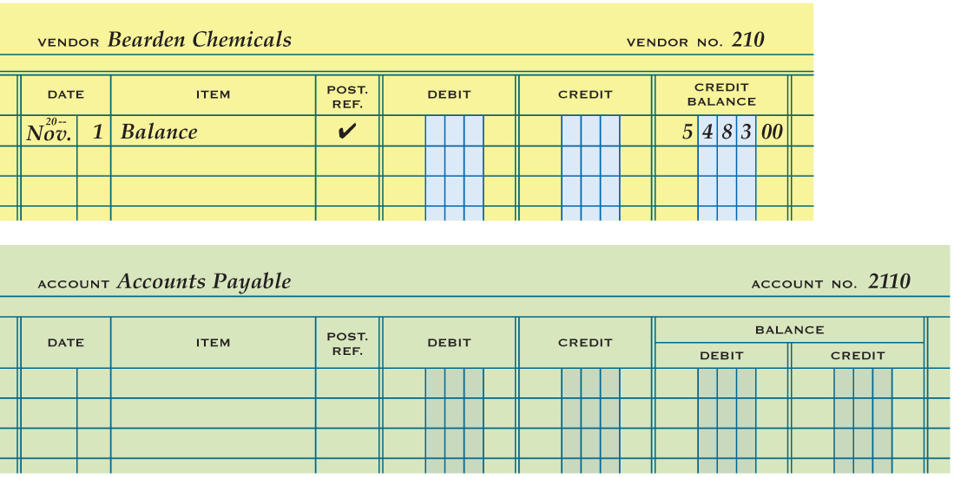
Subsidiary Ledger Form
Lesson 9-1
LO3
1
Account Name
2
Account Number
Date
3
4
Balance
5
Check Mark
6
Account Balance
Same column headings
SLIDE 8

Slide 9
Lesson 9-1 Audit Your Understanding
Lesson 9-1
1. What is the primary difference between retail and wholesale merchandising businesses?
ANSWER
A retail merchandising business sells to those who use or consume the goods. A wholesale merchandising business buys and resells merchandise primarily to other merchandising businesses.
SLIDE 9

Slide 10
Lesson 9-1 Audit Your Understanding
Lesson 9-1
2. What allows a corporation to own property, incur liabilities, and enter into contracts in its own name?
ANSWER
A corporation, through the rights granted in its charter, has the legal rights of a person.
SLIDE 10

Slide 11
Lesson 9-1 Audit Your Understanding
Lesson 9-1
3. What is the principal difference between the accounting records of proprietorships and corporations?
ANSWER
Proprietorships have a single capital and drawing account for the owner. A corporation has separate capital accounts for the stock issued and for the earnings kept in the business.
SLIDE 11

Slide 12
Lesson 9-1 Audit Your Understanding
Lesson 9-1
4. What is the relationship between a controlling account and a subsidiary ledger?
ANSWER
The sum of the subsidiary ledger accounts is equal to the balance in the general ledger controlling account.
SLIDE 12

Slide 13
Lesson 9-1 Audit Your Understanding
Lesson 9-1
5. What column on a general ledger form is not on an accounts payable ledger form?
ANSWER
Debit Balance
SLIDE 13

