Slide 1
LESSON 9-4 Accounting for Cash Payments
Learning Objectives
LO8 Record cash payments using a cash payments journal.
LO9 Record replenishment of a petty cash fund.

Slide 2
Cash Payments Journal
Lesson 9-4
LO8
A cash payments journal is a special journal used to record only cash payment transactions.
SLIDE 2

Slide 3
Trade Discount
Lesson 9-4
LO8
The retail price listed in a catalog or on an Internet site is called a list price.
A trade discount is a reduction in the list price granted to a merchandising business.
The price after the trade discount has been deducted from the list price is referred to as the net price.
SLIDE 3

Slide 4
Cash Discount
Lesson 9-4
LO8
A cash discount is a deduction that a vendor allows on an invoice amount to encourage prompt payment.
A journal amount column that is not headed with an account title is called a general amount column.
SLIDE 4

Slide 5
Cash Payment of an Expense
Lesson 9-4
LO8
Advertising Expense
November 3. Wrote a check to Kelser Promotions for advertising, $600.00. Check No. 689.
600.00
Cash
600.00
1
Date
2
Account Title
Check Number
4
Debit
Credit
3
5
SLIDE 5

Slide 6
Buying Supplies for Cash
Lesson 9-4
LO8
Supplies—Office
November 6. Wrote a check to Wells Office Supply for store supplies, $56.20. Check No. 690.
56.20
Cash
56.20
1
Date
2
Account Title
Check Number
4
Debit
Credit
3
5
SLIDE 6

Slide 7
Cash Payments for Purchases
Lesson 9-4
LO8
Purchases
November 9. Purchased merchandise from Polar Refrigeration for cash, $480.00. Check No. 697.
480.00
Cash
480.00
1
Date
2
Account Title
Check Number
4
Debit
Credit
3
5
SLIDE 7

Slide 8
Cash Payments on Account with Purchases Discounts
Lesson 9-4
LO8
The period of time during which a customer may take a cash discount is called the discount period.
When a company that has purchased merchandise on account takes a cash discount, it is called a purchases discount.
An account that reduces a related account on a financial statement is called a contra account.
SLIDE 8

Slide 9
Cash Payments on Account with Purchases Discounts
Lesson 9-4
LO8
November 14. Paid cash on account to Galle Electric, $627.20, covering Purchase Invoice No. 489 for $640.00, less 2% discount, $12.80. Check No. 702.
Accounts Payable
640.00
Purchases Discount
12.80
Cash
Purchase Invoice Amount
627.20
1
Date
4
2
Vendor Name
Check Number
Cash Discount
3
5
Purchase Invoice Amount Less the Cash Discount
6
SLIDE 9

Slide 10
Cash Payments on Account without Purchases Discounts
Lesson 9-4
LO8
November 21. Wrote a check to S&R Imports to pay on account, $2,512.00, covering Purchase Invoice No. 468. Check No. 706.
Accounts Payable
2,512.00
Cash
2,512.00
2
Vendor Name
Total Purchase Invoice Account
1
Date
3
Check Number
4
Total Purchase Invoice Amount
5
SLIDE 10

Slide 11
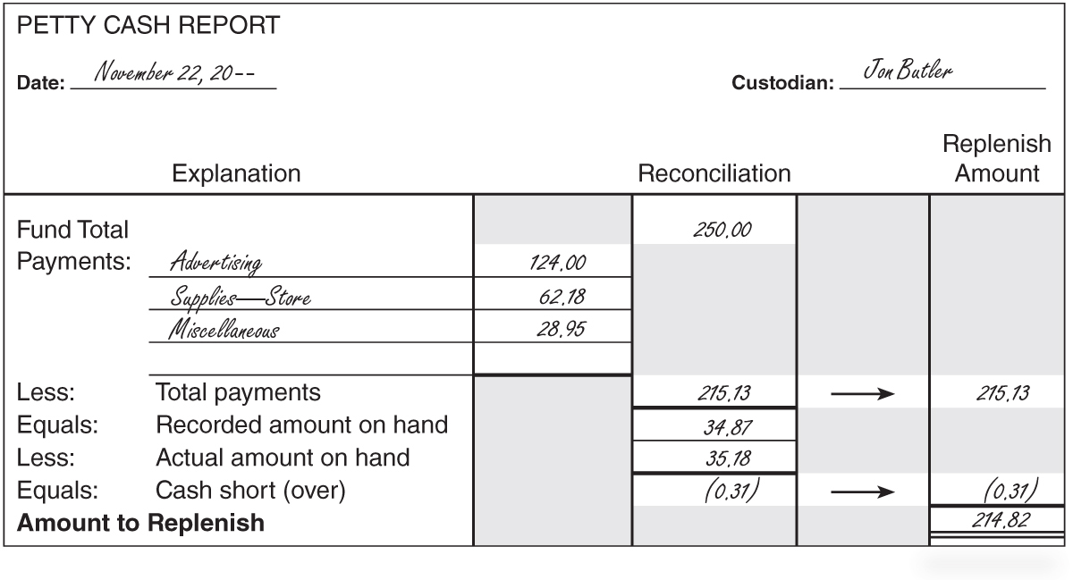
Replenishing a Petty Cash Fund
Lesson 9-4
LO9
November 22. Paid cash to replenish the petty cash fund, $214.82: advertising, $124.00; store supplies, $62.18; miscellaneous, $28.95; cash over, $0.31. Check No. 707.
Account Title
Check Number
Cash Over is a Credit
Date
Amounts
Total Cash Payment
SLIDE 11

Slide 12
Lesson 9-4 Audit Your Understanding
Lesson 9-4
1. What is the net price of an item with a $1,200.00 list price having a 60% trade discount?
ANSWER
$480.00
SLIDE 12

Slide 13
Lesson 9-4 Audit Your Understanding
Lesson 9-4
2. Why would a vendor offer a cash discount to a customer?
ANSWER
To encourage early payment
SLIDE 13

Slide 14
Lesson 9-4 Audit Your Understanding
Lesson 9-4
3. What is recorded in the general amount columns of the cash payments journal?
ANSWER
Cash payment transactions that do not occur often
SLIDE 14

Slide 15
Lesson 9-4 Audit Your Understanding
Lesson 9-4
4. What is meant by terms of sale 2/10, n/30?
ANSWER
Two ten means 2% of the invoice amount may be deducted if the invoice is paid within 10 days of the invoice date. Net thirty means that the total invoice amount must be paid within 30 days.
SLIDE 15

Slide 16
Lesson 9-4 Audit Your Understanding
Lesson 9-4
5. When journalizing a cash payment to replenish petty cash, what is entered in the Account Title column of the cash payments journal?
ANSWER
The titles of the accounts for which the petty cash funds were used
SLIDE 16

Slide 17
Lesson 9-4 Audit Your Understanding
Lesson 9-4
6. How is cash short recorded in the account, Cash Short and Over?
ANSWER
As a debit
SLIDE 17

